Slide 1
IS 4800 Empirical Research Methods
for Information Science
Class Notes Feb 3, 2012
Instructor: Prof. Carole Hafner, 446 WVH
hafner@ccs.neu.edu Tel: 617-373-5116
Course Web site: www.ccs.neu.edu/course/is4800sp12/

Slide 2
Outline
First exam postponed until Friday Feb. 10
  (covers thru descriptive statistics – review Tues.)
Review/finish descriptive statistics
Survey methods
  Survey administration
  Constructing Questionnaires
  Types of Questionnaire Items
  Composite measures
  Sampling
Discuss Team Project 1

Slide 3
Review Measurement Scales
Nominal – color, make/model of a car, race/ethnicity, telephone number (!)
Ordinal – grades (4.0, 3.0 . . ); high, med, low
  Not many found in natural world
Interval – a date, a time
Ratio – distance (height, length) in space or time; weight, amt of money (cost, income)

Slide 4
Factors Affecting Your
Choice of a Scale of Measurement
Information Yielded
  A nominal scale yields the least information.
  An ordinal scale adds some crude information.
  Interval and ratio scales yield the most information.
Statistical Tests Available
  The statistical tests available for nominal and ordinal data (nonparametric) are less powerful than those available for interval and ratio data (parametric)
  Use the scale that allows you to use the most powerful statistical test

Slide 5
Descriptive Statistics
Frequency distributions, and bar charts or histograms (covered last time)
Bar charts vs. histograms
  Bar chart: categorial x-variable
    Exs: color vs. frequency; states in NE vs. population
  Histogram: numeric x-variable
    Exs: height vs. frequency; family income vs. lifespan
Measure of central tendency and spread
  Normal Distribution; Skewness

Slide 6
Measures of Center: Definition
Mode
  Most frequent score in a distribution
  Simplest measure of center
  Scores other than the most frequent not considered
  Limited application and value
Median
  Central score in an ordered distribution
  More information taken into account than with the mode
  Relatively insensitive to outliers
  Prefer when data is skewed
  Used primarily when the mean cannot be used
Mean
  Numerical average of all scores in a distribution
  Value dependent on each score in a distribution
  Most widely used and informative measure of center

Slide 7
Measures of Center: Use
Mode
  Used if data are measured along a nominal scale
Median
  Used if data are measured along an ordinal scale
  Used if interval data do not meet requirements for using the mean (skewed but unimodal), or if significant outliers
Mean
  Used if data are measured along an interval or ratio scale
  Most sensitive measure of center
  Used if scores are normally distributed

Slide 8
Measures of Spread: Definitions
Range
  Subtract the lowest from the highest score in a distribution of scores
  Simplest and least informative measure of spread
  Scores between extremes are not taken into account
  Very sensitive to extreme scores
Interquartile Range
  Less sensitive than the range to extreme scores
  Used when you want a simple, rough estimate of spread
Variance
  Average squared distance of scores from the mean
Standard Deviation
  Square root of the variance
  Most widely used measure of spread

Slide 9
Measures of Spread: Use
The range and standard deviation are sensitive to extreme scores
  In such cases the interquartile range is best
When your distribution of scores is skewed, the standard deviation does not provide a good index of spread
  use the interquartile range

Slide 10
Which measures of center and spread?
Favorite Color
Red
Blue
Pink
Black
Grey
Tan
Green
Purple
Orange
Yellow

Slide 11
Which measures of center and spread?
Happiness

Slide 12
Which measures of center and spread?
Salary

Slide 13
Which measures of center and spread?
Student Year
Junior
Middler
Senior
Freshman
Sophmore

Slide 14
Which measures of center and spread?
Performance

Slide 15
Which measures of center and spread?
Attitude Towards Computers

Slide 16
Example of a Boxplot
What is this?
Notes:
Quartiles – simply counting values (as per median).

Slide 17
Calculating Mean and Variance

Slide 18
Z-scores
Measures that have been normalized to make comparisons easier.
Z-scores descriptives
  Mean?
  SD?
  Variance?
Notes:
Mean = 0
SD = 1
Variance = 1

Slide 19
Summary
Frequency distribution
  Categorial data: Nominal and ordinal
  Mode sometimes useful
Measure of central tendency
  Scale data: Interval and ratio
  Mean and median
Measure of dispersion
  Scale data
  Variance, standard deviation
The important of presenting data graphically

Slide 20
Overview – Using Survey Research
Survey administration
Constructing Questionnaires
Types of Questionnaire Items
Composite measures
Sampling

Slide 21

Terminology Soup
Questionnaire = Self-Report Measure = Instrument
Survey Instrument vs. Lab Instrument
Composite Measure ~ Index ~ Scale

Slide 22
Using Survey Research
I. Survey administration

Slide 23
Administering Your Questionnaire
MAIL SURVEY
  A questionnaire is mailed directly to participants
  Mail surveys are very convenient
  Nonresponse bias is a serious problem resulting in an unrepresentative sample
INTERNET SURVEY
  Survey distributed via e-mail or on a Web site
  Large samples can be acquired quickly
  Biased samples are possible because of uneven computer ownership across demographic groups
  Check out surveygizmo.com

Slide 24
Administering Your Questionnaire
TELEPHONE SURVEY
  Participants are contacted by telephone and asked questions directly
  Questions must be asked carefully
  The plethora of “junk calls” may make participants suspicious
GROUP ADMINISTRATION
  A questionnaire is distributed to a group of participants at once (e.g., a class)
  Completed by participants at the same time
  Ensuring anonymity may be a problem

Slide 25
Administering Your Questionnaire
INTERVIEW
  Participants are asked questions in a face-to-face structured or unstructured format
  Characteristics or behavior of the interviewer may affect the participants’ responses

Slide 26
Administering Your Questionnaire
In general
  Personal techniques (interview, phone) provide higher response rates, but are more expensive and may suffer from bias problems.

Slide 27
2. Overview of Questionnaire Construction

Slide 28
Parts of a Questionnaire
In any study you normally want to collect demographics – usually done through questionnaire
Single items
Composite items

Slide 29
Questionnaire Construction
Items can be optional. Flow often depicted verbally and/or pictorially.
14. Have you ever participated in the Model Cities program?
[ ] Yes
[ ] No
If Yes: When did you last attend
attend a meeting?
_________________

Slide 30
Questionnaire Construction
Many heuristics for ordering questions, length of surveys, etc. For example:
  Put interesting questions first
  Demonstrate relevance to what you’ve told participants
  Group questions in to coherent groups

Slide 31
Questionnaire Construction
Additional heuristics
  Organize questions into a coherent, visually pleasing format
  Do not present demographic items first
  Place sensitive or objectionable items after less sensitive/objectionable items
  Establish a logical navigational path

Slide 32
3. Types of Questionnaire Items
Restricted (close-ended)
  Respondents are given a list of alternatives and check the desired alternative
Open-Ended
  Respondents are asked to answer a question in their own words
Partially Open-Ended
  An “Other” alternative is added to a restricted item, allowing the respondent to write in an alternative

Slide 33
Types of Questionnaire Items
Rating Scale
  Respondents circle a number on a scale (e.g., 0 to 10) or check a point on a line that best reflects their opinions
  Two factors need to be considered
    Number of points on the scale
    How to label (“anchor”) the scale (e.g., endpoints only or each point)
Notes:
Magic number is 7-10, 7 is most common.
Anchorning endpoints is sufficient.

Slide 34
Types of Questionnaire Items
  A Likert Scale is a scale used to assess attitudes
    Respondents indicate the degree of agreement or disagreement to a series of statements
    I am happy.
    Disagree 1 2 3 4 5 6 7 Agree
  A Semantic Differential Scale allows participate to provide a rating within a bipolar space
    How are you feeling right now?
    Sad 1 2 3 4 5 6 7 Happy

Slide 35
Writing Good Items
Use simple words
Avoid vague questions
Don’t ask for too much information in one question
Avoid “check all that apply” items
Avoid questions that ask for more than one thing
Soften impact of sensitive questions
Avoid negative statements (usually)

Slide 36
Two Most Important Rules in
Designing Questionnaires?
Use an existing validated questionnaire if you can find one.
If you must develop your own questionnaire, pilot test it!

Slide 37
Acquiring A Survey Sample
You should obtain a representative sample
  The sample closely matches the characteristics of the population
A biased sample occurs when your sample characteristics don’t match population characteristics
  Biased samples often produce misleading or inaccurate results
  Usually stem from inadequate sampling procedures

Slide 38
Sampling
Sometimes you really can measure the entire population (e.g., workgroup, company), but this is rare…
“Convenience sample”
  Cases are selected only on the basis of feasibility or ease of data collection.

Slide 39
Sampling Techniques
Simple Random Sampling
  Randomly select a sample from the population
  Random digit dialing is a variant used with telephone surveys
  Reduces systematic bias, but does not guarantee a representative sample
    Some segments of the population may be over- or underrepresented
Notes:
Example, those who do not have a landline phone

Slide 40
Sampling Techniques
Systematic Sampling
  Every k^{th} element is sampled after a randomly selected starting point
    Sample every fifth name in the telephone book after a random page and starting point selected, for example
  Empirically equivalent to random sampling (usually)
    May still result in a non-representative sample
  Easier than random sampling

Slide 41
Sampling Techniques
Stratified Sampling
  Used to obtain a representative sample
  Population is divided into (demographic) strata
    Focus also on variables that are related to other variables of interest in your study (e.g., relationship between age and computer literacy)
  A random sample of a fixed size is drawn from each stratum
  May still lead to over- or underrepresentation of certain segments of the population
Proportionate Sampling
  Same as stratified sampling except that the proportions of different groups in the population are reflected in the samples from the strata

Slide 42
Sampling Example:
You want to conduct a survey of job satisfaction of all employees but can only afford to contact 100 of them.
Personnel breakdown:
  50% Engineering
  25% Sales & Marketing
  15% Admin
  10% Management
Examples of
  Stratified sampling?
  Proportionate sampling?

Slide 43
Sampling Techniques
Cluster Sampling
  Used when populations are very large
  The unit of sampling is a group rather than individuals
  Groups are randomly sampled from the population (e.g., ten universities selected randomly, then students are sampled at those schools)

Slide 44
Sampling Techniques
Multistage Sampling
  Variant of cluster sampling
  First, identify large clusters (e.g., US all univeritites) and randomly sample from that population
  Second, sample individuals from randomly selected clusters
  Can be used along with stratified sampling to ensure a representative sample (e.g. small vs. large, liberal arts college vs. research university)

Slide 45
Sampling and Statistics
If you select a random sample, the mean of that sample will (in general) not be exactly the same as the population mean. However, it represents an estimate of the population mean
If you take two samples, one of males and one of females, and compute the two sample means (let’s say, of hourly pay), the difference between the two sample means is an estimate of the difference between the population means.
This is the basis of inferential statistics based on samples

Slide 46
Sampling and Statistics (cont.)
If larger the sample, the better estimate (more likely it is close to the population mean)
The variance/SD of the sample means is related to the variance/SD of the population. However, it is likely to be LESS (!) than the population variance.

Slide 47
Inference with a Single Observation
?
Population
Parameter: μ
Sampling
Inference
Observation X_{i}
Each observation X_{i} in a random sample is a representative of unobserved variables in population
How different would this observation be if we took a different random sample?
June 9, 2008
47
47

Slide 48
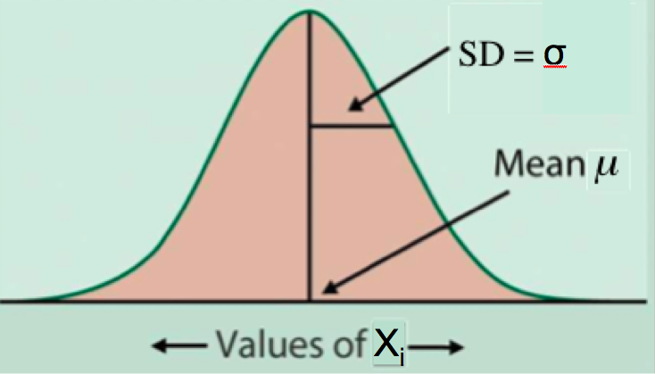
Normal Distribution
The normal distribution is a model for our overall population
  Can calculate the probability of getting observations greater than or less than any value
Usually don’t have a single observation, but instead the mean of a set of observations
June 9, 2008
48

Slide 49
Inference with Sample Mean
?
Population
Parameter: μ
Sampling
Inference
Estimation
Sample
Statistic: x
Sample mean is our estimate of population mean
How much would the sample mean change if we took a different sample?
Key to this question: Sampling Distribution of x
June 9, 2008
49

Slide 50
Sampling Distribution of Sample Mean
Distribution of values taken by statistic in all possible samples of size n from the same population
Model assumption: our observations x_{i} are sampled from a population with mean μ and variance σ²
Sample 1 of size n x
Sample 2 of size n x
Sample 3 of size n x
Sample 4 of size n x
Sample 5 of size n x
Sample 6 of size n x
Sample 7 of size n x
Sample 8 of size n x
.
.
.
Distribution
of these
values?
Population
Unknown
Parameter:
μ
June 9, 2008
50

Slide 51
Mean of Sample Mean
First, we examine the center of the sampling distribution of the sample mean.
Center of the sampling distribution of the sample mean is the unknown population mean:
mean( X ) = μ
Over repeated samples, the sample mean will, on average, be equal to the population mean
  no guarantees for any one sample!
June 9, 2008
51

Slide 52
Variance of Sample Mean
Next, we examine the spread of the sampling distribution of the sample mean
The variance of the sampling distribution of the sample mean is
variance( X ) = σ²/n
As sample size increases, variance of the sample mean decreases!
  Averaging over many observations is more accurate than just looking at one or two observations
June 9, 2008
52

Slide 53
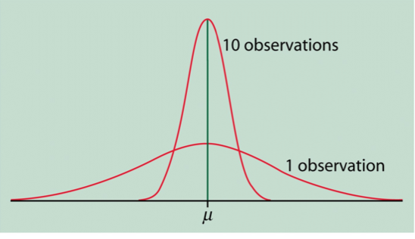
Comparing the sampling distribution of the sample mean when n = 1 vs. n = 10
June 9, 2008
53

Slide 54
Law of Large Numbers
Remember the Law of Large Numbers:
  If one draws independent samples from a population with mean μ, then as the sample size (n) increases, the sample mean x gets closer and closer to the population mean μ
This is easier to see now since we know that
mean(x) = μ
variance(x) = σ²/n 0 as n gets large
June 9, 2008
54

Slide 55
Example
Population: seasonal home-run totals for 7032 baseball players from 1901 to 1996
  Take different samples from this population and compare the sample mean we get each time
  In real life, we can’t do this because we don’t usually have the entire population!
Sample Size | Mean | Variance
100 samples of size n = 1 | 3.69 | 46.8
100 samples of size n = 10 | 4.43 | 4.43
100 samples of size n = 100 | 4.42 | 0.43
100 samples of size n = 1000 | 4.42 | 0.06
Population Parameter | μ = 4.42
June 9, 2008
55

Slide 56
Distribution of Sample Mean
We now know the center and spread of the sampling distribution for the sample mean.
What about the shape of the distribution?
If our data x₁,x₂,…, x_{n} follow a Normal distribution, then the sample mean x will also follow a Normal distribution!
June 9, 2008
56

Slide 57
Example
Mortality in US cities (deaths/100,000 people)
This variable seems to approximately follow a Normal distribution, so the sample mean will also approximately follow a Normal distribution
June 9, 2008
57

Slide 58
Central Limit Theorem
What if the original data doesn’t follow a Normal distribution?
HR/Season for sample of baseball players
If the sample is large enough, it doesn’t matter!
June 9, 2008
58

Slide 59
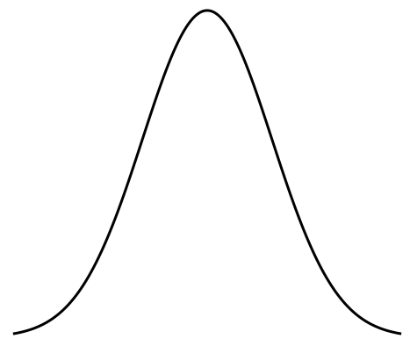
Central Limit Theorem
  If the sample size is large enough, then the sample mean x has an approximately Normal distribution
  This is true no matter what the shape of the distribution of the original data!
μ
June 9, 2008
59

Slide 60
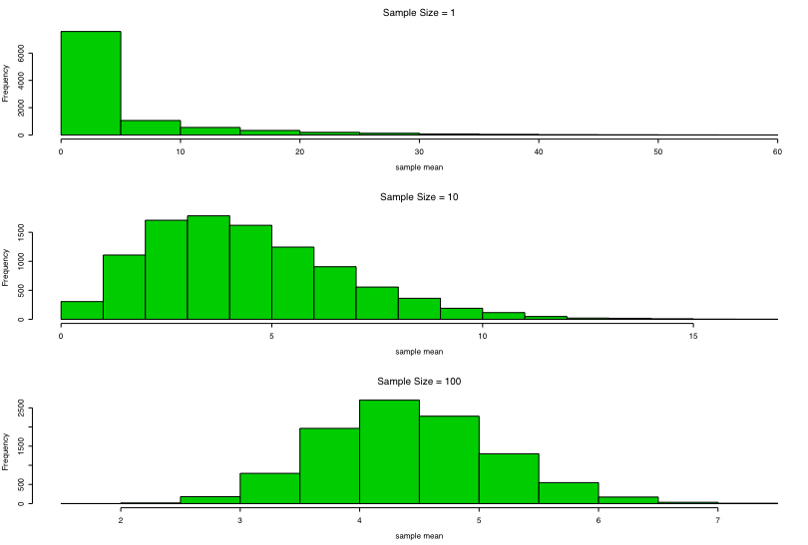
Example: Home Runs per Season
Take many different samples from the seasonal HR totals for a population of 7032 players
  Calculate sample mean for each sample
n = 1
n = 10
n = 100
June 9, 2008
60

