Slide 1
Advance Systems
Introduction to Distributed Systems

Slide 2





Distributed systems are everywhere
Air traffic control
Space shuttle
Banking systems
Grid power systems
Cloud computing
Distributed storage
Distributed databases
Blockchains

Slide 3
What is a distributed system?
A distributed computing system is a set of computer programs executing on one or more computers and coordinating their actions. (Coordination is typically done through messages.)
A distributed system is one in which the failure of a
computer you did not even know existed can render
your own computer unusable.
Attributed to Leslie Lamport

Slide 4
Why do we need distributed systems
Server
Client 1
Client n
Client-server architecture

Slide 5
Why do we need distributed systems
Server 4
Server 3
Server 1
Server 2
Fault-tolerance: Resilience to failures and attacks by having multiple replicas
Client 1
Client n
Client-server architecture with several server replicas

Slide 6
Why do we need distributed systems
Server 4
Server 2
Server 3
Fault-tolerance: Resilience to failures and attacks by having multiple replicas
Performance: Reduce latency by placing replicas next to clients (distribute replicas geographically)
Server 1
Client 1
Client n
Client-server architecture with several server replicas geographically distributed

Slide 7
Why do we need distributed systems
Server 4
Server 2
Server 3
Server 2
Server 2
Fault-tolerance: Resilience to failures and attacks by having multiple replicas
Performance: Reduce latency by placing replicas next to clients (distribute replicas geographically)
Scalability: Increase resources, computation and storage
Server 1
Client 1
Client n
Client-server architecture with multiple server replicas geographically distributed
Peer 1
Peer 2
Peer 3
Peer n
Peer-to-peer architecture

Slide 8

What do we expect from distributed systems?
Reliability
Provide continuous service
Availability
Ready to use
Safety
Do what they are supposed to do, avoiding catastrophic consequences
Security
Withstand passive/active attacks from outsiders or insiders

Slide 9

…not easy to achieve because
Failures
Computers and networks fail in many (often unpredictable) ways
Attacks
Computers get compromised
Constraints
Real-time
Storage and computation
Performance
SLAs
Complexity

Slide 10

How do computer systems fail?
Halting
No way to detect except by using timeout
Fail-stop (crash)
Accurately detectable halting failures
Send-omission/receive-omission
Network and network partitions
Timing
Temporal property of the system is violated
Byzantine
Arbitrary failures, include both benign and malicious failures

Slide 11

Why do computers get compromised?
Software bugs
Administration errors
Lack of diversity, same vulnerability is exploited
The explosion of the Internet facilitates the spread of malware
Social engineering attacks

Slide 12
What does it mean for a distributed system to be correct?
Safety
a condition that must hold in every finite sequence (from an execution)
“nothing bad happens”
Liveness
a condition that must hold a certain number of times
“something good happens”
What about performance?
A very slow system is not necessarily useful

Slide 13
Communication models for distributed systems
Δ = the time it takes to send a message between two processes
Synchronous
Δ is known and fixed
Asynchronous:
There is no bound for Δ
Partially synchronous:
Variant 1: There is a bound for Δ but it it not known
Variant 2: Bound for Δ is known and holds after a time T
Easier to design systems but not realistic
More realistic, but we have impossibility results
Compromise between the above

Slide 14
Building blocks for distributed systems
How to order events
Lamport and vector clocks
How to obtain a global snapshot of the system
Chandi-Lamport
How to coordinate
Consensus/agreement: Paxos, Raft, PBFT
Distributed transactions: 2PC, 3PC
Leader election: algorithms require or are more efficient if a leader coordinates the protocol
How to implement a distributed service
State-machine replication approach
Solutions designed for different models
failure
communication
security

Slide 15
When things go wrong
Designing and implementing distributed systems that are correct is a very challenging task
Consequences can be very significant
Data loss
Security vulnerabilities
Service unavailability
Performance degradation

Slide 16
A network partition’s impact on github
What happened: A routine maintenance work to replace failing 100G optical equipment resulted in the loss of connectivity for 43 seconds between POP US East Coast and DC East Coast.
Result:
Degraded service for 24 hours and 11 minutes.
Multiple internal systems were affected which resulted in displaying of information that was out of date and inconsistent.
No user data was lost; but required manual reconciliation of a few seconds of database writes that took hours
For the majority of the incident, GitHub was also unable to serve webhook events or build and publish GitHub Pages sites.
https://blog.github.com/2018-10-30-oct21-post-incident-analysis/

Slide 17
What is cs4730/7610 about?
THEORY + SYSTEMS
Theory
Fundamental problems
Algorithms solving this problems
Impossibility results
Trade-offs between properties provided by distributed systems
Systems
What can go wrong when designing, implementing, testing and deploying a distributed service
Design of existing and popular software
Dependencies between different services

Slide 18
Course overview
MODULE 1 – FUNDAMENTAL TOPICS
Ordering events and distributed snapshots
Time in distributed systems. Clock synchronization. Global states and distributed snapshots. Detecting failures.
Consensus
Synchronous systems, asynchronous systems, byzantine failures (including randomized solutions).
Distributed commit and consistency models
2PC and 3PC. Weak and strong consistency in partitioned database systems. Linearizability. CAP Theorem.

Slide 19
Course overview
MODULE II – ADVANCED TOPICS
Process Groups
Leader election, membership, reliable multicast, virtual synchrony. Gossip protocols.
Quorums
Paxos. Viewstamped replication. BFT.
Peer-to-peer systems
File sharing, lookup services, streaming, publish-subscribe

Slide 20
Course overview
MODULE III – SYSTEMS
Files systems
GFS, HDFS
Databases
BigTable, HBase, Spanner, DynamoDB, Casandra
Lock services
Chubby, Zookeeper, Zab
Computational services
MapReduce, Spark
Distributed ledgers:
Digital currency (BitCoin), smart contracts (Etherum)
Infrastructure for ML
TensorFlow, GraphLab

Slide 21
4730 vs 7610
Research project
More demanding projects, extra credit from 4730 is required in 7610
Less TA support
Higher pace of the class

Slide 22
How do we know that distributed systems are correct?

Slide 23
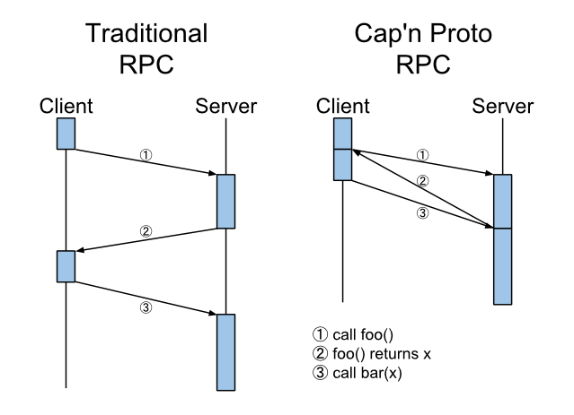



Development lifecycle
Requirement
(informal prose)
Design
(messages,
state machine)
Implementation
(binary, dependencies
operating systems)
Deployment
(production
conditions)
Ideal world: Validation at each step

Slide 24
How do we know systems achieve their goals
Provable properties
Safety and liveness: Assume specific failures and communication models
Cryptographic properties: Prove that computationally-bounded attackers can not solve certain mathematical problems (e.g. factorization)
Code inspection
Examining the code for bugs and vulnerabilities
Testing
Activity aimed at evaluating an attribute or capability of a program or system and determining that it meets its required results
Correctness, reliability, performance, security testing
Formal methods
Use rigorously specified mathematical models to build software and hardware systems.
Formal methods use mathematical proof as a complement to system testing in order to ensure correct behavior

Slide 25
Formal Methods
Formal methods use mathematical proof as a complement to system testing in order to ensure correct behavior
Theorem Proving
Analyzing a formal description for important properties based on computer-based proofs
Model Checking
Checking whether a finite-state model of a system meets a given specification in an exhaustive manner
Lightweight FM
Using formal techniques formal methods are used in specific locations, and different formal methods may be used in different subsystems, to analyze a system either statically or dynamically

Slide 26
Benefits
Eliminate ambiguity
Forces the system designer to rigorously think about the system specification
Many protocols are described in natural language which is imprecise
Facilitate understanding
Complex functionality easier to understand when modeled
Forces to identify assumptions
Provide proofs
Generate formal proofs about the system studied
Show that a system meets a property

Slide 27
Limitations
ACL2
Alloy
Coq
CryptoVerif
Dafny
Dafny
Isabelle
IVy
Proverif
Spin
TLA+
Tamarin
Cost
It takes effort and time to create rigorous specifications
They require a high-level of expertise
Narrow specificity
Most formal methods introduce some form of computational model, which limits their applications
Usability
There are many tools with specific capability
Limited documentation

Slide 28
Consensus

Slide 29
Consensus in distributed systems
Consensus: According to Merriam-Webster dictionary it means general agreement
When do we need consensus in distributed systems?
Read-Modify-Write Memory
Database commit
Transactional file system
Totally ordered broadcast

Slide 30
Communication models for distributed systems
Δ = the time it takes to send a message between two processes
Synchronous
Δ is known and fixed
Asynchronous:
There is no bound for Δ
Partially synchronous:
Variant 1: There is a bound for Δ but it it not known
Variant 2: Bound for Δ is known and holds after a time T
Easier to design systems but not realistic
More realistic, but we have impossibility results
Compromise between the above

Slide 31
Why consider the synchronous model
The strict timing guarantees make the behavior of the system more predictable and easier to reason about.
Algorithms are often simpler to design and analyze compared to asynchronous systems.
Faults like crashes or communication failures can be detected based on timing constraints.

Slide 32
Most common failure models
Fail-stop (crash): accurately detectable halting failures, once failed the process does not restart
Omission: just a subset of the messages are delivered
Network partitioning: subset of processes are not reachable
Byzantine: arbitrary failures, include both benign and malicious failures; processes can be authenticated or not

Slide 33
1: Consensus in synchronous systems with no failures

Slide 34
The consensus problem
Input:
Each process has a value, either 1 or 0
Properties:
Agreement: all nodes decide on the same value
Validity: if a process decides on a value, then there was a process that started with that value

Slide 35
Consensus in a synchronous system: No failures
Failure model:
No faults
Assumptions:
Communication is synchronous
Algorithm - requires 1 round:
Each process sends its value to all the other processes
After time Δ, each process decides:
1: If all received values including its own are 1
0: otherwise decides 0
WHY IS THIS ALGORITM CORRECT?
(i.e. provides agreement and validity)

Slide 36
Consensus in a synchronous system with crash failures: Model
Failure model:
Any process can crash, once crashed, a process does not recover
At most f processes can crash
Communication model
Communication is synchronous
Network is a fully connected graph (any process can communicate with any other process regardless if other processes crash)

Slide 37
Consensus in a synchronous system with crash failures: Properties
Input:
1 or 0 to each process
Properties:
Agreement: all non-faulty processes decide on the same value
Validity: if a process decides on a value, then there was a process that started with that value
Termination: non-faulty processes decide in a finite time
NOTE: FAULTY PROCESSES MAY DECIDE DIFFERENTLY FROM CORRECT PROCESSES

Slide 38
Example 1: 4 processes, 1 crash
1
p1
p2
0
1
p3
p4
1
Round 1
1, 0, 1, 1
0
p1
p2
p3
p4
1, ?, 1, 1
1, ?, 1, 1
P2 crashes after it sent its value to p1 but before sending it to p2 and p3.
Can p1, p3, and p4 decide now?

Slide 39
Discussion
Processes p3 and p4 have incomplete information from p1, they missed what p2 sent
Can p3 and p4 know what p2 sent? Yes, from p1
NEED multiple rounds in which processes send each other the information they have
How many rounds do I need to ensure that the algorithm is correct (i.e. all non-faulty processes decide on the same value)

Slide 40
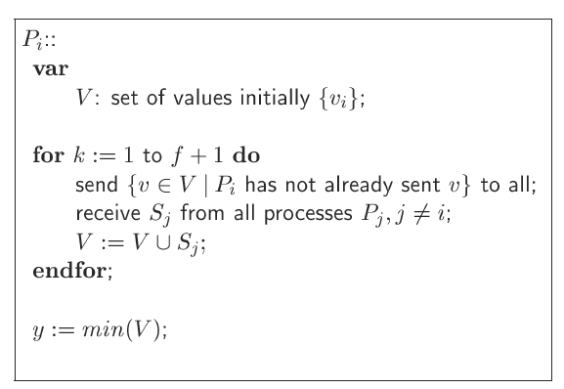
Consensus in a synchronous system with crash failures: Algorithm
Algorithm tolerates at most f failures, out of n nodes
Each process maintains V the set of values proposed by other processes (initially it contains only its own value)
In every round a process:
Sends to all other processes the values from V that it has not sent before
After f+1 rounds each process decides on the minimum value in V
f < n

Slide 41
Example 1: cont.
Round 1
Round 2
1, 0, 1, 1
0
1, 0, 1, 1
0
p1
p2
p1
p2
p3
p4
p3
p4
1, ?, 1, 1
1, ?, 1, 1
1, 0, 1, 1
1, 0, 1, 1
P2 crashes after it sent its value to p1 but before sending it to p2 and p3.
P1 sends , 0, 1, 1 to all
P3 sends 1, ,1 to all
P4 sends 1, , ,1 to all
Can p1, p3, and p4 decide now?

Slide 42
Example 2: 4 processes, 1 crash
1
p1
p2
1
1
p3
p4
1
Round 1
1, 1, 1, 1
1
p1
p2
p3
p4
1, ?, 1, 1
1, ?, 1, 1
P2 crashes after it sent its value to p1 but before sending it to p2 and p3.
Can p1, p3, and p4 decide now?

Slide 43
A closer look…
Remember that communication is synchronous (the time it takes to send a message between two process is known and fixed)
A process in a round may:
Send messages to any set of processes
Receive messages from any set of processes
Do local processing
Make a decision
Crash
If a process p crashes in a round, then any subset of the messages sent by p in this round can be lost
If a message was sent in a round it is either received in that round or it will never be received at all

Slide 44
Key: all processes must be sure that all processes that did not crashed have the same information (so they can make the same decision)
Processes can not decide in less than f+1 because they can not distinguish between executions in which all alive have the same list, or all alive have different lists.

Slide 45
Example 3
Consider that you have 5 processes and 2 processes can crash
After 1 round p1 has all 5 values, can he decide?
No, because he is not sure that every other process has all the information he has, for example, p5 crashed and p1 is the only one having info from p5
After round 2, can p1 decide?
He has all the info.
But what about p2? P2 can not be sure that all the other processes received the info from p1, maybe p1 send his list to p2 and then crashed
Can he decide now?
After round 3? Can p2 decide? Yes, assuming that p2 does not have the same list as another process, leads to more than 2 processes have crashed which contradicts our assumption

Slide 46
Sketch proof for the agreement property
Assume by contradiction that two processes decide on different values, this means they had different final set of values when making a decision in the f+1 round, let’s say p has a value v that q does not have
How come that p got v and q did not? The only possible case is that a third process s, sent v to p, and crashed before sending v to q. SO in ROUND f +1, process s crashed (1 process)
Because q does not have v it means that any process that may have sent v crashed also in round f, say that there was 1 procees
Proceeding in this way, we infer at least one crash in each of the preceding rounds.
STOP! We can have at most f crashes and we obtained that there are f+1 crashes (one in each round) → contradiction.

Slide 47
Byzantine Generals Problem (Byzantine Consensus)
Several Byzantine generals are laying siege to an enemy city
They can only communicate by messenger
They have to agree on a common strategy, attack or retreat.
Some general may be traitors (their identity is not known)
Do you see the connection with the consensus problem?

Slide 48
Consensus in Asynchronous Systems
There is no asynchronous algorithm that achieves
agreement on a one-bit value in the presence of crash
faults. The result is true even if no crash actually occurs!
Also known as the FLP result
Michael J. Fischer, Nancy A. Lynch, and Michael S. Paterson for "Impossibility of Distributed Consensus with One Faulty Process," Journal of the ACM, April 1985, 32(2):374

Slide 49
Chord

Slide 50
Distributed Hash Tables
Decentralized distributed systems that partition a set of keys among participating nodes
Goal is to efficiently route messages to the unique owner of any given key
Typically designed to scale to large numbers of nodes and to handle continual node arrivals and failures
Examples: Chord, CAN, Pastry,Tapestry

Slide 51
DHT Design Goals
Decentralized system:
One node needs to coordinate with a limited set of participants to find the location of a file; should work well in the presence of dynamic membership
Scalability:
The system should function efficiently even with thousands or millions of nodes
Fault tolerance:
The system should be reliable even with nodes continuously joining, leaving, and failing

Slide 52
DHT: Keys and Overlays
Key space:
Ownership of keys is split among the nodes according to some partitioning scheme that maps nodes to keys
Overlay network:
Nodes self organize in an overlay network; each node maintains a set of links to other nodes (its neighbors or routing table).
Overlay and routing information is used to locate an object based on the associated key

Slide 53
DHT: Storing an Object
Compute key according to the object-key mapping method
Send message store(k,data) to any node participating in the DHT
Message is forwarded from node to node through the overlay network until it reaches the node S responsible for key k as specified by the keyspace partitioning method
Store the pair (k,data) at node S (sometimes the object is stored at several nodes to deal with node failures)

Slide 54
DHT: Retrieving an Object
Compute key according to the object-key mapping method
Send a message to any DHT node to find the data associated with k with a message retrieve(k)
Message is routed through the overlay to the node S responsible for k
Retrieve object from node S

Slide 55
Key Partitioning
Key partitioning: defines
what node “owns what keys” <=> ”stores what objects”
Removal or addition of nodes should not result in entire remapping of key space since this will result in a high cost in moving the objects around
Use consistent hashing to map keys to nodes.
Distance function between keys, d(k1,k2)
A node with ID i owns all the keys for which i is the closest ID, measured according to distance function d.
Consistent hashing has the property that removal or addition of one node changes only the set of keys owned by the nodes with adjacent IDs, and leaves all other nodes unaffected.

Slide 56
Overlay Networks and Routing
Nodes self-organize in a logical network defined by the set of links to other nodes each node must maintain
Routing:
Greedy algorithm, at each step, forward the message to the neighbor whose ID is closest to k.
When there is no such neighbor, then this is the closest node, which must be the owner of key k

Slide 57
CHORD
Efficient lookup of a node which stores data items for a particular search key.
Provides only one operation: given a key, it maps the key onto a node.
Example applications:
Co-operative mirroring
Time-shared storage
Distributed indexes
Large-scale combinatorial search

Slide 58
Assumptions
Communication in underlying network is both symmetric and transitive
Assigns keys to nodes with consistent hashing
Hash function balances the load
Participants are correct, nodes can join and leave at any time
Nodes can fail

Slide 59
Chord Rings
Key identifier = SHA-1(key)
Node identifier = SHA-1(IP address)
Consistent hashing function assigns each node and key an m-bit identifier using SHA-1
Mapping key identifiers to node identifiers:
Identifiers are ordered on a circle modulo 2^{m} called a chord ring.
The circle is split into contiguous segments whose endpoints are the node identifiers. If i1 and i2 are two adjacent IDs, then the node with greater identifier i2 owns all the keys that fall between i1 and i2.

Slide 60
Example of Key Partitioning in Chord
m = 6
10 nodes
N1
N56
N8
K54
K10
N51
N14
N48
N21
N42
K24
N38
N32
K38
K30

Slide 61
How to Perform Key Lookup
Assume that each node knows only how to contact its current successor node on the identifier circle, then all node can be visited in linear order.
When performing a search, the query for a given identifier could be passed around the circle via these successor pointers until they encounter the node that contains the key corresponding to the search.

Slide 62
Example of Key Lookup Scheme
succesor(k) = first node whose ID is >= ID of k in identifier space
N1
K45
N8
N48
N14
N42
Takes 7 hops
N38
N32
N21

Slide 63
Scalable Key Location
To accelerate lookups, Chord maintains additional routing information (m entries): finger table
The i^{th} entry in the table at node n contains the identity of the first node s that succeeds n by at least 2^{i-1} on the identifier circle.
s = successor(n+2^{i-1}).
s is called the i^{th} finger of node n

Slide 64
Scalable Lookup Scheme
m = 6
N1
N56
Finger Table for N8
N8
N51
N8+1 | N14
N8+2 | N14
N8+4 | N14
N8+8 | N21
N8+16 | N32
N8+32 | N42
N48
finger 6
finger 1,2,3
N14
finger 5
N42
finger 4
N38
N21
finger [i] = first node that succeeds (n+2^{i-1})mod2^{m}
N32

Slide 65
Scalable Lookup
Each node has finger entries at power of two intervals around the identifier circle
Each node can forward a query at least halfway along the remaining distance between the node and the target identifier.

Slide 66
Lookup Using Finger Table
Finger Table for N51
N51+1 | N56
N51+2 | N56
N51+4 | N56
N51+8 | …
N51+16 | …
N51+32 | …
m = 6
Takes 3 hops to locate
K54
N1
N56
Finger Table for N42
N8
N51
N42+1 | N48
N42+2 | N48
N42+4 | N48
N42+8 | N51
N42+16 | N1
N42+32 | N14
N48
Finger Table for N8
N14
N8+1 | N14
N8+2 | N14
N8+4 | N14
N8+8 | N21
N8+16 | N32
N8+32 | N42
N42
N38
N32
N21
finger [i] = first node that succeeds (n+2^{i-1})mod2^{m}

Slide 67
Node Joins and Failures/Leaves
When a node N joins the network, some of the keys previously assigned to N’s successor should become assigned to N.
When node N leaves the network, all of its assigned keys should be reassigned to N’s successor.
How to deal with these cases?

Slide 68
Node Joins and Stabilizations
Everything relies on successor pointer.
Up to date successor pointer is sufficient to guarantee correctness of lookups
Idea: run a “stabilization” protocol periodically in the background to update successor pointer and finger table.
Guarantees to add nodes in a fashion to preserve reachability
Does not address the cases when a Chord system thas split into multiple disjoint cycles, or a single cycle that loops multiple times around the identifier space

Slide 69
Stabilization Protocol
Each time node N runs stabilize protocol, it asks its successor for its predecessor p, and decides whether p should be N’s successor instead.
Stabilize protocol notifies node N’s successor of N’s existence, giving the successor the chance to change its predecessor to N.
The successor does this only if it knows of no closer predecessor than N.

Slide 70
Impact of Node Joins on Lookups
If finger table entries are current then lookup finds the correct successor in O(log N) steps
If successor pointers are correct but finger tables are incorrect, correct lookup but slower
If incorrect successor pointers, then lookup may fail

Slide 71
Voluntary Node Departures
Leaving node may transfers all its keys to its successor
Leaving node may notify its predecessor and successor about each other so that they can update their links

Slide 72
Node Failures
Stabilize successor lists:
Node N reconciles its list with its successor S by copying S’s successor list, removing its last entry, and prepending S to it.
If node N notices that its successor has failed, it replaces it with the first live entry in its successor list and reconciles its successor list with its new successor.

Slide 73
CHORD Summary
Efficient location of the node that stores a desired data item is a fundamental problem in P2P networks
Separates correctness (successor) from performance (finger table)
Chord protocol solves it in an efficient decentralized manner
Routing information: O(log N) nodes
Lookup: O(log N) nodes
Update: O(log2 N) messages
It also adapts dynamically to the topology changes introduced during the run

Slide 74
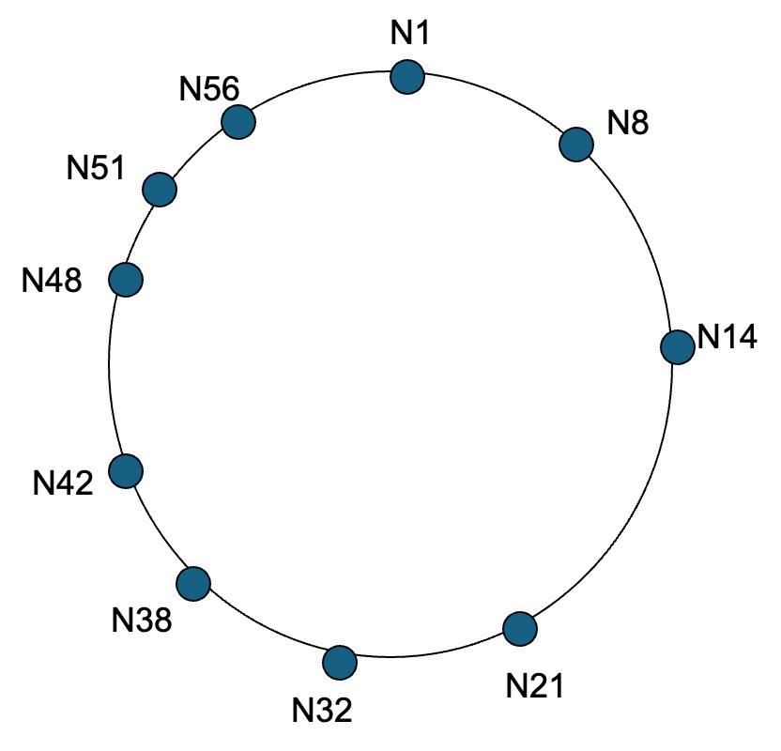
Exercise
Answer the following questions:
(1) On what node will object 5 be placed?
(2) How many hops it takes to find object 50 without the finger table?
(3) How many hops it takes to find object 50 with the finger table?

