Slide 1

CS1100: Computer Science and Its Applications
Text Processing
Created By
Martin Schedlbauer
m.schedlbauer@neu.edu

Slide 2
Processing Text
Excel can be used not only to process numbers, but also text.
This often involves taking apart (parsing) or putting together text values (strings).
The parts into which we split a string will be called fields.
Fields may be separated by delimiting text
And/or fields may have a fixed width which permits them to be identified.

Slide 3
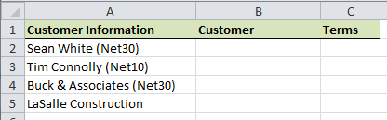
Example
Text processing is often necessary when files are imported from other programs:
We’d like to extract the customer name and the payment terms from the text in column A.

Slide 4
Terminology
The process of taking text values apart is called parsing.
  text value = string
  part of a text value = substring

Slide 5
Text Processing Functions
Excel provides a number of functions for parsing text:
  RIGHT – take part of the right side of a text value
  LEFT – take part of the left side of a text value
  MID – take a substring within a text value
  LEN – determine the number of characters in a text value
  FIND – find the start of a specific substring within a text value

Slide 6

LEFT Function
The LEFT function extracts a specific number of characters from the left side of a text value:
=LEFT(A1,4)

Slide 7

RIGHT Function
The RIGHT function extracts a specific number of characters from the right side (end) of a text value:
SPECIFY THE NUMBER OF CHARACTERS, NOT WHERE TO START!
=RIGHT(A1,4)

Slide 8

MID Function
The MID function extracts some number of characters starting at some position within a text value:
Number of Characters
=MID(A1,5,4)
Where to start

Slide 9

FIND Function
FIND returns the position where a substring starts within a string.
Finds the first occurrence only.
Returns a #VALUE! error if the substring cannot be found.
=FIND("DEF",A1)
=FIND(" ",A2)
=FIND(",",A3)

Slide 10

Case Sensitivity
Note that FIND is case sensitive.
As an alternative, Excel has a SEARCH function which is not case sensitive but otherwise works the same way as FIND.
=FIND("cde",A16)
=SEARCH("cde",A17)

Slide 11

IFERROR and FIND
Since FIND returns an error when a substring cannot be found, we need to use a sentinel value.
=FIND("[",A5)
=IFERROR(FIND("[",A5),"")

Slide 12
LEN Function
The LEN function returns the total number of characters in a text, i.e., the “length” of the text value:
=LEN(A9)

Slide 13
LEN Function
The LEN function returns the total number of characters in a text, i.e., the “length” of the text value:
A is the first character
N is the 14th character
=LEN(A9)

Slide 14
TRIM Function
The TRIM function removes all spaces before and after a piece of text. Spaces between words are not removed.
This is useful if the text you are trying to parse has trailing spaces which may result in errors later
  For example, if you need to use a result later in a VLOOKUP function.

Slide 15
Example 1 – Delimiting Text
You are given a list of usernames, each followed by a comma, then a space, then the user’s full name
A comma followed by a space only appears between the username and full name
Everything following the username, the comma and the space is the user’s full name

Slide 16
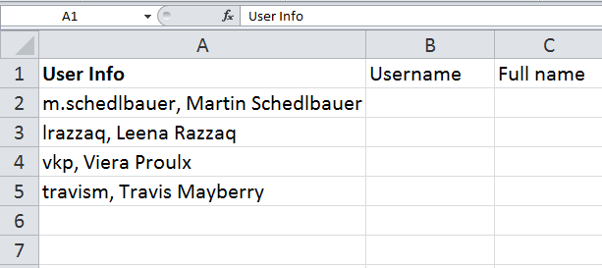
Locating the Delimiter
(where to split the text)
The first step is to identify the location where the split will be made
The split location may be identified by
  Delimiting text
  A fixed width field

Slide 17
Delimiting Text
Delimiting text is any sequence of characters that can reliably be used to end one part of the text to be split and the beginning of another.
In this example, a comma followed by a space can serve as delimiting text.
On the other hand, the width of each field may vary, so we cannot identify the splitting location by field widths

Slide 18
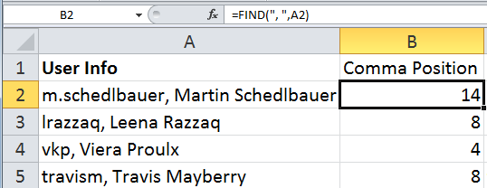
Finding the Delimiting Text
Since the width of each field may vary, and we cannot identify the splitting location by field widths, we need to find the location of the comma and space
Use FIND to return the location of the delimiter.
=FIND(“, ”,A2)

Slide 19
Splitting the Text
LEFT: Number of characters to read
  Start position = 1
  End Position = Find(delimiter, cell) – 1
  Number of characters =
  End position – Start Position + 1 =
  End position

Slide 20
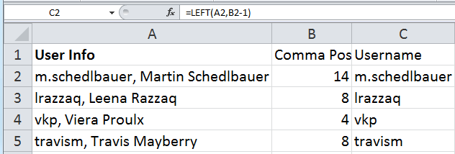
Splitting the Text
Once we have found the delimiting text, we can split the original text using functions like LEFT, RIGHT and MID
Note that we must adjust the length in our function to omit the delimiting text.
  =LEFT(A2, B2 – 1)

Slide 21
Splitting the Text
RIGHT: Number of characters to read
  Start position =
  FIND(delimiter, cell) + LEN(delimiter)
  End Position = LEN(cell)
  Number of characters =
  End position – Start Position + 1 =

Slide 22
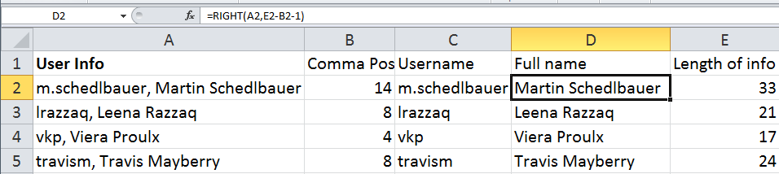
Splitting the Text
Using the RIGHT function to find the full name, we need to find the number of characters from the right
  Subtract the length of the whole text by the location of the delimiter and adjust to omit the delimiter
=RIGHT(A2, E2 – (B2+2) + 1)

Slide 23
Splitting the Text
Using the RIGHT function to find the full name, we need to find the number of characters from the right
  Subtract the length of the whole text by the location of the delimiter and adjust to omit the delimiter
=RIGHT(A2, E2 – B2 – 1)

Slide 24
Splitting the Text
MID: Start Position, Number of characters to read
  Start position =
  FIND(first delimiter,cell) + LEN(first delimiter)
  End Position = FIND(second delimiter, cell)-1
  Number of characters =
  End position – Start Position + 1

Slide 25
Splitting the Text
We could also use the MID function …
=MID(A2, B2+2, E2-(B2+2)-1)

Slide 26
Splitting the Text
We could also use the MID function …
=MID(A2, B2+2, E2 - B2 + 1)

Slide 27
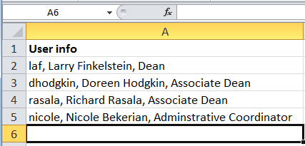
Divide and Conquer
Divide and Conquer is a strategy for solving problems by breaking up a big problem into similar smaller problems
  Example: suppose we are given a username, followed by a comma and a space, followed by a real name, followed by another comma and a space, followed by a job title.

Slide 28
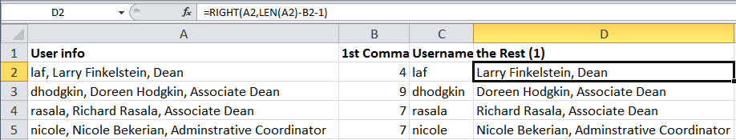
Divide and Conquer
Split Once
Our first step will be to split the original text into two parts
  A username
  Everything else

Slide 29
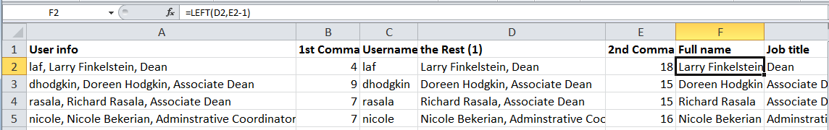
Divide and Conquer
Split Again
Repeat the splitting process by splitting the remainder into the full name and the job title
Using this strategy, we could repeat the splitting process into smaller and smaller pieces until we have solved the problem.
In the above example, we are done.

Slide 30
FIND Function
FIND returns the position where a substring starts within a string.
Optional Value: position to start search
To find second comma: find a comma starting after the first comma.

Slide 31
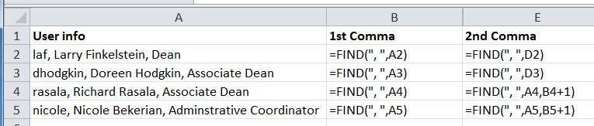
FIND Function
FIND returns the position where a substring starts within a string.
Optional Value: position to start search

Slide 32
Parsing Optional Data
Sometimes we need to split some text into parts, but one of the parts may be missing.
A reasonable first step is to determine whether or not the data is present.

Slide 33
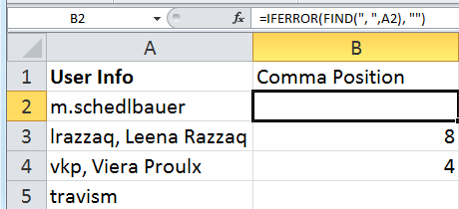
Parsing Optional Data
Example
Suppose we are given a list of usernames optionally followed by commas and a full name
Use IFERROR and FIND to see if there is a comma and return the position if so.

Slide 34
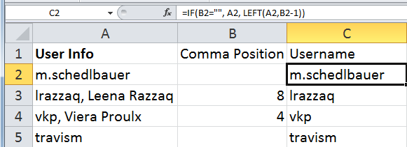
Parsing Optional Data
Example
Now use an IF statement to extract the username

Slide 35
Parsing Text
To extract parts of a text value (parsing) requires thoughtful analysis and often a divide-and-conquer approach.

Slide 36
Strategy
You need think about your strategy:
  How do I detect where the first name starts?
  Are there some delimiters?
  What is the delimiter?
  Does it always work?
  Is there always a first or last name?
Break the problem into several problems and create auxiliary or helper columns.

Slide 37
HIDDEN COLUMNS
Solving complex parsing problems often requires the use of intermediate values:
  Solve the problem in pieces, don’t do it all in a single formula
So, place intermediate values into temporary columns and then hide the column to make the model less confusing to read.

Slide 38
Let’s Put This Together…
Let’s see if we can parse the text into its name and terms components…
Before starting with formulas, think about your strategy.
  How can you recognize the beginning and end of the name component?
  How about the beginning and end of the terms component?
  Do we need intermediate values?

Slide 39
COUNTA Function
We have already seen COUNT as a way to count the number of cells in a range.
However, COUNT only counts cells that contain numbers.
  What about text?
To count the number of cells that contain some value (either text or number), use COUNTA.

Slide 40
COUNTBLANK Function
As an alternative to COUNTA, there is COUNTBLANK.
This function counts the number of cells in a range that do not contain any value (either text or number).

