Slide 1

CS1100: Computer Science and Its Applications
Excel Basics
Modified from originals created by Martin Schedlbauer, Peter Douglass and Peter Golbus

Slide 2
Spreadsheets
Spreadsheets are among the most useful technical business applications.
Principally used for calculations and manipulation of tabular data.
Common spreadsheet applications:
  Microsoft Excel
  Google Spreadsheet

Slide 3
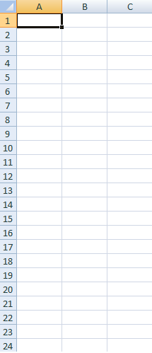
Spreadsheet Layout
Tabular layout arranged in rows and columns.
  Columns are labeled with letters
  Rows are labeled with numbers
Cells are at the intersection of rows and columns
  Example cell reference: A3, C9
Cells can contain:
  Numbers, dates, text, or other data
  Formulas using functions and cell references

Slide 4
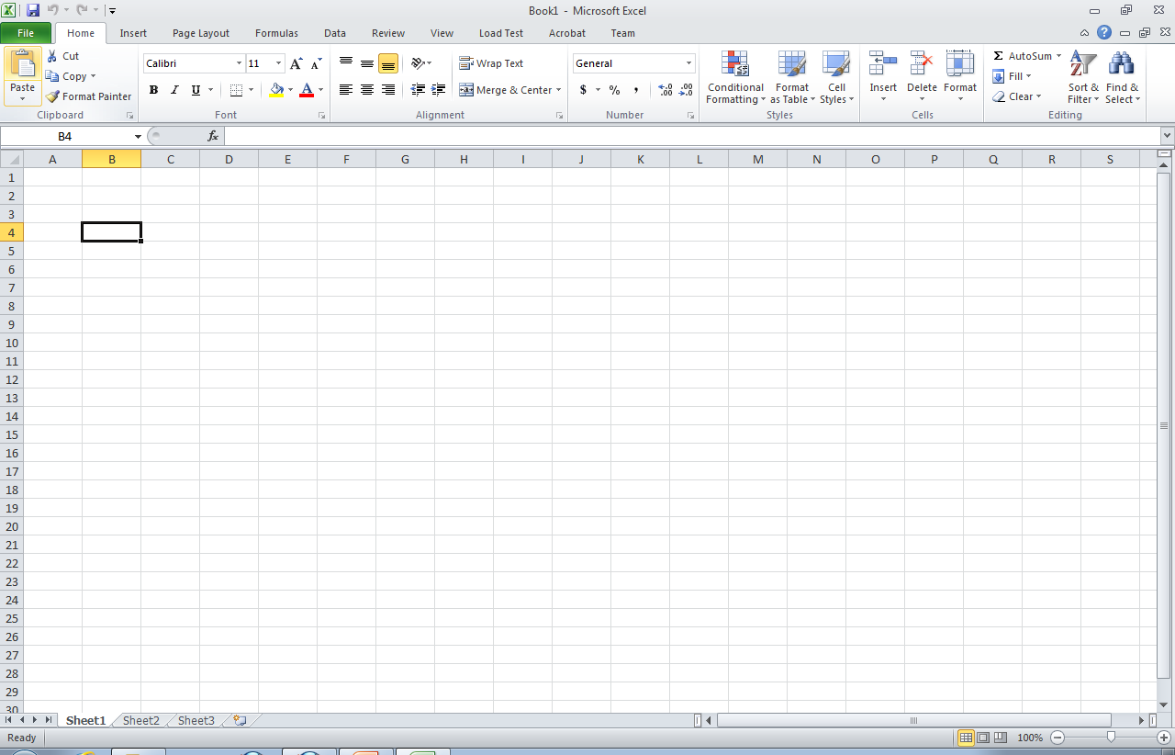
Cell Reference

Slide 5
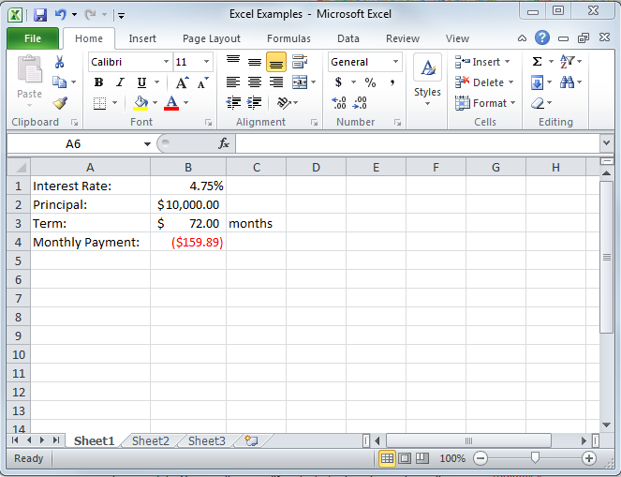
Microsoft Excel 2010

Slide 6
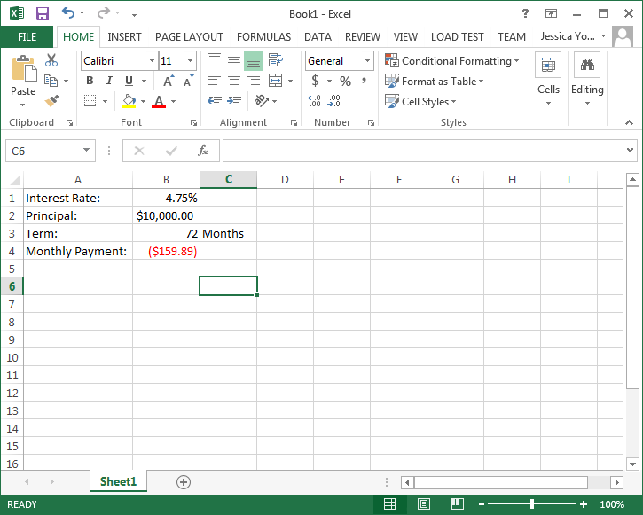
Microsoft Excel 2013

Slide 7
Cell Ranges
Many functions require cell ranges:
  Column Range: A1:A10
  Row Range: A5:K5
  Matrix: A1:C5

Slide 8
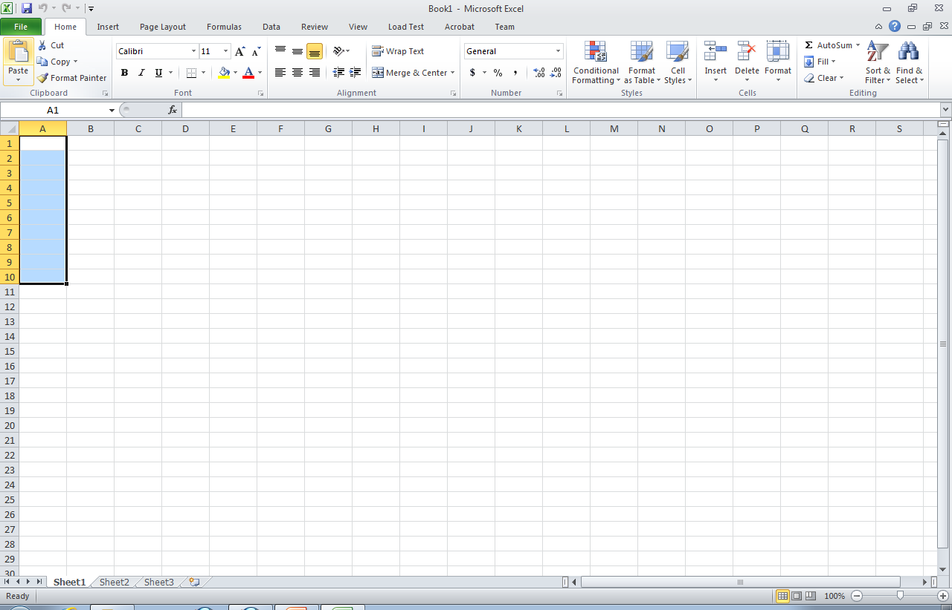
Column Range: A1:A10

Slide 9
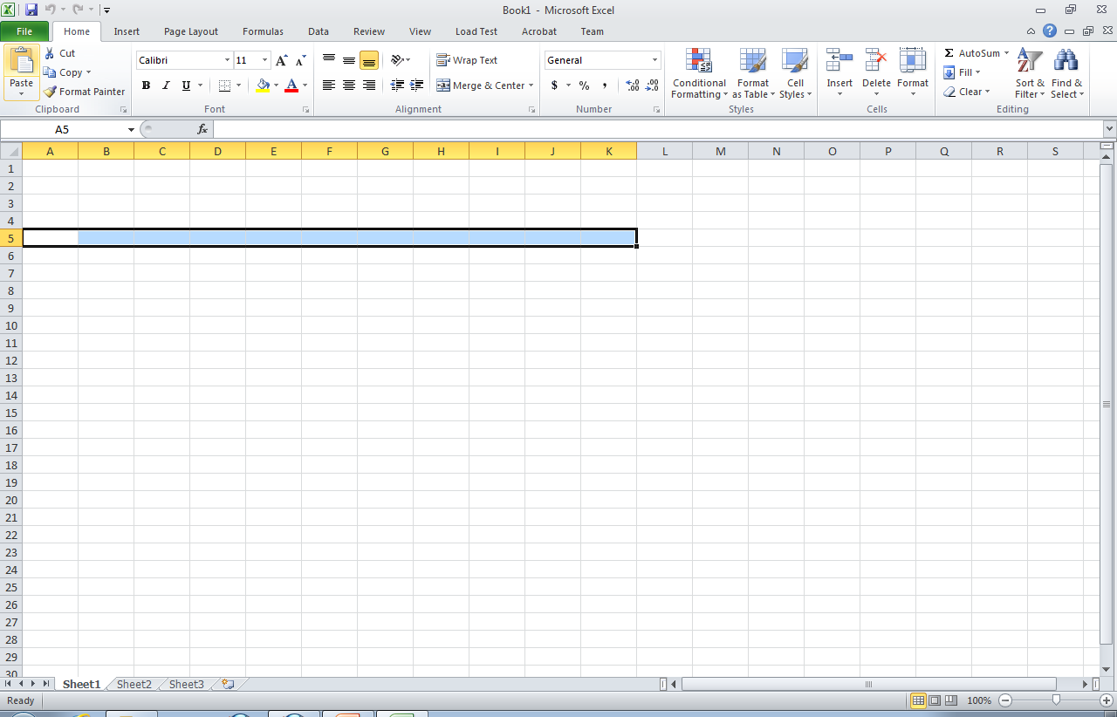
Row Range: A5:K5

Slide 10
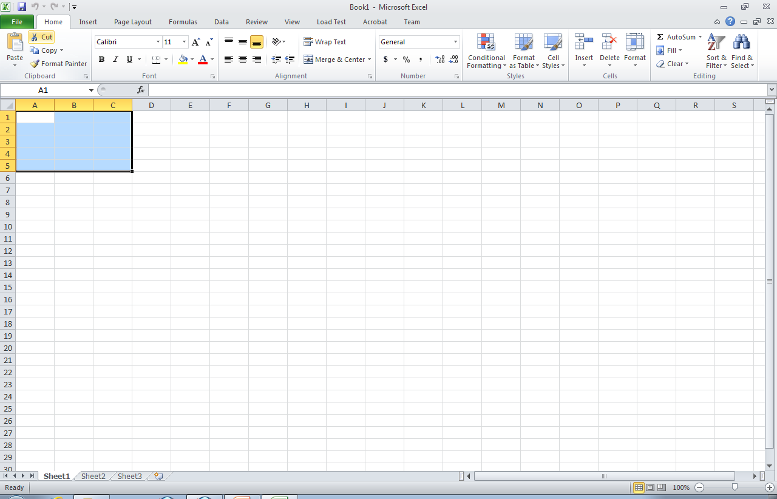
Matrix: A1:C5

Slide 11
Functions
Excel provide thousands of functions to build spreadsheet models:
  Financial, e.g., pmt, irr, fv, db
  Aggregation, e.g., sum, count, average
  Text, e.g., left, mid, trim
  Date & Time, e.g., today, time, second
  Lookup, e.g., choose, vlookup, match
  Logical, e.g., if, not, or
  Statistical, e.g., median, correl
  Engineering, e.g., bessel, imlog
  Trigonometric, e.g., sin, tan, acos

Slide 12
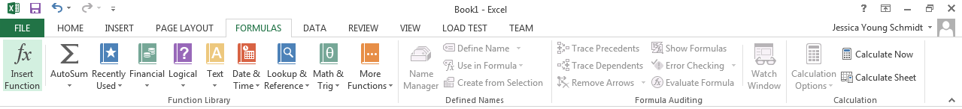
Function Library

Slide 13
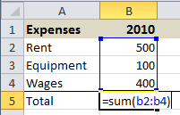
Entering Formulas and Functions
To enter formulas and functions:
  start entry with =
Example:

Slide 14
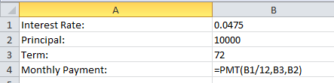
Cell References in Functions
Most functions require parameters.
To keep your model flexible and correct even when the data changes, only use cell references in functions.

Slide 15
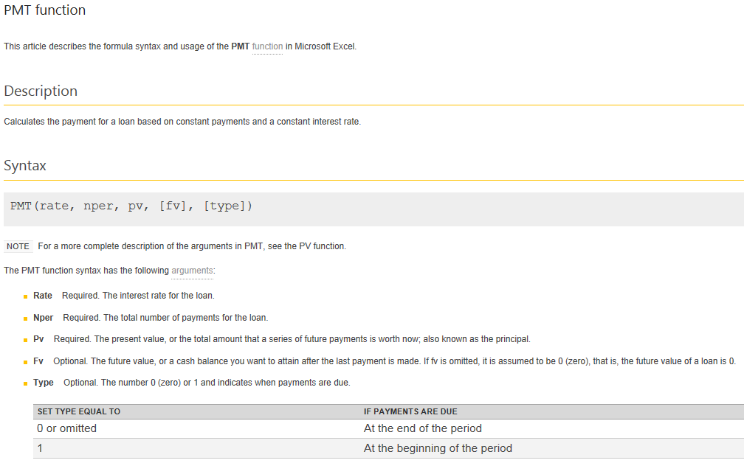

Slide 16
Copying Cells
To copy cells:
  CTRL+C to copy and CTRL+V to paste
  or
  Use cell dragging
Cell references are automatically adjusted when copied.
Cell references can be locked $.
  $A1:$A5 is not adjusted when column copied
  A$1:C$1 is not adjusted when row copied
  $A$1 is never adjusted when copied

Slide 17
Examples1
Copying Formula

Slide 18
Copying Formulas
Relative cell references adjust when copying:
  Columns references adjust when copying across columns
  Row references adjust when copying across rows
Generally, the adjustment is desirable, but sometimes it is not:
  Lock cell references by making them absolute references
  Use $ before row and/or columns for locking

Slide 19
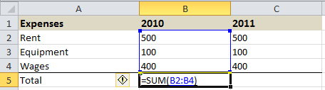
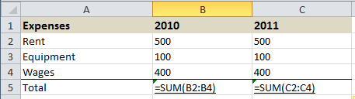
Demo: Copying Formulas
Notice what happens to the cell references when copying from row to row or column to column.
Click to watch video demonstration

Slide 20
Anchors and Cell Dragging
Formulas can be copied to adjacent cells by dragging.
Dragging changes cell references.
Usually this is what you want, but sometimes it breaks your formulas.
Anchors ($) stop cell references from changing.
But when do you use them?

Slide 21
When to Anchor
Manually rewrite your formula in the cell to the right and the cell below the original cell.
Compare the letters in the original formula to the letters in the formula to the right.
If a letter didn’t change, put a $ before it in the original cell.

Slide 22
When to Anchor
Manually rewrite your formula in the cell to the right and the cell below the original cell.
Compare the numbers in the original formula to the letters in the formula to below.
If a number didn’t change, put a $ before it in the original cell.

Slide 23
Examples1
Wrong Referencing

Slide 24
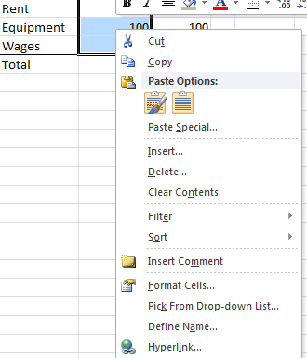
Named Ranges
To make your formulas easier to read, use named cell ranges.
To create a named range:
  Highlight cells to include in named range
  Click right mouse button on any cell in the selected range for context menu
  Choose “Define Name…” and provide name
Note: named ranges are never adjusted when row or column copied, i.e. both cells and columns are automatically anchored in named ranges.
Click here to watch demonstration…

Slide 25
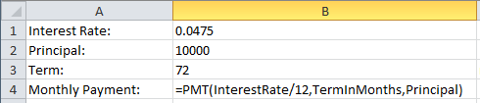
Named Ranges in Functions
Named ranges can make function parameters easier to understand:

Slide 26
Managing Named Ranges
To manage (delete, edit, rename, etc) named ranges
  In the Formulas ribbon
  Click on Name Manager

Slide 27
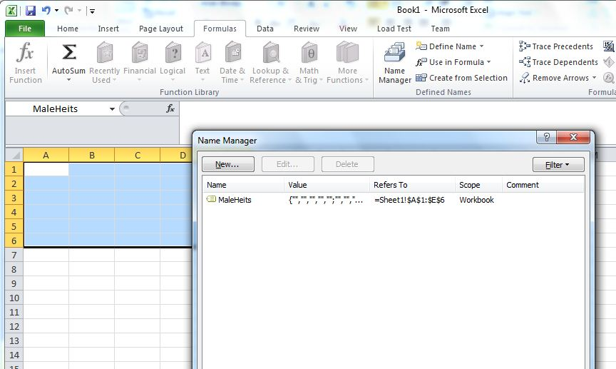
Managing Named Ranges

Slide 28
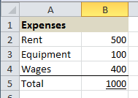
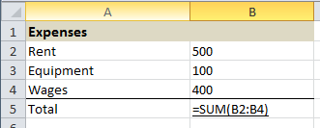
Showing Formulas
To show the formulas in your spreadsheet, press CTRL+~.

Slide 29
Formatting
Formatting changes the way values are displayed, but does not change the actual value being used in functions.
Common formatting options:
  Currency values
  Time and date values
  Numeric formats and decimal points
  Percent

Slide 30
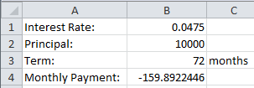
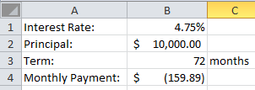
Demo: Formatting
Unformatted values
Percent
Currency
Accounting
Formatted values
Click here to watch demonstration…

Slide 31
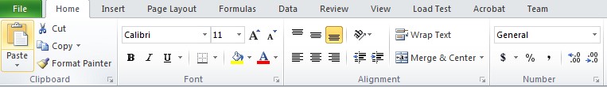
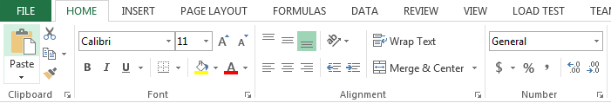
Formatting

Slide 32

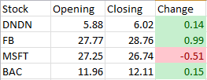
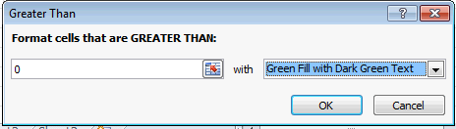
Conditional Formatting
Conditional formatting allows the application of specified formatting only when certain conditions are met.
On the Home tab, in the Styles group, click the arrow next to Conditional Formatting

Slide 33
Rounding
Rounding actually changes the value by rounding up or down to some specified accuracy.
The rounded value is copied to another cell.
To round, use the ROUND() function:
  =ROUND(A1,2)
  =ROUNDUP(A1,2)
Notes:
Note the difference between rounding and formatting precision.

Slide 34
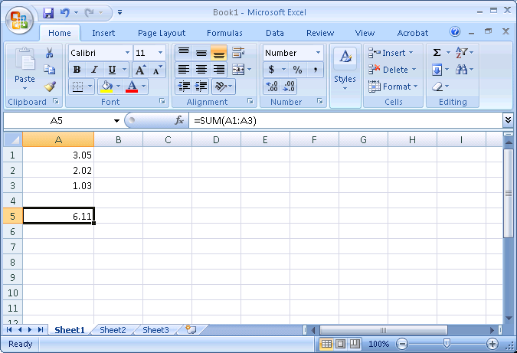
Formatting Example

Slide 35
Look Carefully at the Formatting Example
It appears to say that the sum of
  3.05
  2.02
  1.03
  is 6.11
That is not mathematically correct!
The next slide shows what is actually in each cell. (Control / ~)

Slide 36
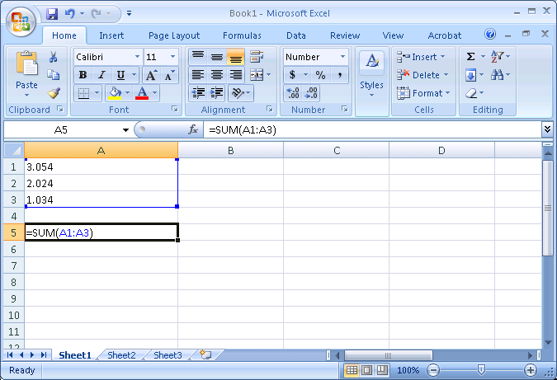
Formatting Example with Control / ~

Slide 37
What happened?
What happened is that the cells in column ‘A’ were formatted to show only 2 digits after the decimal point.
However, the numbers in column ‘A’ actually had more than 2 digits after the decimal point. The last digits were “hidden”.
Hiding some of the digits can yield results that appear to be wrong.

Slide 38
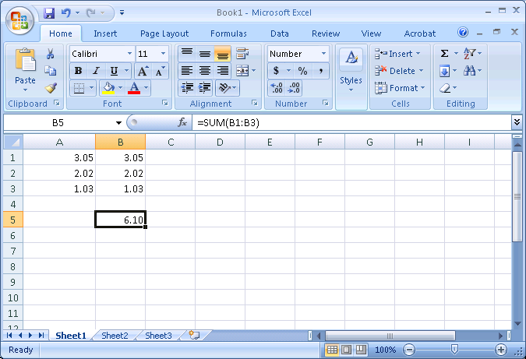
Rounding Example

Slide 39
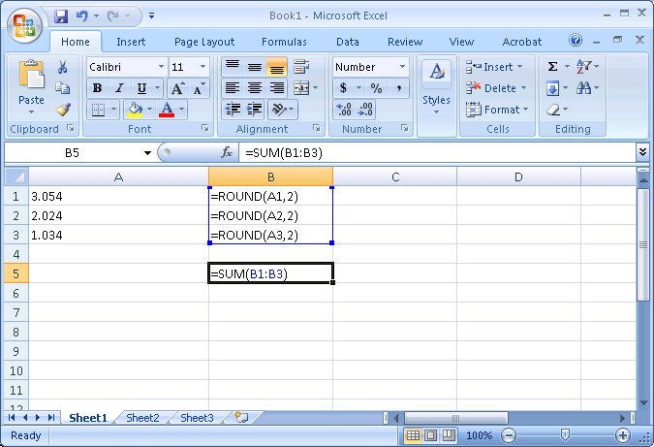
Rounding Example with Control / ~

Slide 40
Rounding Example
The addition in column ‘B’ is now mathematically correct.
The value that appears in cell B5 is in fact the sum of the numbers appearing in cells B1:B3

Slide 41
Warning!
The values displayed by a computer application are often not the values that are used inside that application.
If you need a value that has only a certain number of digits after the decimal place, you must round that value, not merely format it.
Excel: ROUND(Range, Decimal Places)

Slide 42
Bottom Line
If a computer’s arithmetic appears incorrect, it is may be a formatting / rounding error.
Excel: fix these errors with the ROUND function.

Slide 43
Hiding Columns or Rows
To make spreadsheets easier to read, you may wish to hide rows or columns that contain auxiliary (or supporting) values or temporary calculations.
Right-Click on the row or column header and select “Hide”.
Click here to watch demonstration…

Slide 44
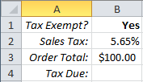
The IF Function
The IF function allows a cell to be filled with one of two possible values.
General form of IF:
  =IF(condition,value_if_true,value_if_false)
Example:
Cell B4 is either $0 if the customer is tax exempt or the tax due is the order total multiplied by the tax rate.
=IF(B1="Yes",0,B2*B3)

Slide 45
Taking a Closer Look at IF
Does cell B1 contain “Yes”?
If so, then cell B4 will be filled with the value 0
If not, then cell B4 will be filled with the result of the formula B2*B3
=IF(B1="Yes", 0, B2*B3)

Slide 46
A Closer Look at the Statement
true
=IF( B1="Yes", 0, B2*B3)
false

Slide 47
Examples1
IF practice
jys

Slide 48
How Does IF Work?
IF does not perform any calculation, it simply fills a cell with one of two values.
The values can be:
  literals (actual numbers or text), e.g., 0
  results of functions or formulas
  empty cells ("") are two double-quotes
  some cell reference, e.g., B2

Slide 49
The IF Condition
The IF condition is a logical expression, I.E. it evaluates to true or false.
Examples:
  equality (=)
  less than (<) or less than or equal (<=)
  greater than (>) or greater than or equal (>=)
Complex conditions can be built with the AND and OR functions.

Slide 50
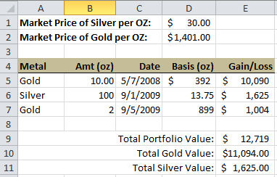
A Complete Spreadsheet Model
Spreadsheet to calculate the market value of a precious metals portfolio.
SUMIFS(sum_range, criteria_range1, criteria1)
=B5*(IF(A5="Gold",$D$2,$D$1)-D5)
=SUM(E5:E7)
=SUMIFS(E5:E7,A5:A7,"Gold")

Slide 51
SUMIFS
Adds the cells in a range that meet multiple criteria.
SUMIFS(sum_range, criteria_range1, criteria1, [criteria_range2, criteria2], ...)
The SUMIFS function syntax has the following :
  sum_range Required. One or more cells to sum, including numbers or names, ranges, or cell references that contain numbers. Blank and text values are ignored.
  criteria_range1 Required. The first range in which to evaluate the associated criteria.
  criteria1 Required. The criteria in the form of a number, expression, cell reference, or text that define which cells in the criteria_range1 argument will be added.
  criteria_range2, criteria2, … Optional. Additional ranges and their associated criteria.
jys

Slide 52
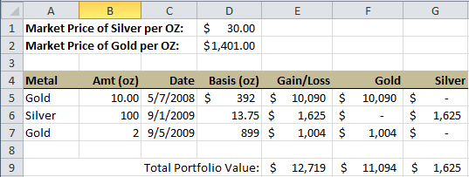
Filtering Data
An alternative way of summing data.
=IF($A5=F$4,$E5,0)
=SUM(F5:F7)

Slide 53
Examples1
portolio1
jys

Slide 54

AVERAGE
Returns the average (arithmetic mean) of the arguments.
AVERAGE(number1, [number2], ...)
The AVERAGE function syntax has the following arguments:
  Number1 Required. The first number, cell reference, or range for which you want the average.
  Number2, ... Optional. Additional numbers, cell references or ranges for which you want the average, up to a maximum of 255.
=AVERAGE(A1:A5)

Slide 55

COUNT
=COUNT(A1:A5)
The COUNT function counts the number of cells that contain numbers, and counts numbers within the list of arguments. Use the COUNT function to get the number of entries in a number field that is in a range or array of numbers.
COUNT(value1, [value2], ...)
The COUNT function syntax has the following arguments :
  value1 Required. The first item, cell reference, or range within which you want to count numbers.
  value2, ... Optional. Up to 255 additional items, cell references, or ranges within which you want to count numbers.
Note The arguments can contain or refer to a variety of different types of data, but only numbers are counted.

Slide 56

STDEV.S
=STDEV.S(A1:A5)
Estimates standard deviation based on a sample (ignores logical values and text in the sample).
The standard deviation is a measure of how widely values are dispersed from the average value (the mean).
STDEV.S(number1,[number2],...])
The STDEV.S function syntax has the following :
  Number1 Required. The first number argument corresponding to a sample of a population. You can also use a single array or a reference to an array instead of arguments separated by commas.
  Number2, ... Optional. Number arguments 2 to 254 corresponding to a sample of a population. You can also use a single array or a reference to an array instead of arguments separated by commas.

Slide 57
COUNTIF
COUNTIF allows you to display the number of cells in a range whose values meets specific criteria.
The syntax of the COUNTIF function is: COUNTIF(range,criteria) … where range is a group of cells, and criteria is the value a cell must have to be counted.
The default operator for criteria is "equals" and should not be specified.
Operators ( >, <, >=, <=, <> and =) must be enclosed in quotation marks and <> means "not equal”.

Slide 58
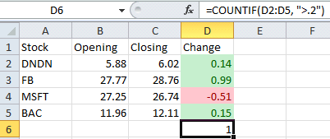
COUNTIF
Example:

Slide 59
Flexible Models
Excel Basics

Slide 60
Assume Data May Change!
It is best practice to write your spreadsheets in such a way that they give correct results for given data, regardless of what that data might be, and not merely the correct results for a particular data set.
If the data changes, the answer should be correct for the new data set.

Slide 61
Don’t Duplicate Data!
Since the given data for a problem may change, this data should appear as given data in one place only.
If data given for a problem is repeated in many places, then changing that data will require changes in many places.
  This can be a source of errors as well as a source of unnecessary work.

Slide 62
Building Flexible Models
Don’t use actual numbers of text in your formulas and functions, i.e., don’t “hard code” values.
To keep your model general and flexible when data change, use only cell references.

Slide 63
Inductively Defined Problems
An inductively defined problem has 2 parts:
  A set of starting conditions
  A set of rules that describe how data changes from one step to the next.

Slide 64
Inductively Defined Problems
This is the starting condition
Example:
  You deposit $1000 in a savings account
  At the end of each year, you receive 4% interest on the balance in your account.
This rule describes how data changes from one step to the next

Slide 67
Inductively Defined Problems
The parameters of our problem appear separately from the calculations that model our problem (columns A and B).
There is a special year 0 in our solution that serves as a place holder for our starting condition.
The formulas for the data for each year other than year 0 are similar, differing only in the cells that they reference.

