Slide 2
Leena Razzaq
Office: 310BWVH
Email: lrazzaq@ccs.neu.edu
Office hours: Monday 11am-1pm or by appointment
jys

Slide 6
Course Web Site
http://www.ccs.neu.edu/course/cs1100su14
  Also linked from Blackboard
Course Materials
  Excel Tutorials
  Access Tutorials
  PPT Slides
Blackboard:
  Submit Labs, Quizzes, Tests
  Grades

Slide 7
Communication
Communication through Blackboard’s email feature
  Be sure your Blackboard email address is correct and that you check it often
Piazza Discussion Group
  Anonymous posts are fine.

Slide 8
Grading & Assessment
Assessment | Grade %
Excel Quiz | 10%
Excel Test | 25%
Access Quiz | 10%
Access Test | 25%
Lecture Quizzes | 5%
Excel Part of Final (optional) | Average with Excel Test
Access Part of Final (optional) | Average with Access Test
Excel Labs (5) | 12.5%
Access Labs (5) | 12.5%
Lab 0 | Mandatory, but 0%
A better test grade replaces a lower quiz grade.
jys

Slide 9
Course Format
There are four class sessions per week, all held in the computer lab, WVH 210.
Class sessions alternate between lecture/discussion of the material, and time to work on lab assignments.
Lectures will end with a very short quiz. Lecture quizzes are worth 5% of your final grade.
Attendance in lab sections is optional if all lab assignments due to that point have been submitted.
  I.E. You may leave (quietly, please) when you are done.
  You may miss additional explanation/clarification of previously discussed material, but never new material.

Slide 10
Lab Assignments
Labs are intended to reinforce and deepen your study of the covered material
You are expected to not only study the provided resources, but investigate additional resources
Labs are to be completed individually
Late submissions are subject to penalties

Slide 11
Late Submissions
20 percentage points will be deducted per late day from assignments which are submitted after the due date.
The only exception is a valid medical excuse accompanied by a physician's note.

Slide 12


Slide 13
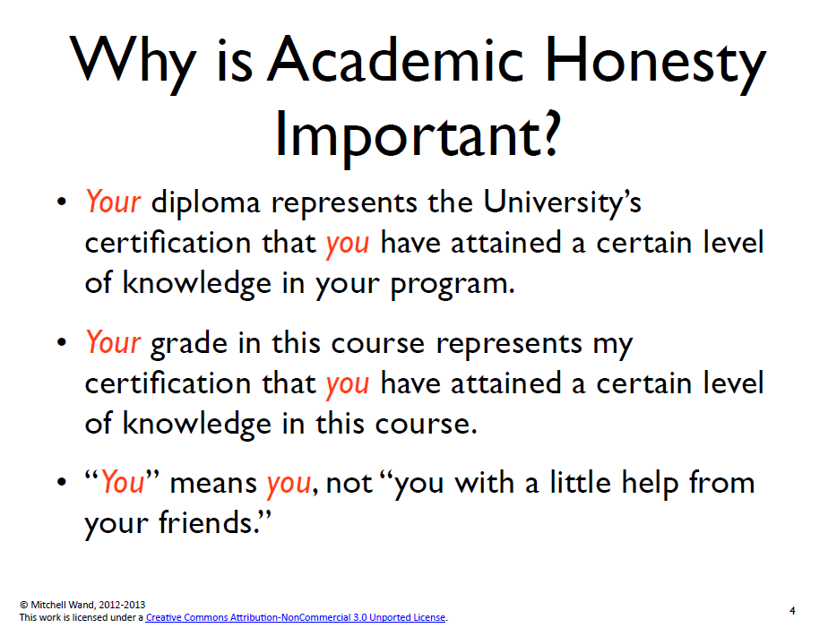

Slide 14
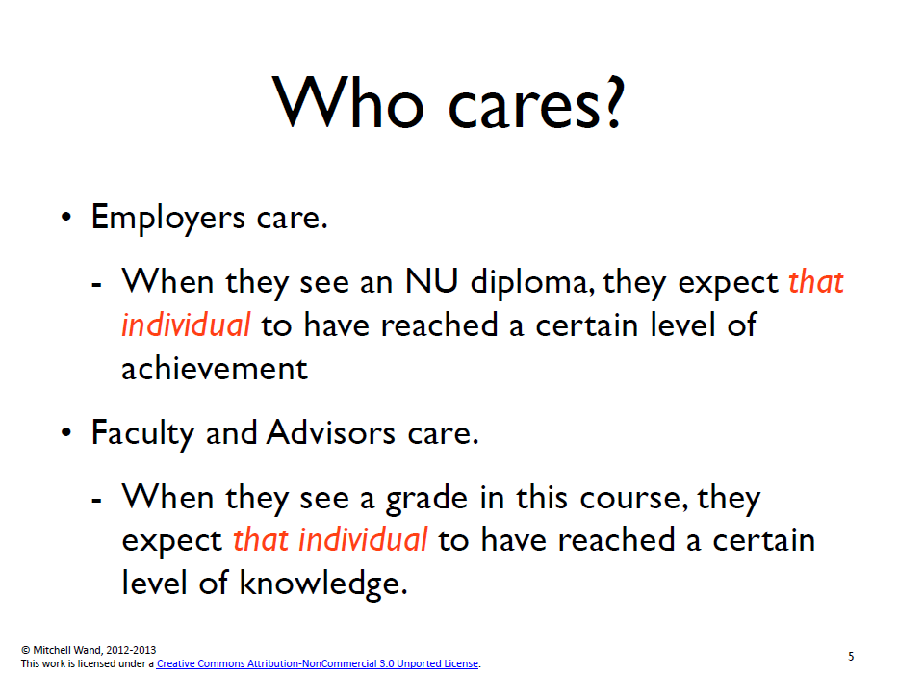

Slide 15
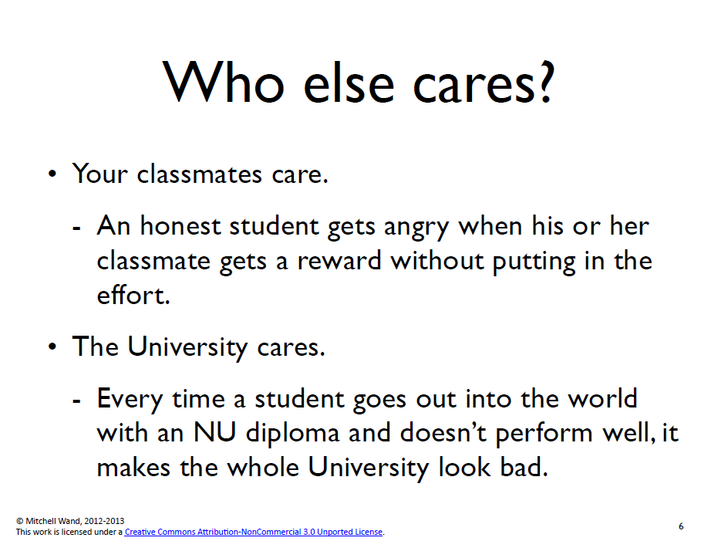

Slide 16
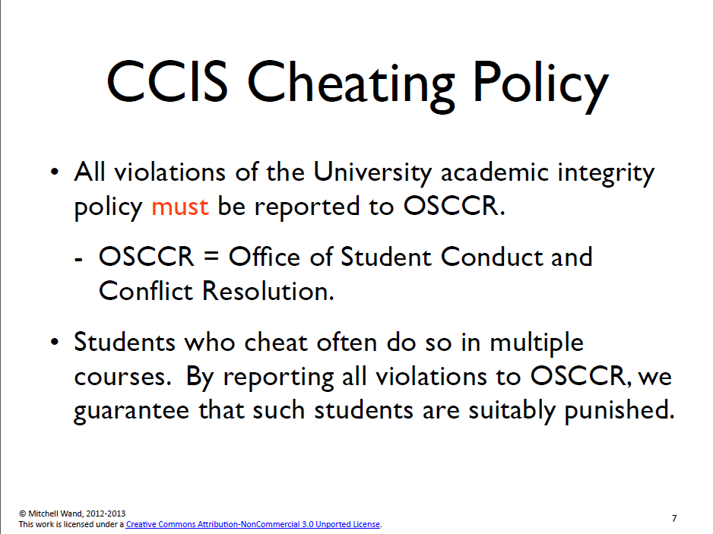

Slide 17
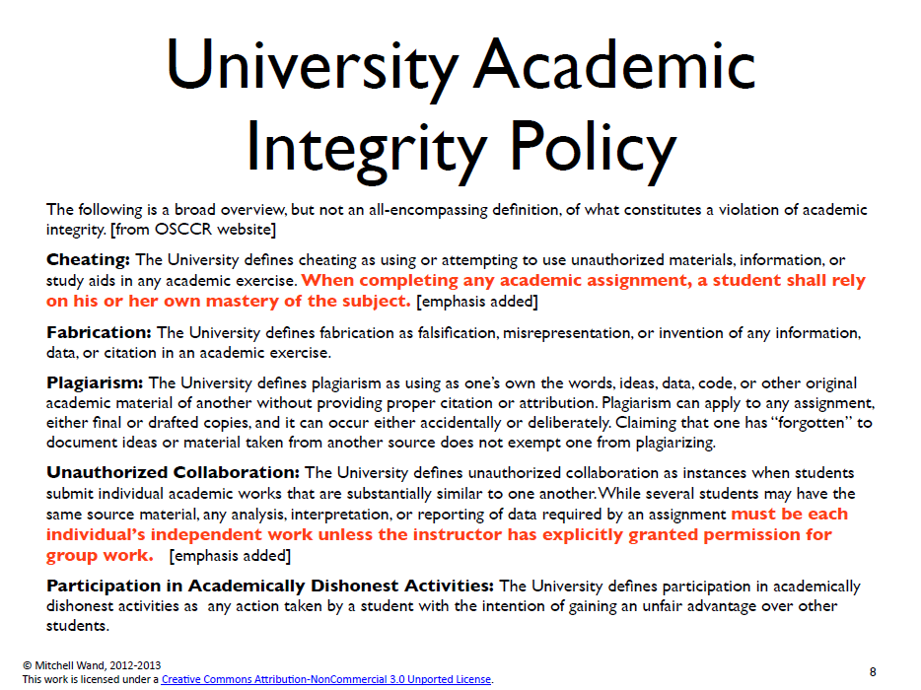

Slide 18
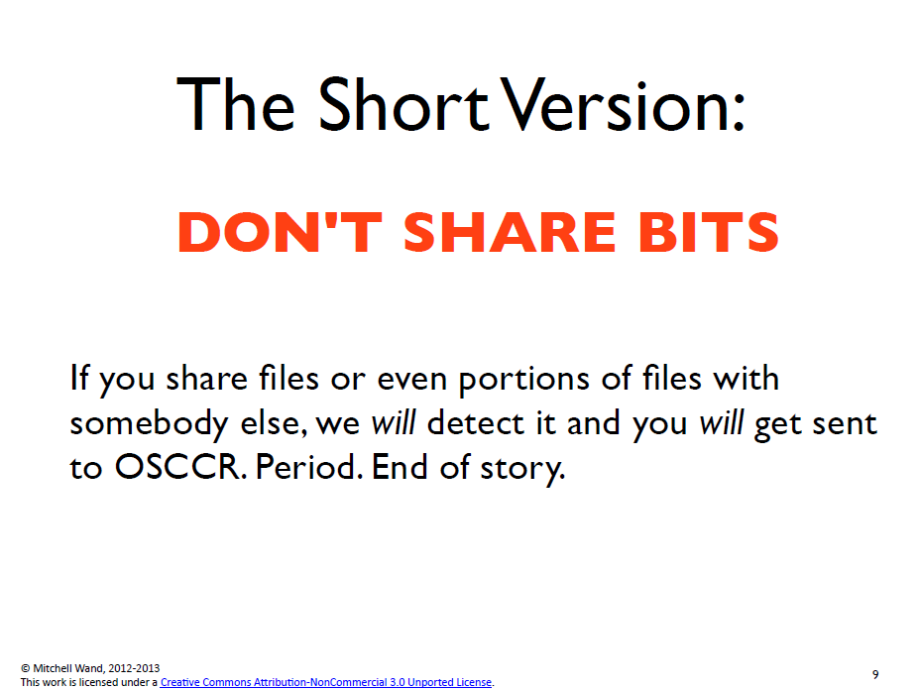

Slide 19
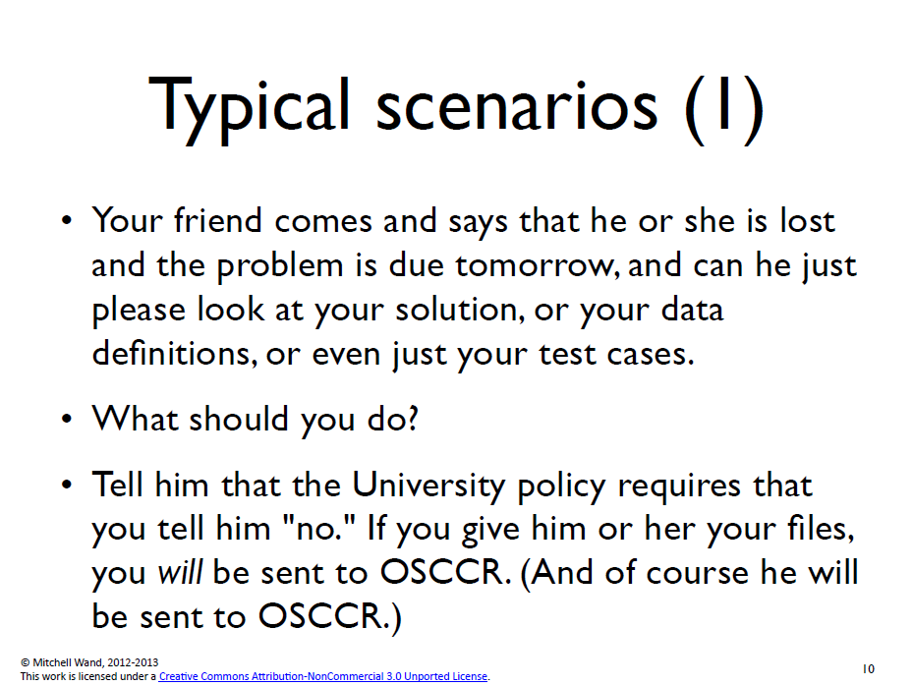

Slide 20
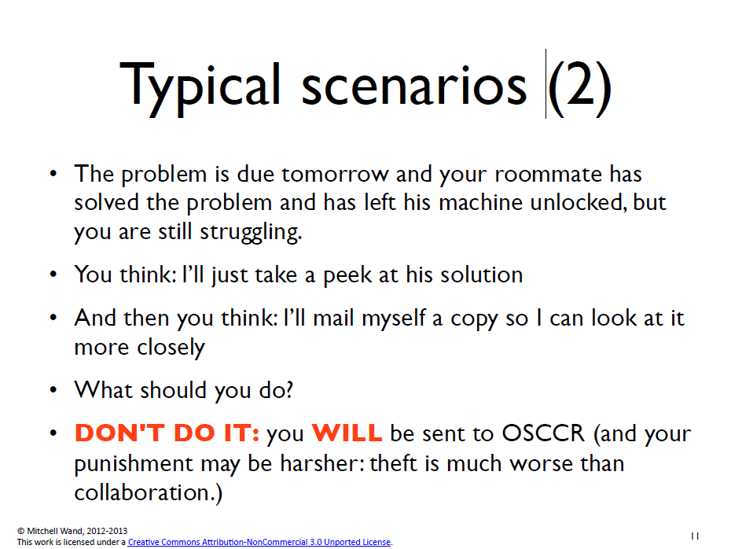

Slide 21
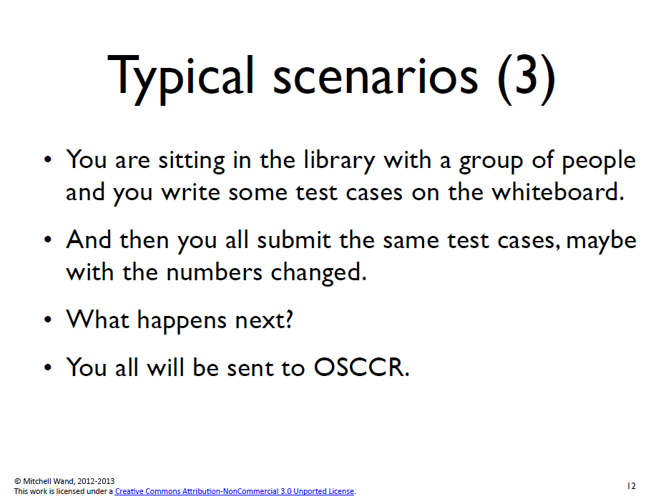

Slide 22
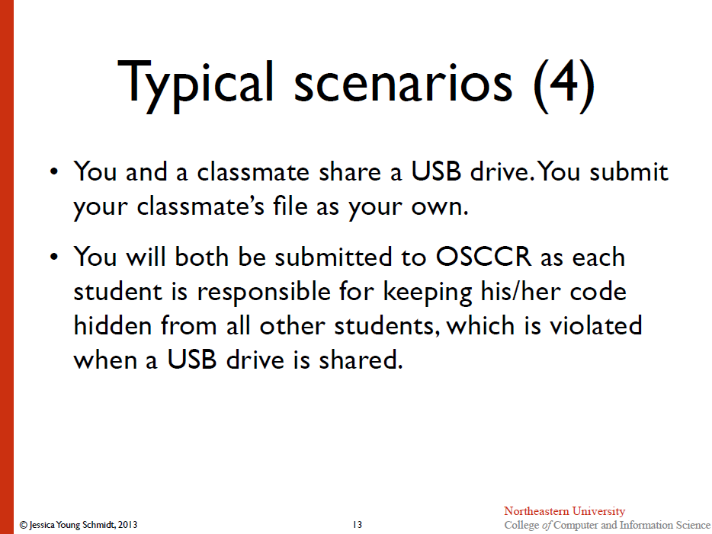

Slide 23
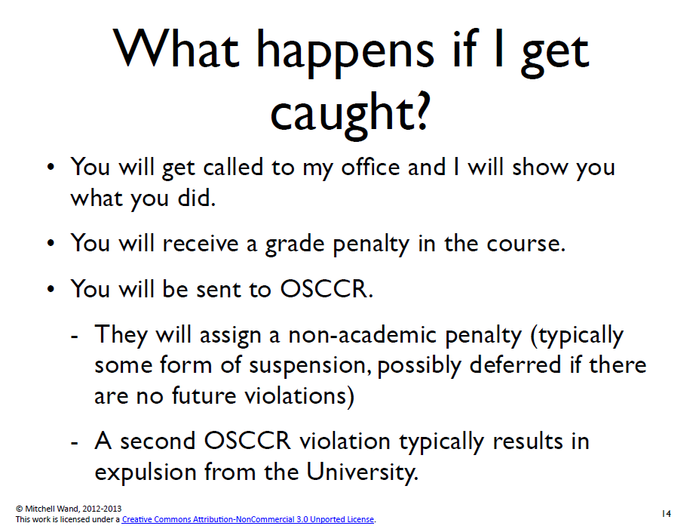

Slide 24
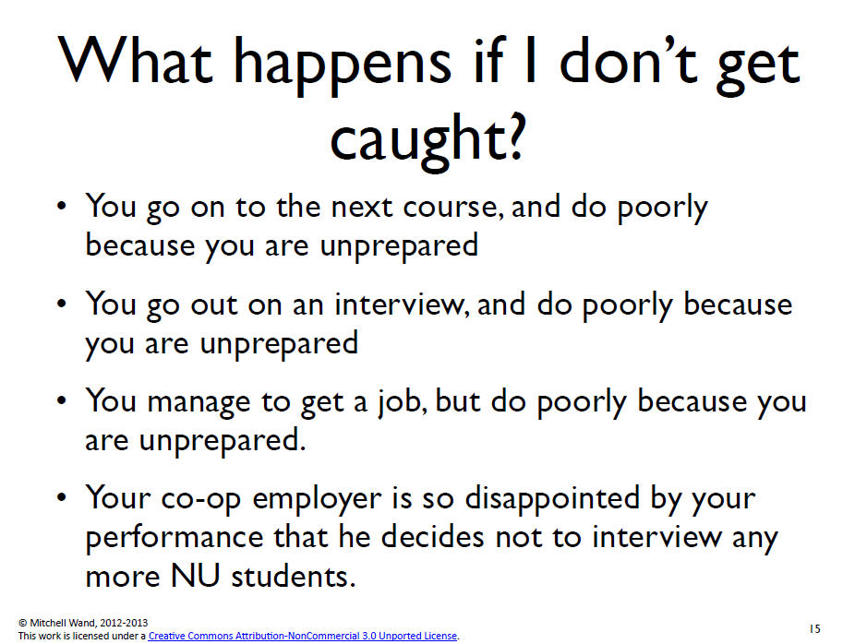

Slide 25
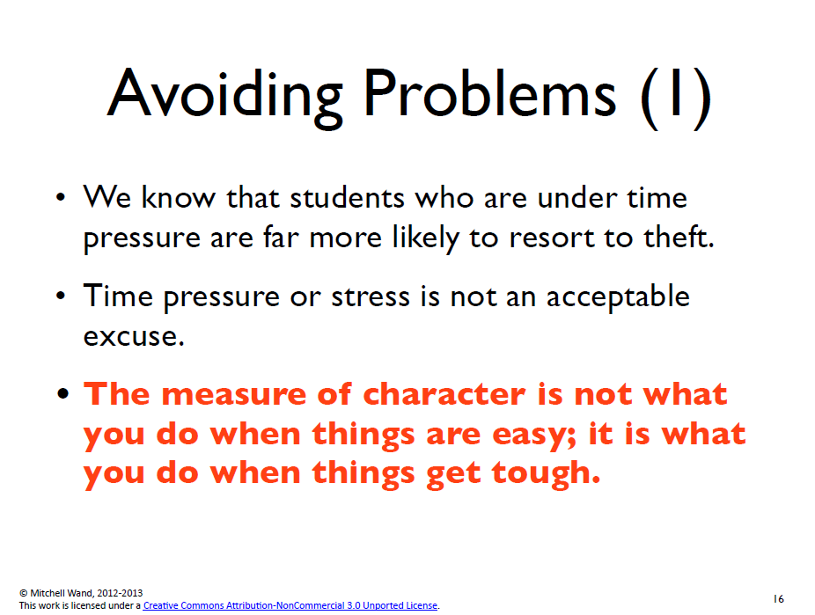

Slide 26
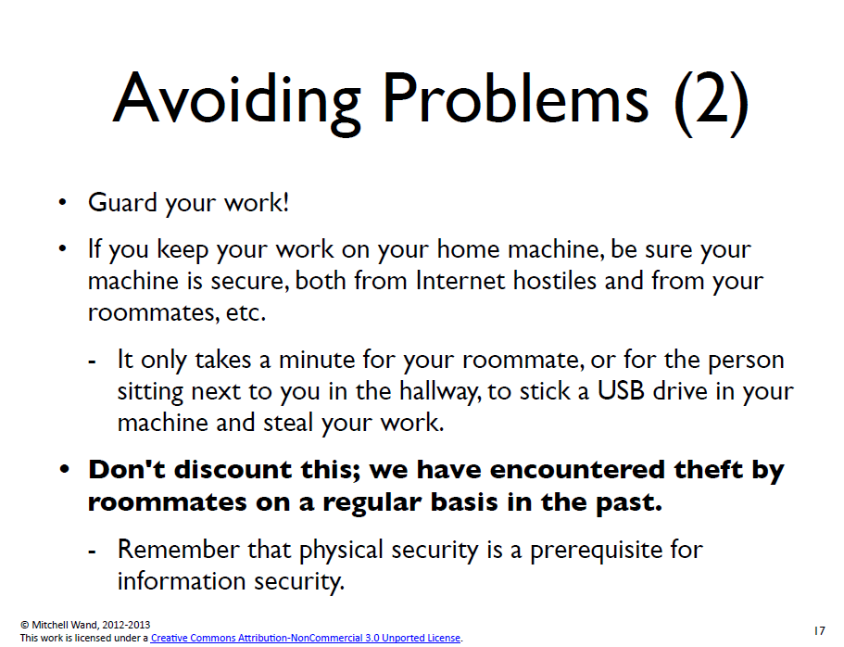

Slide 27
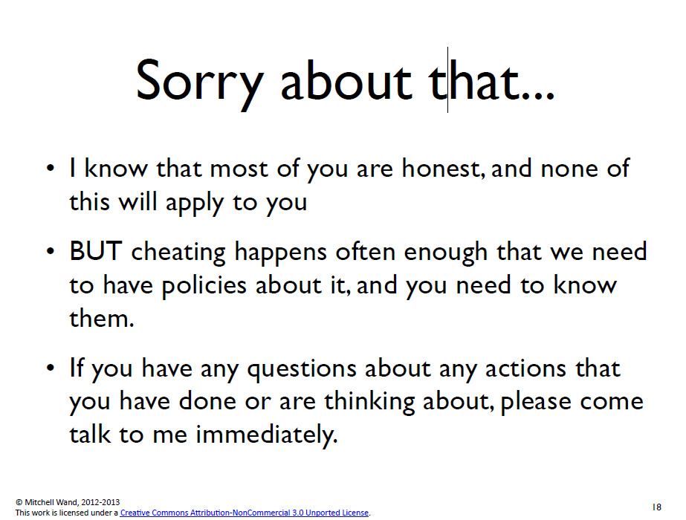

Slide 28
General Principles
Assume Your Data May Change!
  It is best practice when creating spreadsheets or writing database queries to assume that the given data for a problem might change.

Slide 29
General Principles
Don’t Duplicate Given Data!
  Since the given data for a problem may change, this data should appear in one place only.
  If data given for a problem is repeated in many places, then changing that data will require changes in many places.
    This can be a source of errors as well as a source of unnecessary work.

Slide 30
General Principles
Ask the Right Question!
  Make sure your formulas will not only work for this data set, but they will work for ANY data set.
  If the data changes, the answer should be correct for the new data set.

Slide 31
A Trivial Example
Here is a simple problem to illustrate the concept of “Ask the Right Question”
  You are asked to find the sum of the following numbers: 2, 5, 7, 8

Slide 33
What’s wrong?
Cell A6 has the correct answer, i.e. 22
However, notice the formula box contains the number 22.
This means that the answer 22 is “hard-coded” in the selected cell. (Hard-coding a correct answer is worth fewer points than a formula that gives an incorrect answer.)
If one of the given data cells changed, say A1 was changed from 2 to 3, then the spreadsheet would look like this:
jys

Slide 35
The spreadsheet now appears to say that the sum of 3, 5, 7 and 8 is 22
This is the wrong answer, but the error is not obvious without careful inspection.
jys

Slide 37
What’s wrong?
In this example, cell A6 again shows the correct answer.
Also the formula box shows that A6 contains a formula for the answer, and not the number 22 itself
However, the formula in cell A6 repeats the data that appears in cells A1 – A4
If the value in cell A1 were changed to 3, then the sum would again be incorrect
jys

Slide 39
What’s wrong?
In this example:
  Cell A6 shows the correct value
  Cell A6 has a formula not a hard-coded value
  The formula does not repeat any data
But:
  The formula does not solve the problem of finding the sum of the cells A1 – A4, and only accidentally gives the right answer
jys

Slide 41
The Fix
Notice that the formula box now contains a formula for calculating the sum
The SUM function adds all the numbers that you specify as arguments.
If one of the cells containing given data changes, the cell containing the answer will change appropriately.
jys

Slide 42
General Principle
Decompose Complex Problems!

Slide 46
Comparison
The Monolithic solution calculates the monthly balance with one complex formula
The Solution with intermediate results, performs the same calculation by breaking up the complex formula into three simpler formulas.

Slide 47
Dividing the solution into smaller parts has advantages
It is easier to catch mistakes
  There are more results that can be checked
It is easier to verify correctness
  Verification can be done step by step
It is easier to reuse the parts
  Say you are asked to find the total amount paid for the loan, it would be easier to make the necessary changes

Slide 48
Syllabus Quiz
All students must take the syllabus quiz and earn a score of 100% in order to pass the course. The syllabus quiz does not count towards a student's grade. The quiz can be taken as often as needed to pass with a score of 100%. The quiz is administered through Blackboard.
You must have 100% on the syllabus quiz by Monday.
jys

