Slide 1

CS1100: Access Reports
A (Very) Short Tutorial on Microsoft Access Report Construction
Created By Martin Schedlbauer
With contributions from Matthew Ekstrand-Abueg

Slide 2
Reports
Reports are formatted output of the results of queries.
Access has two ways to create reports:
Custom Reports
Report Wizard
In both cases, you need a query that contains the information you want to put into the report.

Slide 3
The Orders Database
The database contains data for orders placed by customers.
For each order we collect what was ordered, how much of that item was ordered, and at what price.
For each order we track who placed that order.
For each customer (called a contact) we store where they live.
For each product that we sell we track the product’s description and price.

Slide 4
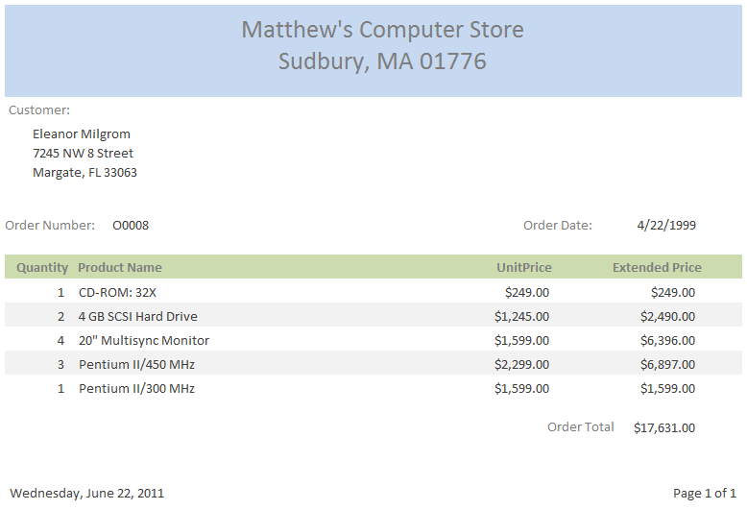
The OrderInvoice Report

Slide 5
Parameterized Query
Allows user to input a specific value for a query.
E.g. ask user what name, zip code, product, etc. they would like information about.
In the criteria field, set an attribute that does not exist in any joined tables.

Slide 6
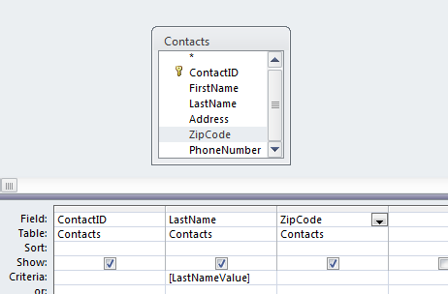
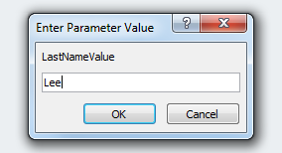

Parameterized Query
In the criteria field, set an attribute that does not exist in any joined tables.

Slide 7
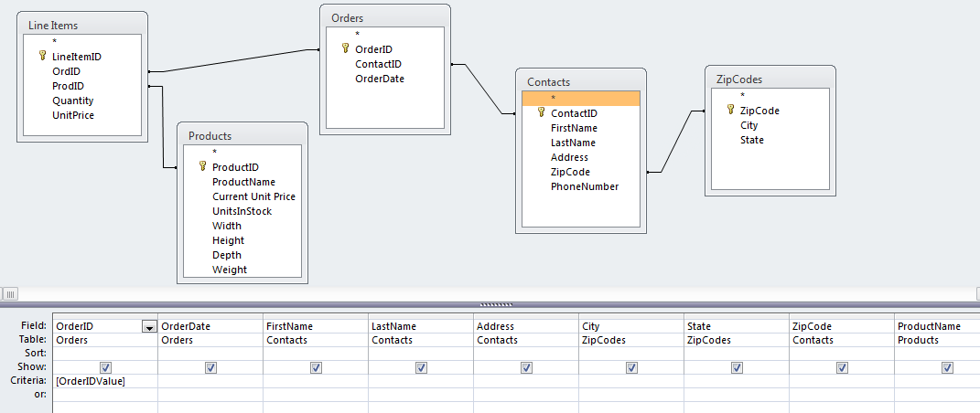
The Query for the Report
What fields do we need for this report?

Slide 8
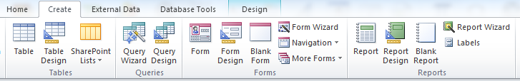
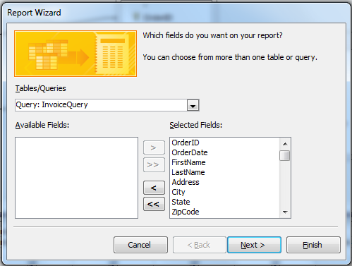
Report Wizard

Slide 9
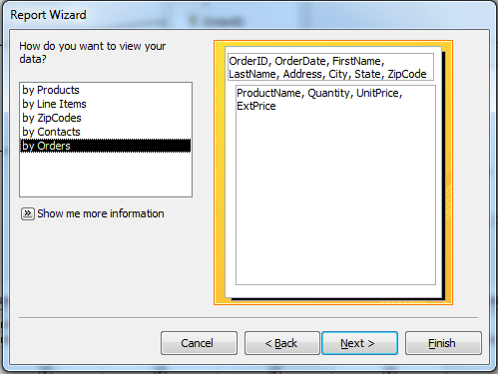
Grouping Data in Reports

Slide 10
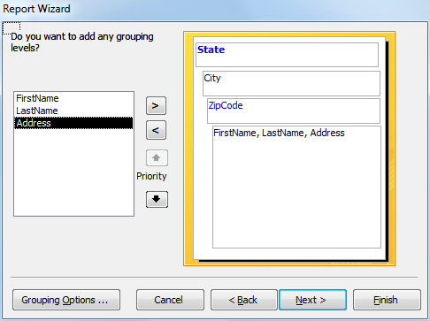
Grouping Levels
IGNORE

Slide 11
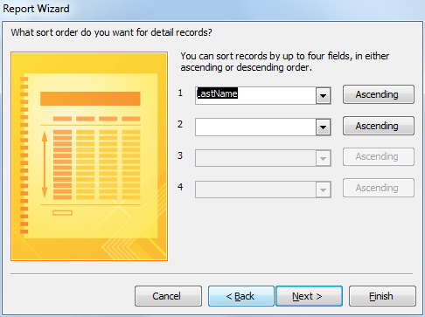
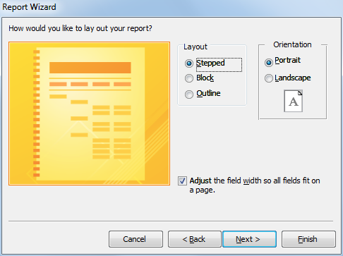
Sorting and Layout

Slide 12
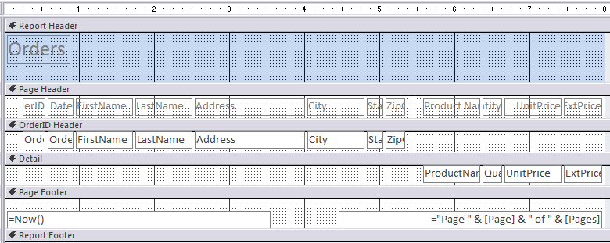
Report Design

Slide 13
Report Design
Headers and footers are for data/labels that describe the section (e.g. Order ID for the header, and Order Total for the footer)

Slide 14
Report Design
The Detail section is repeated for each item in the query (e.g. Line Item information)

Slide 15


Text vs. Controls
Note that there are two icons for adding “text” – they are NOT the same:
The Text Box allows you to add a field from the query; must be bound to a field
The Label allows you to add free-form text

Slide 16

Rearranging the Report
Move items to where you want them.
Each item is a field plus a label.
Fields can contain “expressions”:
Create a new text box for each expression, do not reuse an existing one (will cause errors)

Slide 17
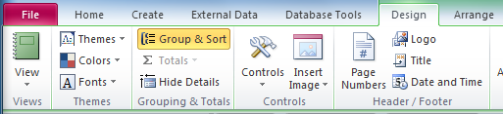
Adding a Footer
In Design View, under the Design Tab, click Group & Sort
Group & Sort

Slide 18

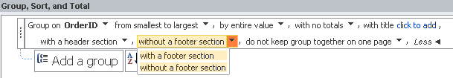
Adding a Footer
Select More to display OrderID settings:
Select the dropdown to add a footer:
More
Add a footer

Slide 19

Aggregating Over Details
Now that you have added a footer to the group (OrderID) you can aggregate over the details of the group (Line Items).
Use aggregate functions (things available in the Total field of query design view) in Text Box expressions.

Slide 20
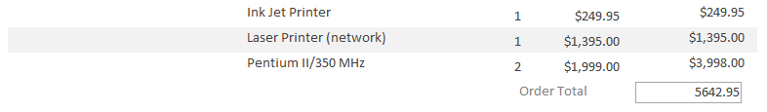
Aggregating Over Details
Now that you have added a footer to the group (OrderID) you can aggregate over the details of the group (Line Items).
Use aggregate functions (things available in the Total field of query design view) in Text Box expressions.

Slide 21
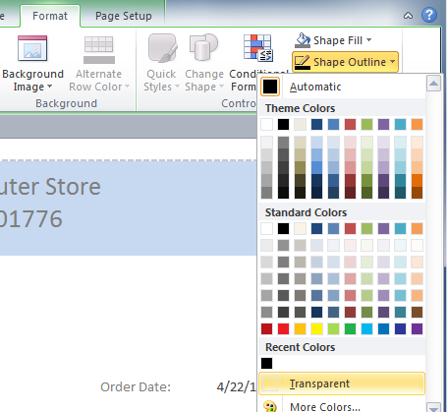
Fixing Label Borders
In the Layout View, click the label with the border
Then go to Format, Shape Outline, and check Transparent

Slide 22
Changing Colors
In Design View, click on the field or area, then go to the Format tab, and click the paint bucket to choose a color.

Slide 23
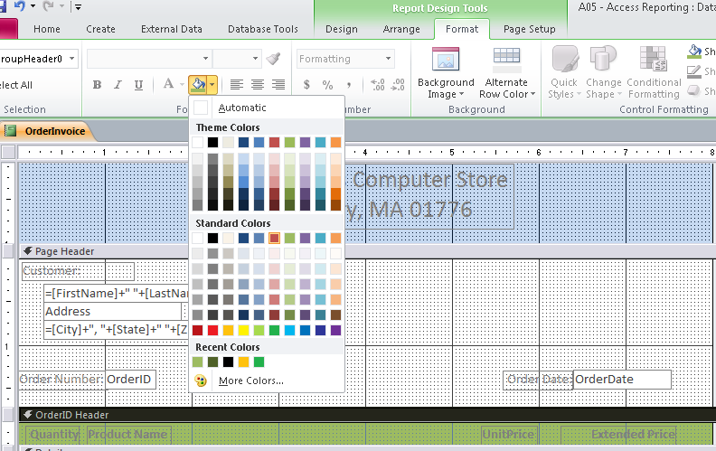
Changing Colors
2. Select a color
1. Click in the area

Slide 24
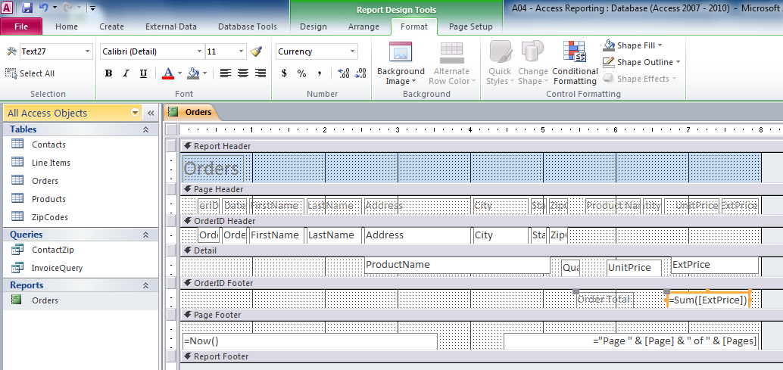
Formatting Values
In Design View, click on the field or area, then go to the Format tab. There is the same formatting pane that there was in Excel.

Slide 25
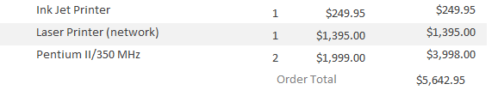
Formatting Values
In Design View, click on the field or area, then go to the Format tab. There is the same formatting pane that there was in Excel.

Slide 26
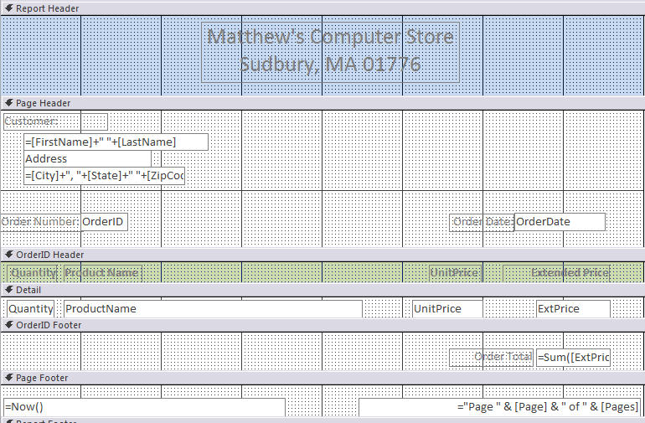
The OrderInvoice Report

Slide 27
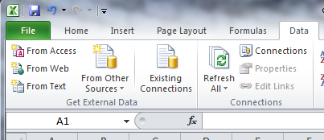
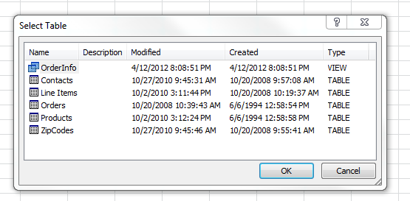
Create a Pivot Table from an Access Table
From the Data Menu, choose “From Access”
Find your Access file and choose the table or query to use in your pivot table.

Slide 28
Summary
Queries can have parameters.
Reports allow information technology professionals to provide data in a more readable format to users.
The Access Wizard creates reports based on queries.
The Report Designer allows reports to be designed using simple “drag-and-drop”.

Slide 29
Try for yourself…
Access Reports

