Slide 1
Creating Complex Queries with Nested queries
CS1100: Data, Databases, and Queries

Slide 2
Nested Queries
Some complex queries must be based on the results of other queries.
The result of a query is a virtual table, i.e., something that looks and can be used like a table, but is not actually stored in the database as a table.
A query can be used (as a table is used) in the design of a query.

Slide 3
Subqueries
A subquery is a query statement that’s nested inside of another query
Sometimes need to use the results of a query as a field in another query, or as a criterion for a query field. Example:
How many orders have a total under $2,000?
To find the answer, first need to calculate order totals and filter out those that are $2,000 and over. Then do a count.

Slide 4
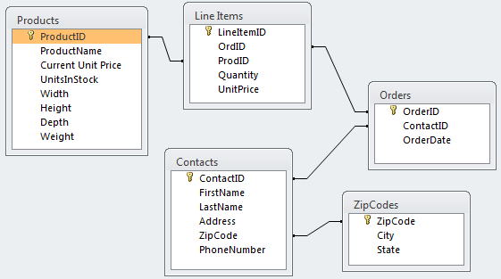
The Database Layout
These are all of the tables in the database:

Slide 5
Where Does The Data Come From?
Orders.OrderID
Order | O0001
Customer Contact
Contact ID: | C0004
Name: | Colon, Nicholas
Address: | 9020 N.W. 75 Street
 | Coral Springs, FL 33065
Order Date: | 4/15/1999
Product ID | Product Name | Quantity | UnitPrice | ExtendedPrice
P0013 | DVD Disks | 1 | $ 23.00 | $ 23.00
P0014 | HD Floppy Disks | 4 | $ 9.99 | $ 39.96
P0027 | Norton Anti-Virus | 1 | $ 115.95 | $ 115.95
 |  | Order Total: |  | $ 178.91
Contacts
ZipCodes
ExtendedPrice =
Quantity * UnitPrice
Orders.OrderDate
LineItems
Total Order Amount

Slide 6
Example:
How many orders were placed that had a total of less than $2000?

Slide 7
Step One: Find a total for each order
What is the total for each order?

Slide 8
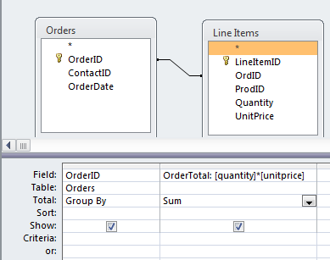
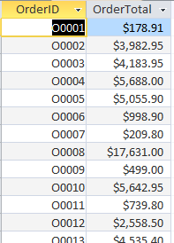
What is the total for each order?

Slide 9
Filter the order totals
Which orders are for less than $2,000?

Slide 10
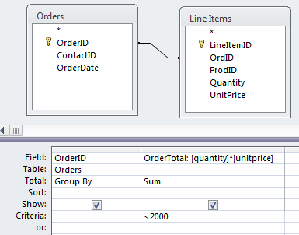
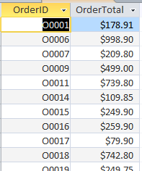
Which orders are for less than $2,000?

Slide 11
Step Two: Use the previous query as a subquery
How many of these orders (orders less than $2,000) are there?

Slide 12
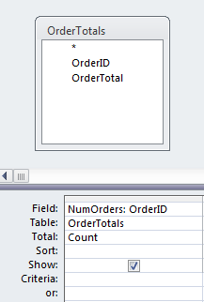

How many of these orders (orders less than $2,000) are there?
This requires that we build a new query with the previous query as a subquery

Slide 13
Query
Who placed these orders less than $2,000?

Slide 14
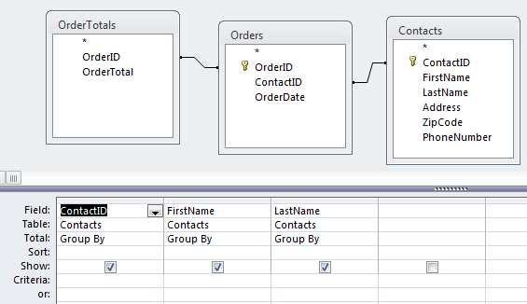
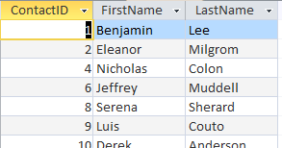
Query
Who placed these orders less than $2,000?
Use OrdersTotal again as a subquery
Combine with Orders and Contacts to get customer information
Use Group By to remove duplicates
There are 15 contacts in total

Slide 15
Watch Out: Access Caches Queries
Whenever Access executes a query it saves (“caches”) the result.
When that query is used as a subquery, Access uses the cached result instead of running it again.
If you then update the subquery, Access does not automatically refresh the result for the query that uses the subquery.

Slide 16
Refreshing Queries
To refresh all queries, you need to:
Close all queries
Click the right mouse button on the query tab and select “Close”
Load the query again
double-click on the query in the navigator
This forces a refresh.

Slide 17
Step by Step
How many orders are there that have a total value of less than $1000?
Create a query that finds all orders with a value less than $1000
Save the query under an appropriate name
Create another query based on the previous query that COUNTs all of the rows
CAUTION: Do not modify or rename queries that are used as subqueries.

Slide 18
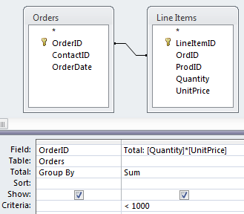
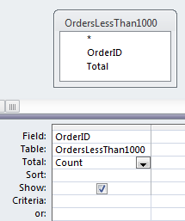

Example: Subquery
Subquery: OrdersLessThan1000
Note the use of the subquery and the aggregate COUNT function
So there are 21 orders with a total less than $1000

Slide 19
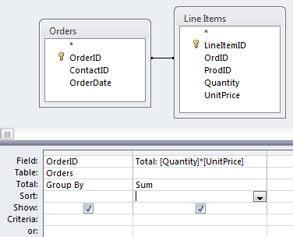
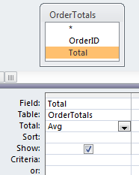

Example: AVG
What is the average cost of all orders?
Note the use of the subquery and the aggregate AVG function
Subquery: OrderTotals

Slide 20
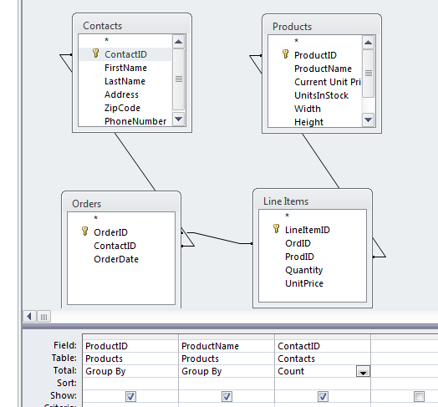
Example
How many different people bought each product?
Attempted query

Slide 21

Example: Counting Unique Occurrences
How many different people bought each product?
Attempted query
Count of Contact IDs

Slide 22
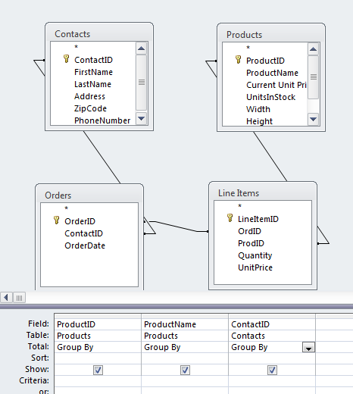

But
Grouping by Contact IDs shows 2 different contacts ordered Product #8

Slide 23
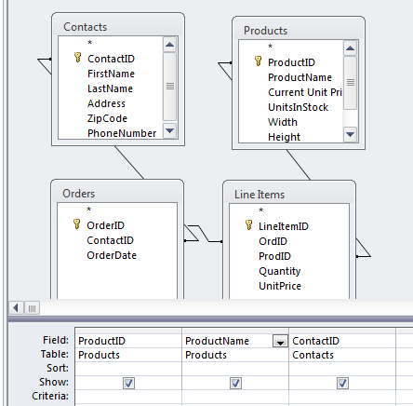
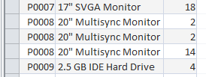
Why?
Let’s remove the Total field and Ungroup.

Slide 24
Why?
Let’s remove the total field.
Someone ordered it twice
We have duplicates
Group by removes duplicates but doesn’t count.
Count aggregates but doesn’t remove duplicates.
So what do we do?

Slide 25
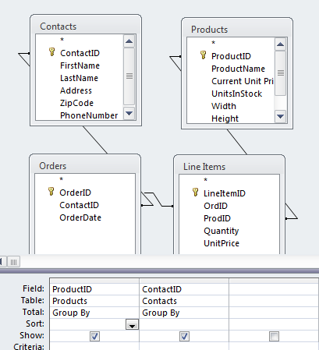
Solution
Use subquery to perform grouping
ProductContactNoDups

Slide 26
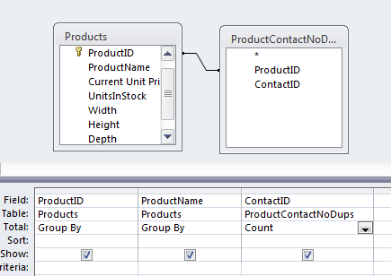

Solution
Use subquery to perform grouping, then count

Slide 27
Try for yourself…
Access Queries

Slide 28
Question 1
Which contacts placed three or more orders?

Slide 29
Question 2
How many contacts placed three or more orders?

Slide 30
Question 3
Which states had contacts that placed 3 or more orders?

Slide 31
Maximum and Minimum
What is the maximum amount of any order that was ever placed?
What is the minimum amount of any order that was ever placed?
Which order was the minimum order?
Who placed the minimum (smallest) order?

Slide 32
Query
What is the maximum amount of any order that was ever placed?

Slide 33
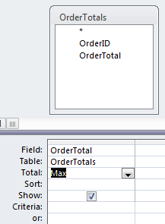

Query
What is the maximum amount of the any order that was ever placed?
Use OrdersTotal again as a subquery
Apply the MAX aggregate function

Slide 34
Query
What is the minimum amount of any order that was ever placed?

Slide 35
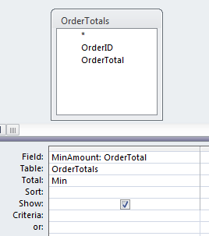

Query
What is the minimum amount of any order that was ever placed?
Use OrdersTotal again as a subquery
Apply the MIN aggregate function

Slide 36
Query
Which order was the minimum order?

Slide 37
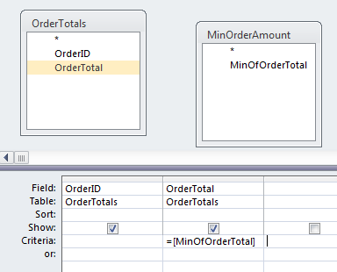
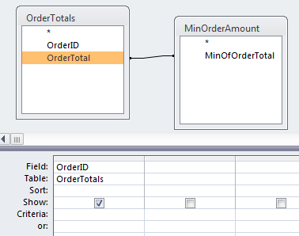
Query
Which order was the minimum order?
Requires the previous query and OrdersTotal as subqueries
Can use one of two approaches
Approach 1: Use Criteria
Approach 2: Create Relationship

Slide 38
Query
Who placed the smallest order?

Slide 39
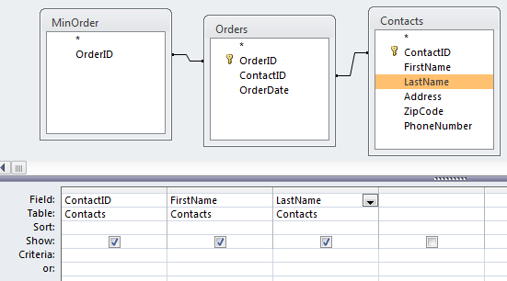

Query
Who placed the smallest order?
Use previous query as subquery
Combine with Orders and Contacts table

Slide 40
Try this:
Which orders contained a line item for the least expensive product (based on CurrentUnitPrice)?
Who ordered the least expensive product?

Slide 41
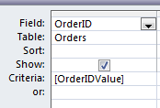
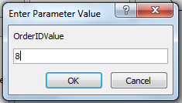
Parameterized Query
To allow user input for a query value:
specify a variable that has a name different from any of the field names

Slide 42
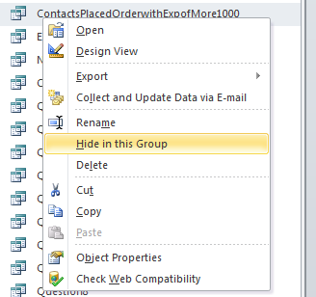
Hiding Subqueries
Queries (and tables) can be “hidden”:
Right-click on query in navigation panel
Select “Hide in this Group”

Slide 43
Unhiding Queries
Click anywhere in the Query Explorer
Select “Navigation Options…”
Check “Show Hidden Objects”
Now all hidden queries are visible and can be unhidden.

Slide 44
Summary
Group By removes duplicate rows where the Group By values are the same
Aggregate functions apply to groups or entire tables depending how they are used
Subqueries are necessary to build complex queries

