Slide 1

Query Construction
CS1100: Data, Databases, and Queries

Slide 2
Layout of the Orders Database
Microsoft Access Tutorial: Data, Databases, and Queries

Slide 3
The Orders Database
We will be using a database that contains data for orders placed by customers for our examples.
This database stores the following information:
  For each order know what was ordered, how much of that item was ordered, and at what price.
  For each order know who placed that order.
  For each customer (called a contact) store where they live.
  For each product track its description and price.

Slide 4
A Sample Order
Order | O0001
Customer Contact
Contact ID: | C0004
Name: | Colon, Nicholas
Address: | 9020 N.W. 75 Street
 | Coral Springs, FL 33065
Order Date: | 4/15/1999
Product ID | Product Name | Quantity | UnitPrice | ExtendedPrice
P0013 | DVD Disks | 1 | $ 23.00 | $ 23.00
P0014 | HD Floppy Disks | 4 | $ 9.99 | $ 39.96
P0027 | Norton Anti-Virus | 1 | $ 115.95 | $ 115.95
 |  | Order Total: |  | $ 178.91

Slide 5
Tables, Rows, and Identifiers
Microsoft Access is a relational database which means that it stores data in tables
Each table contains rows; one row for each record, i.e., a contact, order, product, etc.
Each row in a table has a unique identifier, e.g., OrderID, ProductID, ContactID, etc.

Slide 6
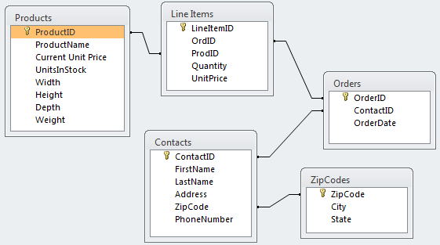
The Database Layout
These are all of the tables in the database:

Slide 7
Where Does The Data Come From?
Orders.OrderID
Order | O0001
Customer Contact
Contact ID: | C0004
Name: | Colon, Nicholas
Address: | 9020 N.W. 75 Street
 | Coral Springs, FL 33065
Order Date: | 4/15/1999
Product ID | Product Name | Quantity | UnitPrice | ExtendedPrice
P0013 | DVD Disks | 1 | $ 23.00 | $ 23.00
P0014 | HD Floppy Disks | 4 | $ 9.99 | $ 39.96
P0027 | Norton Anti-Virus | 1 | $ 115.95 | $ 115.95
 |  | Order Total: |  | $ 178.91
Contacts
ZipCodes
ExtendedPrice =
Quantity * UnitPrice
Orders.OrderDate
LineItems
Total Order Amount

Slide 8
Retrieving Data with Queries
Microsoft Access Tutorial: Data, Databases, and Queries

Slide 9
Queries
Data is retrieved through queries.
Queries are formulated in a specialized language called SQL (pronounced SEQUEL).
Microsoft Access makes it easy to create SQL queries through a simple drag-and-drop interface called the Query Builder.
Queries are eventually integrated into reports, forms, programs, or executed by themselves.

Slide 10
Queries on Tables
Queries retrieve data from one or more tables.
You can specify which
  rows to include in the result through filters (WHERE clause in SQL terminology)
  columns to include in the results
The result of a query is a table that can be used in other queries (as subqueries).

Slide 11
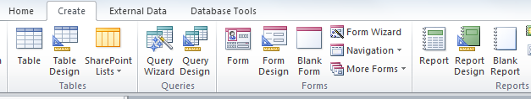
Creating Queries in Access
To create a query:
  Select the Create tab
  Pick Query Design
  Select the tables to include in the query or simply close the dialog and drag the needed tables into the query designer

Slide 12


Running a Query
To run a query, click on:
To return to the query design, click on:

Slide 13
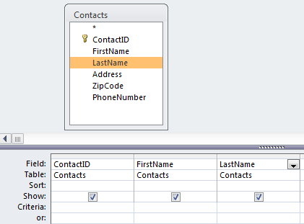
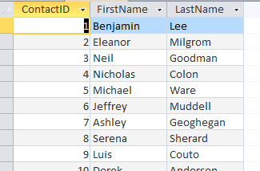
Example: Simple Query
Find the contact id, first name, and last name for each contact.

Slide 14

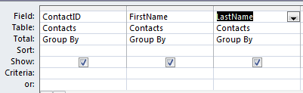
Removing Duplicates
Queries often result in duplicate rows.
These are removed by “grouping rows” with the same value as a single row.
To do a Group By, follow these steps:
  Select the function button in the ribbon
  Select “Group By” for each field

Slide 15
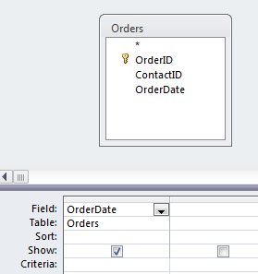
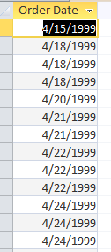
Example: Group By
Find the dates on which orders were placed.
Here’s the result without a Group By:
Note the duplicate rows

Slide 16
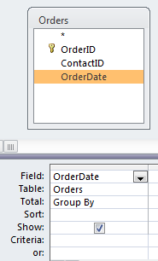
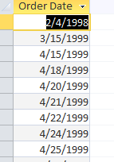
Example: Group By
Here’s the same query with a Group By:
Note that the duplicate rows have been “collapsed” into groups and only the group is displayed

Slide 17
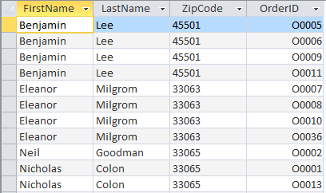
Duplicates with Group By
Group By collapses all rows that contain the same data across all columns.
Contacts are appearing multiple times in this example as the rows are not exactly the same.

Slide 18
Joining Tables
A “join” is a query operation in which rows are selected that have a common value for some row.
  Two columns (each from a different table) can be related if their values represent the same things
To find contacts that actually placed an order¹, the ContactID column value must be the same in the Contacts and the Orders table.
  This essentially finds all contacts who placed at least one order.
¹ There may be contacts in the Contacts table that are not linked to any order, i.e., they never placed an order.

Slide 19
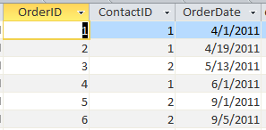

Table Joins
In this example, the ContactID in the Contact table and the ContactID in the Orders table represent the same thing so they can be related.
Orders Table
Contacts Table

Slide 20
Steps for Joining Tables
For every possible combination, take a row from the first table and a row from the second table
Remove all the rows that do not have equal values in the related columns
Merge the related columns into one column

Slide 21
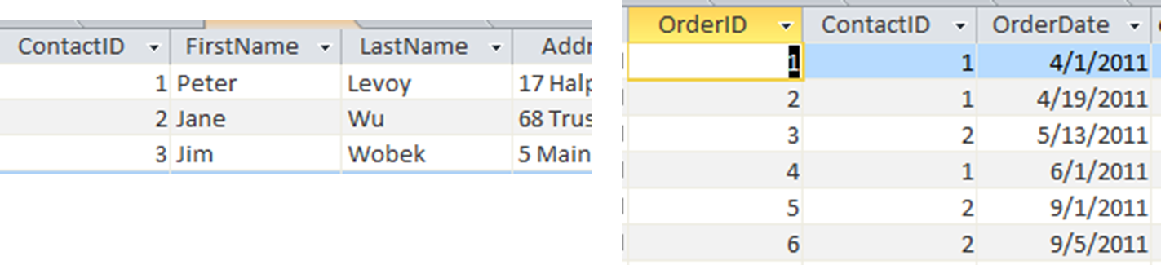
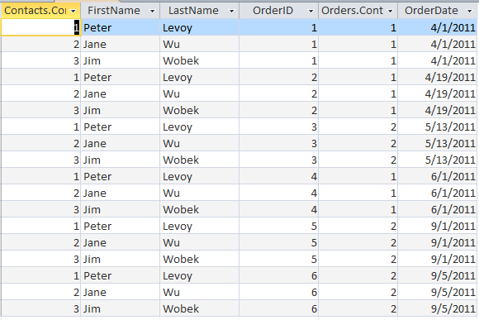
Step 1 – all combinations

Slide 22
Step 2 – remove rows with unequal values in related columns

Slide 23
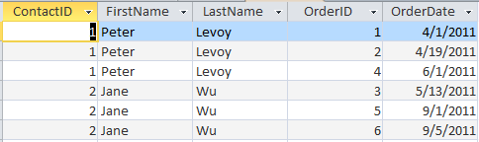
Step 3 – merge related columns

Slide 24
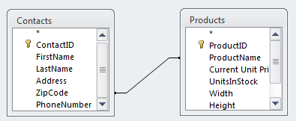
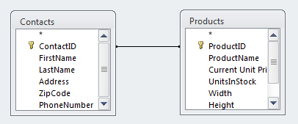
Bad Joins
No Output: Attributes are never equal.
Meaningless Output: That attributes are equal doesn’t mean anything.

Slide 25
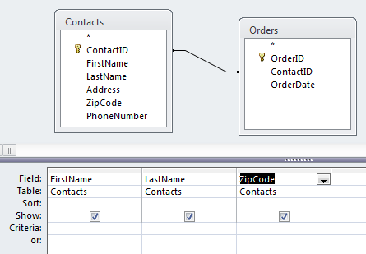
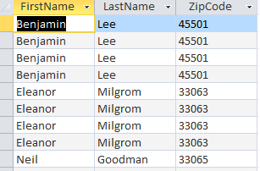
Example: Group By and Join
Find the first name, last name, and zip code of all contacts that placed an order.
Here’s the result without a Group By:
Note the duplicate rows

Slide 26
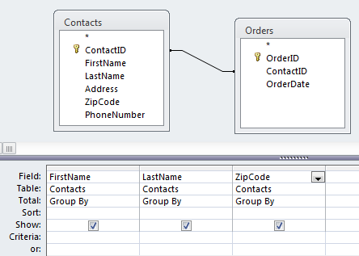
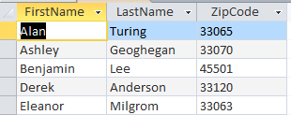
Example: Group By and Join
Find the first name, last name, and zip code of all contacts that placed an order.
Here’s the result with a Group By:
All rows with the same first name, last name, and zip code have been collapsed into a single “group”

Slide 27
Unrelated Tables
It is possible to join tables without relating columns in those tables.
Such a join is called an “outer join” or a “Cartesian product.”
The Cartesian product contains all possible combinations of rows.
For new database users, the Cartesian product is almost always the wrong thing.

Slide 28
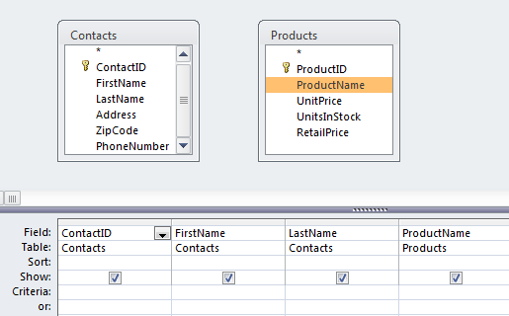
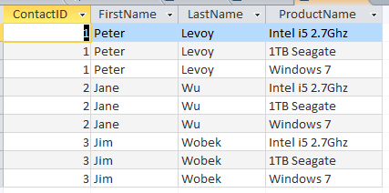
Who ordered which products?
Unrelated tables -- wrong
Every contact is paired with every product.

Slide 29
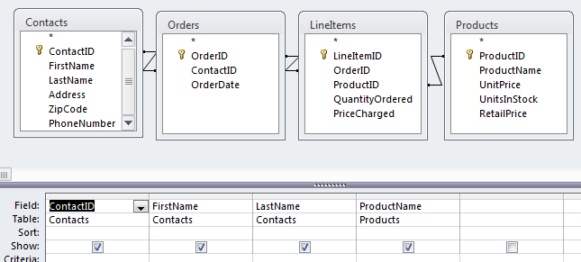
Who ordered which products?
Correct:

Slide 30
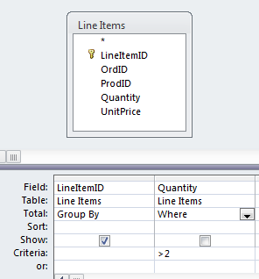
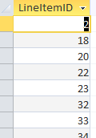
Filtering
Selecting rows that meet certain criteria is done through a WHERE clause.
Lists all of the line items (ID only) that have a Quantity > 2.

Slide 31
Example
List the OrderDates where the Quantity of an item ordered was at least 2. Each date should only appear once in the result.

Slide 32
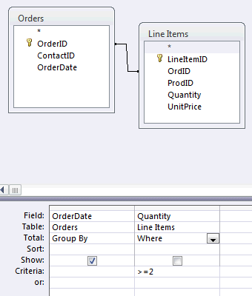
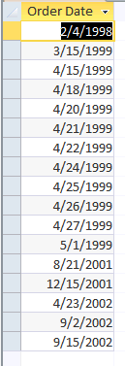
Correct: Use a WHERE Clause
Can’t be shown, may be more than one quantity >=2 per date

Slide 33
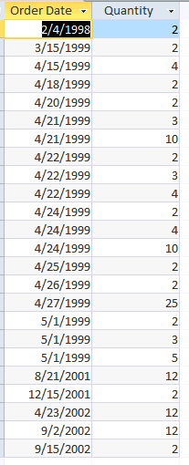
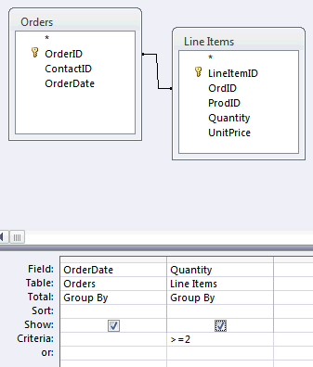
Incorrect: Using a GROUP BY instead of WHERE
Can be shown, some dates appear more than once with several quantities >=2

Slide 34
Selection Criteria
Selection criteria are specified as an algebraic relationship, but queries are generally stated as a narrative, so we need to “translate”.
Narrative | Algebraic Term
At least X | >= X
No more than X | < X
More than X | > X
No less than X | >= X
Less than X | < X
Up to X | < X
At most X | <= X

Slide 35
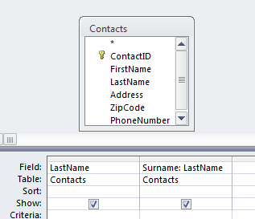
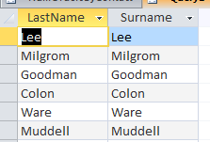
Renaming Attributes
In query design view, attributes can be renamed with a :
  newname: oldname

Slide 36
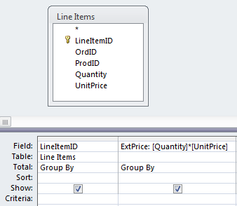

Calculated Fields
A query can also use calculated expressions.
Example:
  List the extended prices for each line item.
Note the user defined field name (ExtPrice) and the use of brackets for the field names, e.g., [Quantity].

Slide 37
Aggregate Functions
Aggregate functions work on multiple rows.
If used within a Group By, they work on the rows within each group.
If used on an entire table or query, they work on all of the rows in the table or query.

Slide 38
Aggregate Functions
Aggregate Function | Description
COUNT | Counts the rows in a table or a group if used in a Group By
SUM | Adds the values of the summed field in a table or a group if used in a Group By
AVG | Averages the values of the field in a table or a group if used in a Group By
MIN | Finds the minimum value of the field in a table or a group if used in a Group By
MAX | Finds the maximum value of the field in a table or a group if used in a Group By
STDEV | Finds the standard deviation of the field in a table or a group if used in a Group By

Slide 39
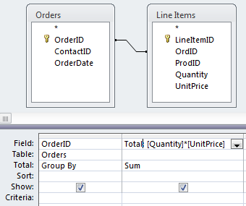
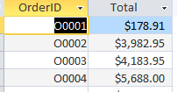
Example: SUM
Find the total of each order, i.e., the sum of the extended prices for each line item within an order.
Note the user defined field name (Total) and the use of brackets for the field names, e.g., [Quantity]. The SUM applies to the values of the [Quantity]*[UnitPrice] within each group.

Slide 40
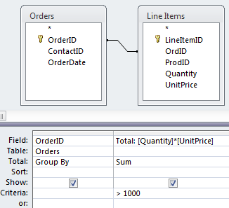
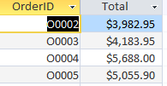
Example: SUM and Filter
Find all orders which have a total value of more than $1000.

Slide 41
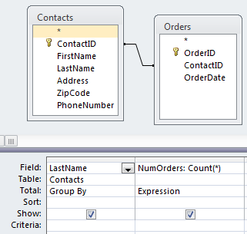
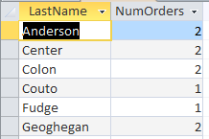
Counting Items in a Group
To count the rows that were collapsed into a group, use the COUNT(*) function.
The Group By collects identical rows into a group. Only the group is displayed, but COUNT counts the number of rows that are in each group. So the above query tells us how many orders each contact placed.

Slide 42
Expressions
Note the use of the “Expression” in the Total row for COUNT(*).
Expression is often required when an aggregate function is used.
Aggregate functions work on the items within a group of the Group By clause:
  COUNT – counts items in a group
  SUM – adds the items in a group (numbers only)

Slide 43
Query
Which orders are for less than $2,000?

Slide 44
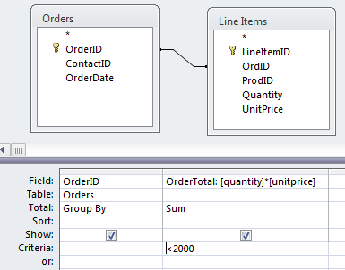
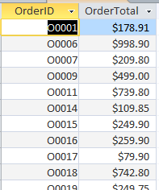
Query
Which orders are for less than $2,000?

Slide 45
Try for yourself…
Access Queries

Slide 46
Question 1
How many orders were placed from each state?

Slide 47
Question 2
Which contacts placed three or more orders?

Slide 48
Question 3
How often was each product ordered?

Slide 49
Question 4
Which products have a total sales volume of more than $10,000, i.e., for which products did the total amount sold across all orders exceed $10,000?

Slide 50
Summary
Group By removes duplicate rows where the Group By values are the same
Aggregate functions apply to groups or entire tables depending how they are used

