Slide 1

Data, Databases, and Queries
Managing Data in Relational Databases

Slide 2
What is this About
Storing, accessing, searching, and viewing data are important in any business.
While spreadsheets work well for small amounts of data, databases are used for larger data collections.
Learning how to access data is an important skill when working with databases.
We will learn how to formulate queries in the Microsoft Access database system.

Slide 3
Reasons to Move to a Database
Too much data in individual files
  Difficult to manage data
Have multiple uses for data
  Need multiple “views” of the data
Need to share the data
  Numerous people are entering, deleting, viewing data
Need to control the data
  Control data values and consistency

Slide 4
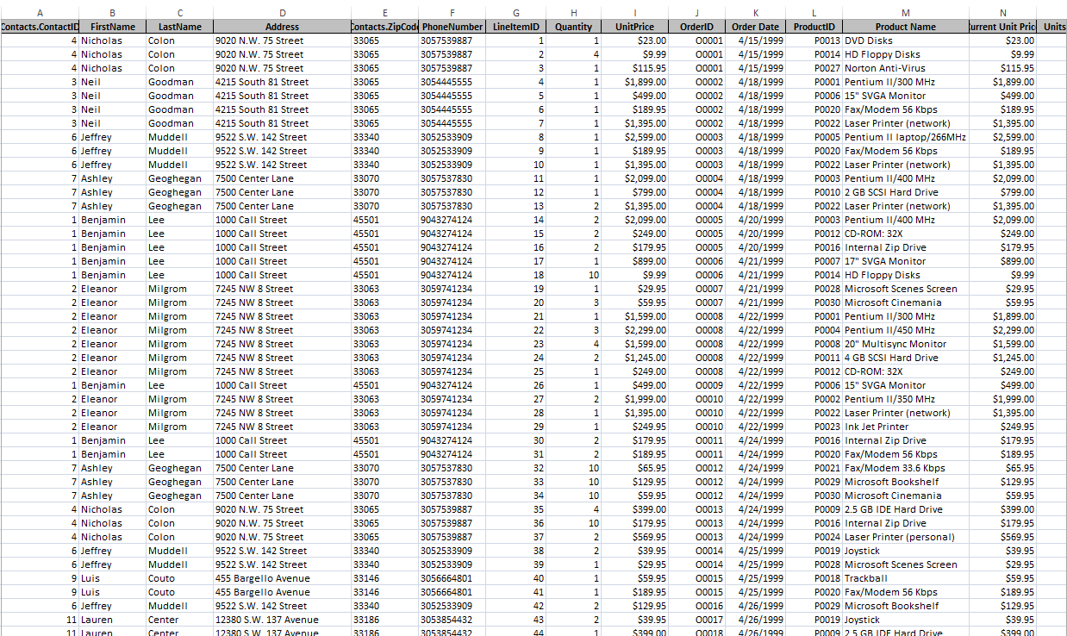
This data for a business belongs in a database…

Slide 5
Value of Knowledge
What we learn here is applicable to many other database that are used by businesses:
  Oracle
  Sybase
  Microsoft SQL Server
  JavaDB
  …
We will also learn how to decompose problems and think logically.

Slide 6
About Microsoft Access
Not available with Mac OS
You can use myApps (remotely login to a virtual Northeastern session). (see the course website under Resources -> Software)
DOWNLOAD AND SAVE!
  You must download and save Access files BEFORE starting to work on them or you will lose your work
.laccdb files: file locking is controlled by a locking file with the file name extension .laccdb.
  Do not submit this file! Close your file first and the .laccdb file goes away.

Slide 7
Relational Databases
Microsoft Access is a relational database which means that it stores data in tables
  Each table stores information about a single subject
Each table contains rows; one row for each record, i.e., a contact, order, product, etc.
Each column (or field) contains different kinds of information about the subject
Each row in a table has a unique identifier (or key), e.g., OrderID, ProductID, ContactID, etc.

Slide 8
Relational Databases
Each table in the database contains information related to a single subject and only that subject.
You can manipulate data about two classes of information (such as customers and orders) based on related data values
Example: it would be redundant to store all customer information with every order.
  In a relational DB, the table for orders contains one field that stores data such as a customer ID which can be used to connect each order with the appropriate customer information.

Slide 9
Relational Databases
Microsoft Access is a relational database which means that it stores data in tables.
Tables contains records; one row for each record, e.g., a contact, order, product, etc.
Tables have attributes; each record has a value for every attribute, e.g., name, price, address…
Each row in a table has a unique identifier attribute called a key, e.g., OrderID, ProductID, ContactID, etc.

Slide 10
Layout of the Orders Database
Microsoft Access Tutorial: Data, Databases, and Queries

Slide 11
The Orders Database
We will be using a database that contains data for orders placed by customers for our examples.
This database stores the following information:
  For each order, we know what was ordered, how many of that item was ordered, and at what price.
  For each order, we know who placed that order.
  For each customer (called a contact), we store where he/she lives.
  For each product, we track its description and price.

Slide 12
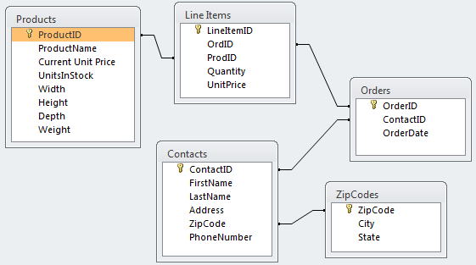
The Database Layout
These are all of the tables in the database:

Slide 13
The Database Layout
For each order, we know what was ordered, how many of that item were ordered, and at what price.
For each product, we know its description and price.
For each order, we know who placed that order.
For each customer (called a contact), we know where he/she lives.

Slide 14
A Sample Order
Order | O0001
Customer Contact
Contact ID: | C0004
Name: | Colon, Nicholas
Address: | 9020 N.W. 75 Street
 | Coral Springs, FL 33065
Order Date: | 4/15/1999
Product ID | Product Name | Quantity | UnitPrice | ExtendedPrice
P0013 | DVD Disks | 1 | $ 23.00 | $ 23.00
P0014 | HD Floppy Disks | 4 | $ 9.99 | $ 39.96
P0027 | Norton Anti-Virus | 1 | $ 115.95 | $ 115.95
 |  | Order Total: |  | $ 178.91

Slide 15
Where Does The Data Come From?
Orders.OrderID
Order | O0001
Customer Contact
Contact ID: | C0004
Name: | Colon, Nicholas
Address: | 9020 N.W. 75 Street
 | Coral Springs, FL 33065
Order Date: | 4/15/1999
Product ID | Product Name | Quantity | UnitPrice | ExtendedPrice
P0013 | DVD Disks | 1 | $ 23.00 | $ 23.00
P0014 | HD Floppy Disks | 4 | $ 9.99 | $ 39.96
P0027 | Norton Anti-Virus | 1 | $ 115.95 | $ 115.95
 |  | Order Total: |  | $ 178.91
Contacts
ZipCodes
ExtendedPrice =
Quantity * UnitPrice
Orders.OrderDate
LineItems
Total Order Amount

Slide 16
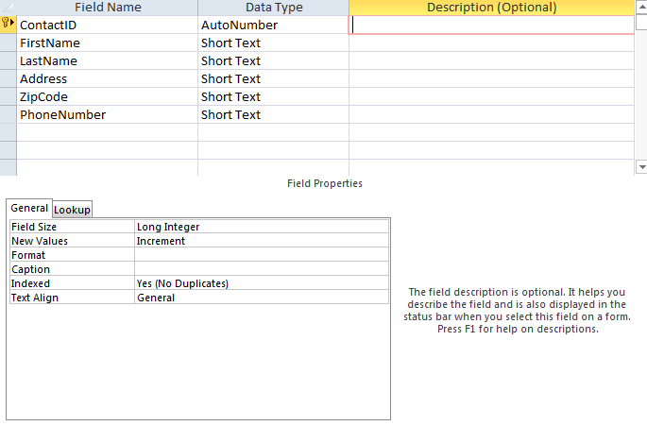
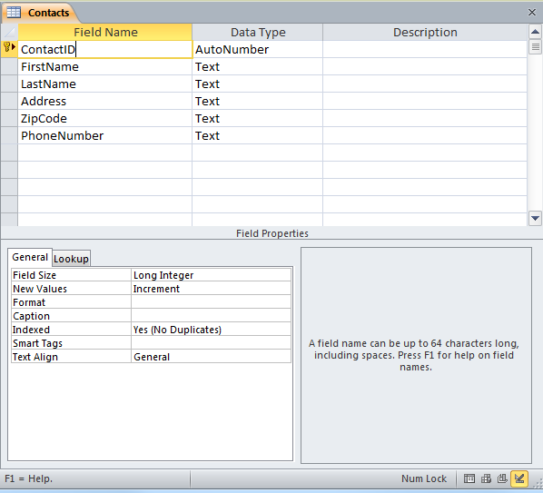
A closer look at the Contacts table
The Design view
  Design your table in this view:

Slide 17
Field Data Types
Short Text – alphanumeric data up to 255 characters
Long Text– alphanumeric data up to 1 gigabyte
Number – numeric data
Date/Time – dates and times
Currency – monetary data
AutoNumber – unique value generated by Access for each new record (not editable)

Slide 18
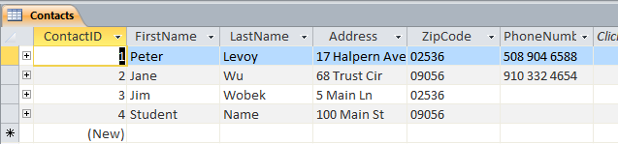
A closer look at the Contacts table
The Datasheet view
  Enter new data in this view

Slide 19

Relationships
From the Database Tools tab, define how the data in tables is related, such as ID fields in tables that should match.
  Example: ContactID in the Contact table is related to ContactID in the Orders table – a one-to-many relationship.

Slide 20
Retrieving Data with Queries
Microsoft Access Tutorial: Data, Databases, and Queries

Slide 21
Queries
Data is retrieved through queries.
Queries are formulated in a specialized language called SQL (pronounced SEQUEL).
Microsoft Access makes it easy to create SQL queries through a simple drag-and-drop interface called the Query Builder.
Queries are eventually integrated into reports, forms, programs, or executed by themselves.

Slide 22
Queries on Tables
Queries retrieve data from one or more tables.
You can specify which
  rows to include in the result through filters (WHERE clause in SQL terminology)
  columns to include in the results
The result of a query is a table that can be used in other queries (as subqueries).

Slide 23
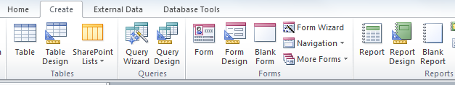
Creating Queries in Access
To create a query:
  Select the Create tab
  Pick Query Design
  Select the tables to include in the query or simply close the dialog and drag the needed tables into the query designer

Slide 24


Running a Query
To run a query, click on:
To return to the query design, click on:

Slide 25
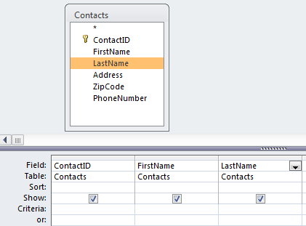
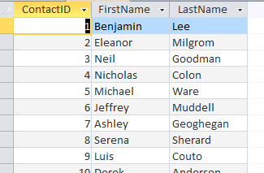
Example: Simple Query
Find the contact id, first name, and last name for each contact.

Slide 26

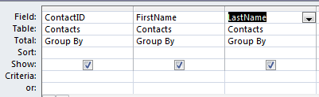
Removing Duplicates
Queries often result in duplicate rows.
These are removed by “grouping rows” with the same value as a single row.
To do a Group By, follow these steps:
  Select the function button in the ribbon
  Select “Group By” for each field

Slide 27
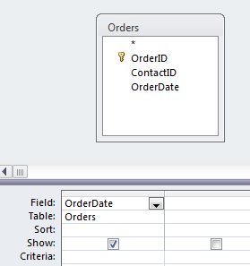
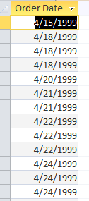
Example: Group By
Find the dates on which orders were placed.
Here’s the result without a Group By:
Note the duplicate rows

Slide 28
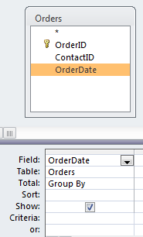
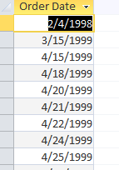
Example: Group By
Here’s the same query with a Group By:
Note that the duplicate rows have been “collapsed” into groups and only the group is displayed

Slide 29
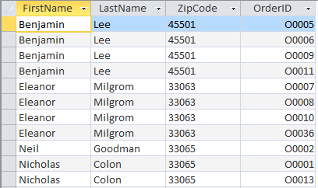
Duplicates with Group By
Group By collapses all rows that contain the same data across all columns.
OrderIDs are not the same in this example so names will show up more than once even if using Group By.

Slide 30
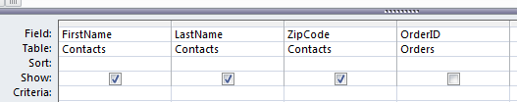

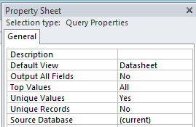
Eliminating Duplicates
Duplicates can be eliminated by specifying that the query should only return unique records.
Watch Demo

Slide 31
Joining Tables
A “join” is a query operation in which rows are selected that have a common value for some row.
To find contacts that actually placed an order¹, the ContactID column value must be the same in the Contacts and the Orders table.
This essentially finds all contacts who placed at least one order.
¹ There may be contacts in the Contacts table that are not linked to any order, i.e., they never placed an order.

Slide 32
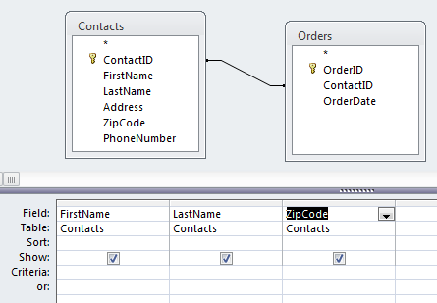
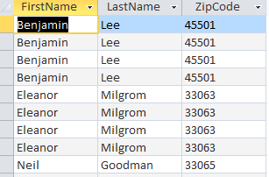
Example: Group By and Join
Find the first name, last name, and zip code of all contacts that placed an order.
Here’s the result without a Group By:
Note the duplicate rows

Slide 33
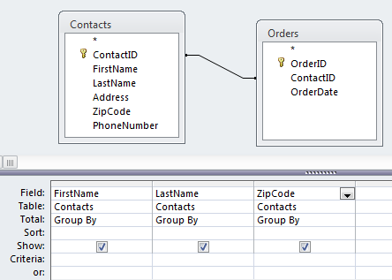
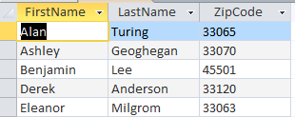
Example: Group By and Join
Find the first name, last name, and zip code of all contacts that placed an order.
Here’s the result with a Group By:
All rows with the same first name, last name, and zip code have been collapsed into a single “group”

Slide 34
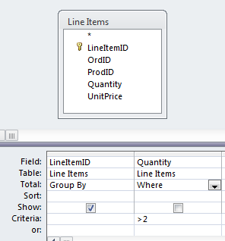
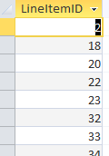
Filtering
Selecting rows that meet certain criteria is done through a WHERE clause.
Lists all of the line items (ID only) that have a Quantity > 2.

Slide 35
Selection Criteria
Selection criteria are specified as an algebraic relationship, but queries are generally stated as a narrative, so we need to “translate”.
Narrative | Algebraic Term
At least X | >= X
No more than X | < X
More than X | > X
No less than X | >= X
Less than X | < X
Up to X | < X
At most X | <= X

Slide 36
RegistrarExampleDatabase
Relationships
Data
Queries
  Student names, address, city, state, zip
  Course with 4 or more credits
  Students in CS2500
  Students in CS1100

