Slide 1
Computational Forms
Topic 9 – Exploring Scenarios
Lesson 1 - Computational Forms

Slide 2
Computational Forms
Worksheets are often used by people other than the author.
Providing inputs in the right cells can be difficult and formulas are often inadvertently damaged.
Form controls and locked cells can help construct reusable models and more user-friendly "applications".
Excel provides a number of common form controls, including sliders, scrollbars, checkboxes, buttons, and so forth.

Slide 3
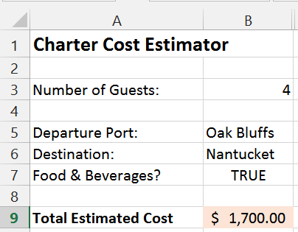
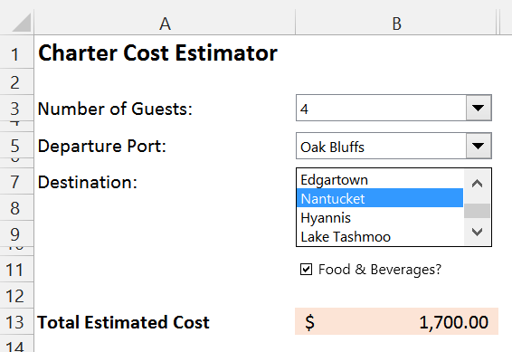
Example Computational Forms
Here's a form that calculates the estimated cost of a yacht charter based on a few rules that involve the number of guests, ports of departure and destinations, and whether food/beverages are desired.
Traditional Worksheet
Computational Form

Slide 4
Forms vs Simple Worksheets
What would happen if the word "Hyannis" were misspelled?
How do users know what all the possible destinations are?
How would you direct users to modify only certain fields?
How much instructions/training would you have to provide for each?

Slide 5
Building Computational Forms
Computational forms are built by adding "form controls" to worksheets and linking them to cells.
The values in the cells are then "entered" through the form control rather than by typing it directly into the cell.
drop down list control is linked to cell D2; whatever is selected in the drop down is placed into D2

Slide 6
Developer Tab | Form Controls
The Form Controls can be found in the Developer Tab (not visible by default):
The INSERT Menu allows you to CREATE elements

Slide 7
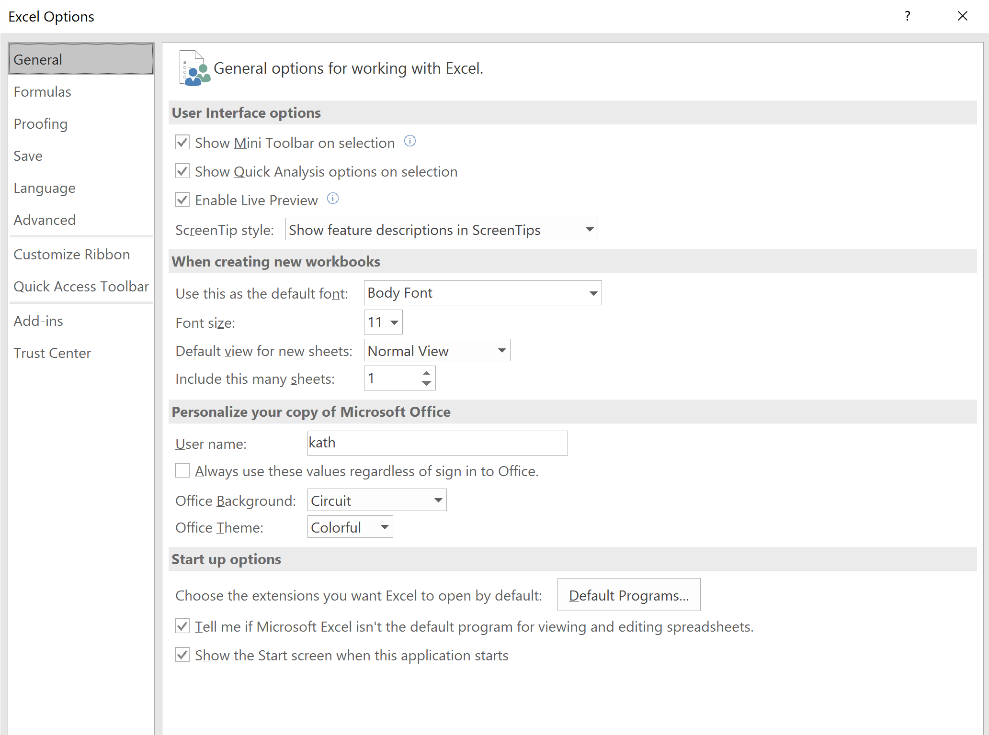
Installing the Developer Tab - Step 1
In the File menu,
select Options
Choose Customize Ribbon
Select Developer

Slide 8
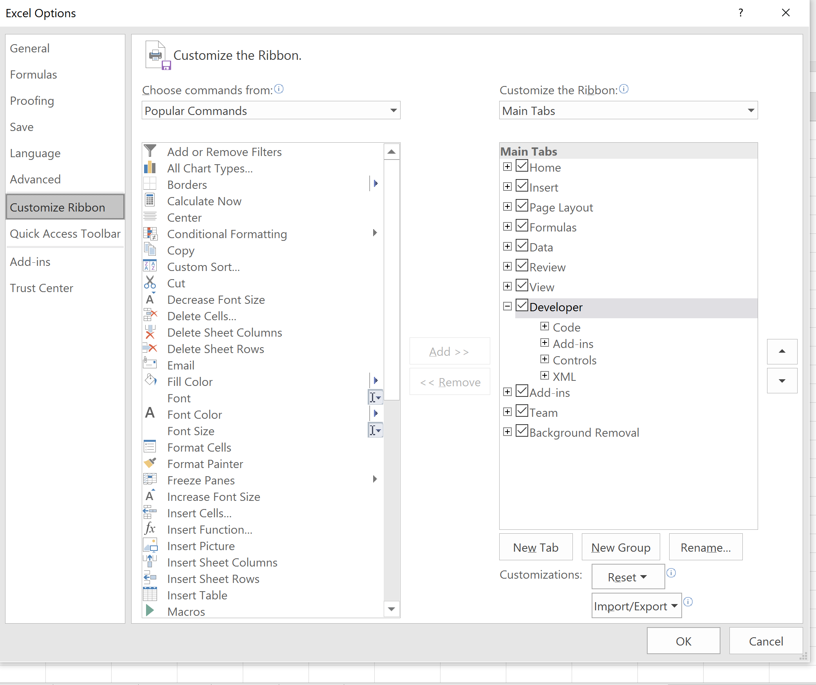
Installing the Developer Tools - Step 2

Slide 9
Interactive Demo
Follow along by building this form.
Note that the form controls require various lookup tables that are generally placed in a separate worksheet.
After the form is built, the linked cells are hidden and only the form controls are visible.

Slide 10
Exploring Scenarios
Spreadsheets are often used to explore different scenarios and do "what-if" analysis.
For example:
What is our expected profit for next year if we sell 10,000, 20,000, or 50,000 units of some new product?
What is the expected impact on profitability of different buildings rentals?
What if next year we'll have 100, 200, or 300 computer science majors? How many sections of each course do we need? How many faculty do we need to hire?
Form controls, in particular sliders, are useful in building interactively "exploratory" models.

Slide 11
An Example: Planning a Conference
Let's say we want to plan a conference and we need to determine what we need to charge in order to at least break even.
Here are some cost parameters we have identified:
The venue rental is a fixed amount.
The cost per attendee (lunch, etc.) can be varied.
We know the expected range of the number of attendees.
We need to set the registration fee so we break even.

Slide 12
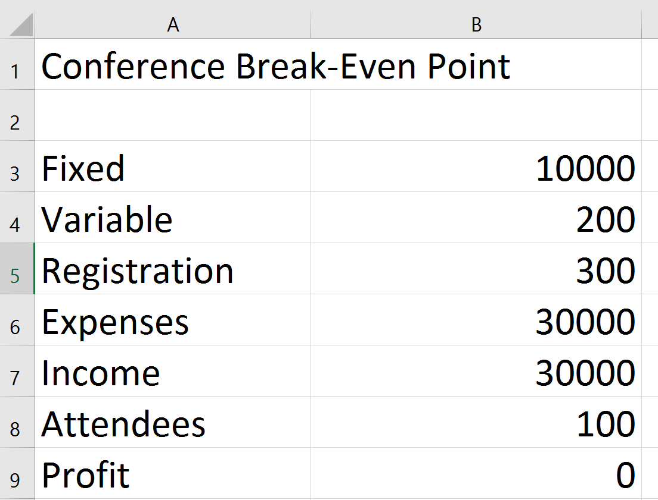
Cost Model as a Spreadsheet
Here's a cost projection model:

Slide 13
Interactive Exploration
We want to explore how the profit changes if we change any of the following values:
Registration Fee
Attendees
Variable Cost

Slide 14
Using the Slider Control for Exploration
A slider is a scroll bar form control that is linked to the value of a given cell allowing us to change the value of the cell by moving the slider rather than entering a value directly.
At the same time, the value shown on the slider changes any time we type in a new value into the linked cell.
All values that depend on this cell are re-computed immediately.

Slide 15
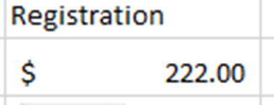
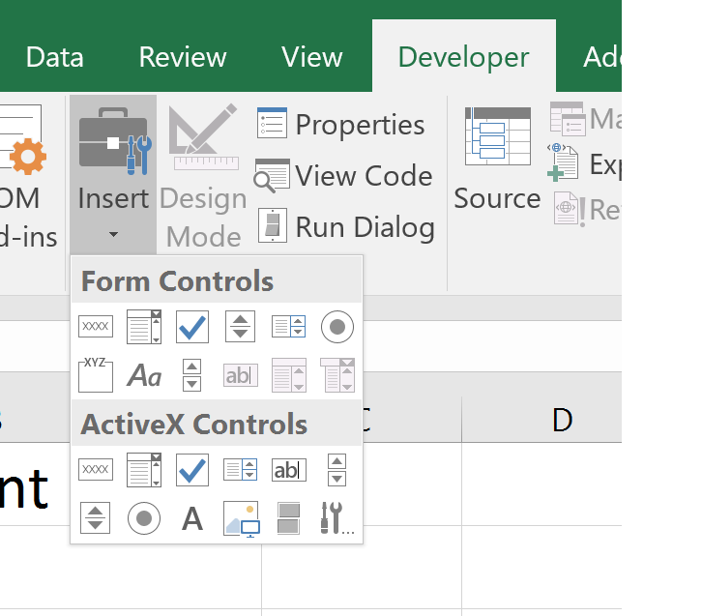
Inserting a Slider
We want to add a slider that will control the values of the Registration Fee cell.
The slider does not have labels – we do not see what it controls unless we manipulate the slider.
So we first create a header (type in the text Registration) in a cell above where the slider will be located, and even fill the cell to refer to the one that will be linked with the slider.

Slide 16
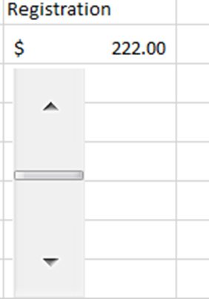
Controlling a Cell Value with the Slider
Manipulating the slider changes the value in the linked cell.
The size of the slider can be changed.

Slide 17
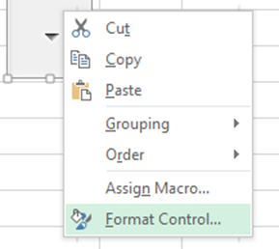
Linking Form Controls to Cells
We need to link the slider tool to the cell that holds the value of the registration fee, and restrict its values to our desired minimum and maximum. (Let’s say, that we charge at least $50 and at most $400 for the registration.)
Right click on the slider when in editing mode (the corners are showing) to select Formal Control:

Slide 18
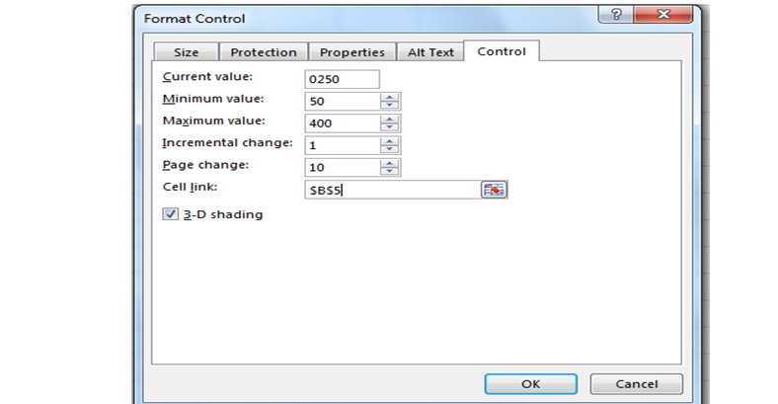
Specifying Format Controls
Specify:
the current value
the smallest
the largest value, how much the cell value changes when the slider is moved.
Also specify the "Cell link" which specifies the cell that contains the value selected by the slider.

Slide 19
An Interactive Exploratory Model
Let's build this model together:

Slide 20
Questions?

