Slide 1
Advance Table Lookup
Topic 5 – Table Lookup
Lesson 3 - Advanced Lookup

Slide 2
Learning Objectives
Upon completion of this lesson, you will be able to:
List the limitations of VLOOKUP
Use the INDEX function in combination with the MATCH function to perform more versatile table lookups

Slide 3
Limitations of VLOOKUP
While VLOOKUP (and HLOOKUP) is the most commonly used search function in Excel, it has its limitations:
the data must be sorted for approximate (interval) lookups to work as it performs a binary search
the lookup value can only be in the first column of the lookup table
The more powerful search function is INDEX used in conjunction with MATCH.

Slide 4
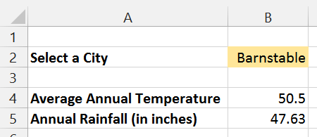
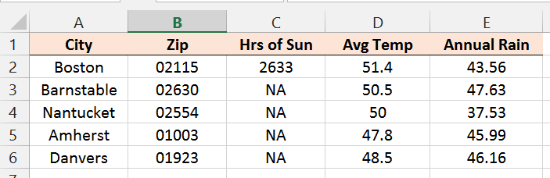
Simple Example of VLOOKUP
=IFERROR(VLOOKUP(B2,ClimateData,4,FALSE),"")
Named Range: ClimateData

Slide 5
Some Thoughts...
The search key must be in the first column of the lookup table.
How would you adjust this so that you can search by Zip Code?
VLOOKUP is too limited for a search like this where you might want to search by City or Zip Code.

Slide 6
The MATCH Function
The MATCH function finds the row in which a lookup value is found in an array of cells.
Use 0 as the third parameter if the lookup values are not ordered.
=MATCH(lookup_value, lookup_array, match_type)
lookup_value — the value to match in lookup_array.
lookup_array — a range of cells with data.
match_type — specifies how Excel matches the lookup_value with values in the lookup_array. For exact matches, always use 0 for this argument.

Slide 7
The INDEX Function
The INDEX function returns the value in the specified cell from a range of cells.
=INDEX(reference, row_num, [column_num])
reference — a range of cells
row_num — the row in reference from which to return data.
column_num — optionally the column in reference from which to return data.

Slide 8
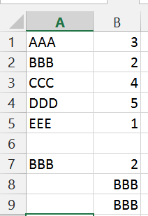
Examples of MATCH and INDEX
=MATCH(A7,A1:A5)
=INDEX(A1:A5,B7)
=INDEX(A1:B5,B7,1)

Slide 9
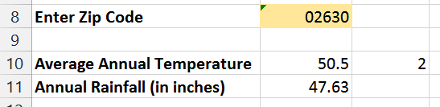
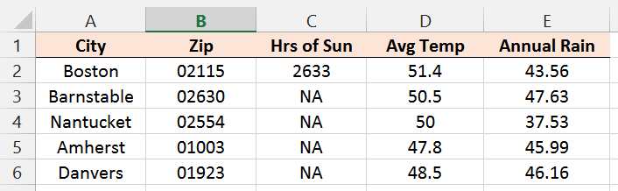
Example Revisited
Here's a solution to the problem we originally posed: how do you look up cities by zip codes if zip code is not the first column as required by VLOOKUP?
=MATCH(B8,Cities!B2:B6,0)
=INDEX(Cities!A$2:E$6,$C$10,5)

Slide 10
Common Errors
VLOOKUP returns a #N/A error:
#N/A means that lookup can't find what you are looking for. This could be because
1) your lookup value is incorrect (in your case it was a negative number)
2) your lookup value is not in the table because you set up the table incorrectly
3) you mispelled the key values when you entered them into the lookup table
4) you have an extra space after the value in the table
5) your named range does not include all of the columns in the lookup table

Slide 11
Summary
If you need to only lookup based on the first column of the lookup table, then VLOOKUP will work.
If you need the ability to look up based on a key that's not in the first column, then INDEX-MATCH is required.

Slide 12
Questions?

