Slide 1
Topic 4: Referencing
Lesson 2 - Multi-Dimensional References

Slide 2
Lesson Objectives
Upon completion of this lesson, you will be able to:
reference cells across worksheets and files
define 3D cell ranges
transpose cell ranges
use MATCH and OFFSET to build more flexible models

Slide 3
Referencing Cells
Formulas and functions generally contain references to cells containing values.
References can be:
2D references with column and row, e.g., C11, or KK32
3D references with column, row, and worksheet, e.g., Categories!C3
4D references with column, row, worksheet, and file, e.g., [Budgets]Categories!C4

Slide 4
Cell Reference Format
Each cell reference uses this canonical format:
To reference a range across cells in the same worksheet:
To reference the same cell across multiple worksheets:
=[FileName]Worksheet!Cell
=[FileName]Worksheet!StartCell:EndCell
=[FileName]Worksheet1:WorkSheetN!Cell

Slide 5
File Path Names
Be sure to only use the file name in your file reference rather than the full path, i.e., do this
[otherFile.xlsx]Worksheet!B4
instead of
["c:\users\martin.s\otherFile.xlsx"]Worksheet!B4
The reason is that otherwise if your files are moved to a different folder, the reference will no longer work.
Of course, if the file is always in the same folder then an absolute path reference is appropriate.

Slide 6
Entering Multi-Dimensional References
A multi-dimensional reference can be typed in using the format shown or selected:
in the cell into which the reference should be placed, enter =
open the file and/or worksheet
click on the cell or range to be referenced and press ENTER

Slide 7
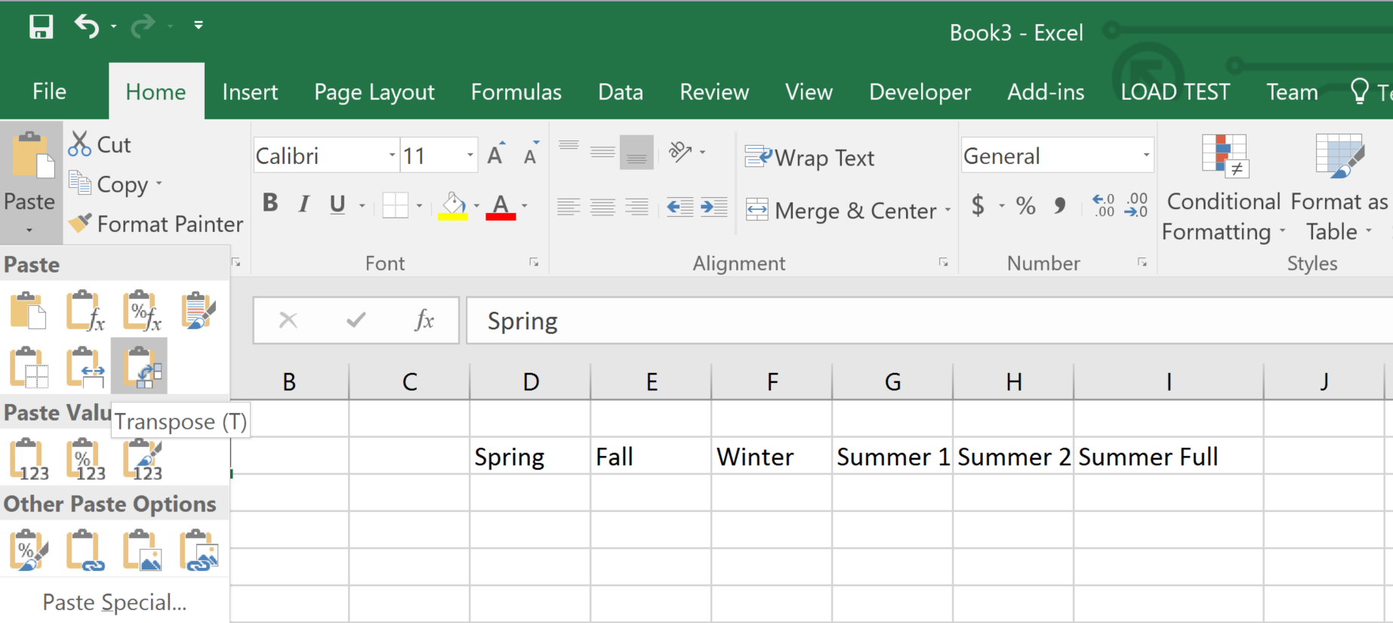
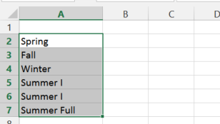
Transposing Cell Ranges
Often a worksheet is in the "wrong" layout and columns should be in rows and vice versa.
To "transpose" rows into columns and vice versa, copy the cells and then do a "Paste Special" with Transpose.

Slide 8
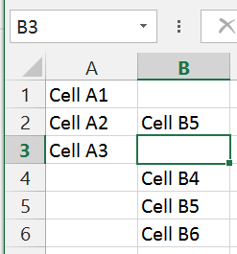
The OFFSET Function
CS Principle
The OFFSET function returns a range of cells that is "offset" a specified number of rows and columns from a starting cell.
Combining OFFSET with MATCH can help build more flexible models.
=OFFSET(reference, rows, columns, [
height][, width])
reference -- starting cell
rows -- number of rows from the starting cell
columns -- number of columns from the starting cell
height -- the height of the range
  number of rows
width -- the width of the range
  number of columns
B4:B6 are literal
strings.
=OFFSET(A2,3,1)
Returned by
OFFSET(A2,3,1)
Computer Science Application:
This is a "relative" pointer reference to memory.

Slide 9
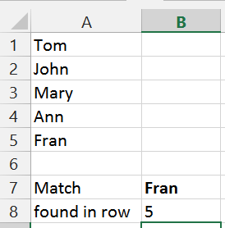
The MATCH Function
The MATCH function looks up a value in a cell range and returns the relative position of the value within the range.
Computer Science Application:
This is a "binary search" and the lookup range must be sorted unless you specify a match type of 0.
=MATCH(B7,A1:A5,0)

Slide 10
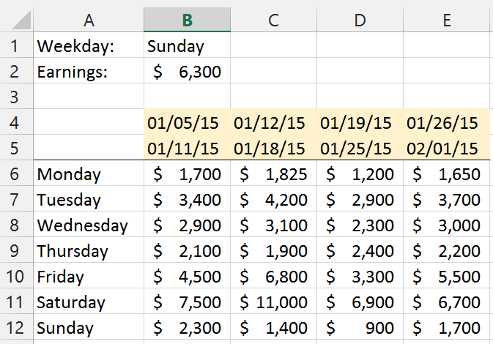
An Example: Flexible Modeling
B1 is changing, B2 must reflect that change.
=SUM(OFFSET(A5,MATCH(B1,A6:A12,0),1,1,4))

Slide 11
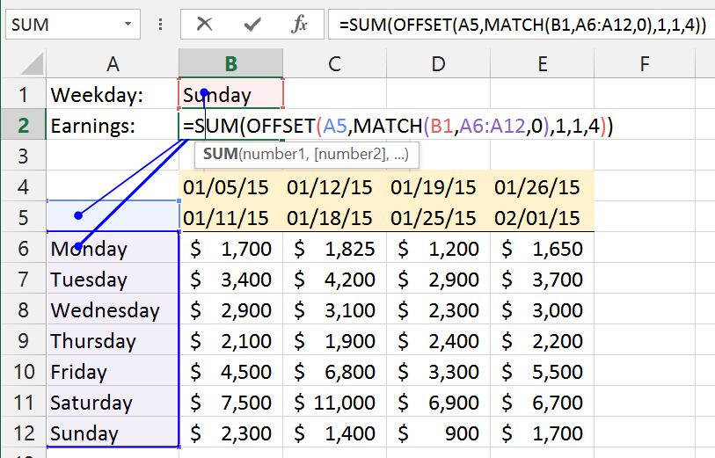
Dependencies Visualized

Slide 12
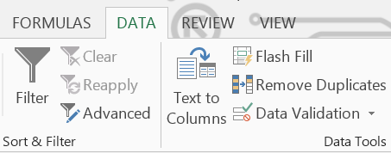
Restricting Input with Dropdown Lists
To avoid data entry errors, use dropdown lists:
create a named range of the values in the dropdown list
select the cell in which the dropdown should appear
navigate to Data | Data Validation
select List from the Allow list
enter = and the named range

Slide 13
Lesson Summary
In this lesson you learned how to:
create 3D and 4D cell ranges
transpose cell ranges
work with relative cell references

Slide 14
Questions?

