Slide 1
Topic 4: Referencing
Lesson 1 - Visualizing Dependencies

Slide 2
Learning Objectives
Upon completion of this lesson, you will be able to:
locate the cells referenced in a formula
trace dependencies between cells
uncover dependency errors
use formula evaluation to find errors

Slide 3
Visualizing Formulas
When you edit a cell that contains a formula, Excel uses color coding to show which cells the formula references.
Note: As the visualization shows, the formula references B1 twice. The following formula is more modular and references B1 only once: =IF(OR(B4="AAA",B4="AARP"),0.9,1)*B$1*12. Follow the DRY rule: Don’t Repeat Yourself. In this example this means: Don’t repeat B$1 in the forumula.

Slide 4
The Structure of a Formula
Excel distinguishes between two types of cell references:
Precedent cells
are referred to by a formula in another cell. For example, if cell D10 contains the formula =B5, cell B5 is a precedent to cell D10.
Dependent cells
contain formulas that refer to other cells. For example, if cell D10 contains the formula =B5, cell D10 is a dependent of cell B5.

Slide 5
Visualizing Dependencies
The Trace Dependents and Trace Precedents mechanisms, located on the ‘Formulas’ tab, are useful in understanding dependent and precedent cells and uncover errors in referencing.

Slide 6
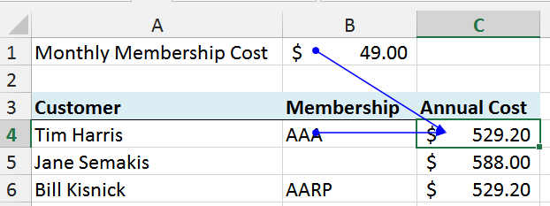
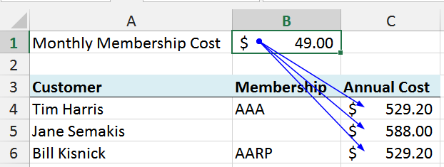
Tracing a Formula's Dependencies
Trace Precedents
Trace Dependents

Slide 7
Dependents of "Starting Balance"

Slide 8
Dependents of First "Extra Deposit"

Slide 9
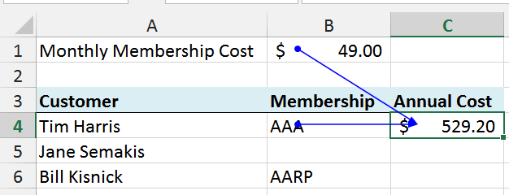
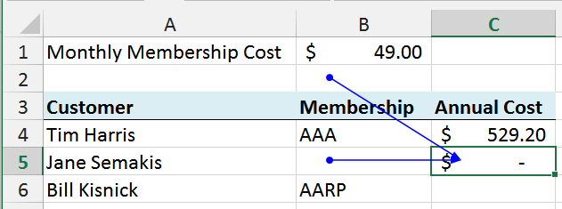
Using Tracing to Understand Anchoring
To understand how to properly anchor columns or rows with $, use tracing before and after you copy a formula.
=IF(OR(B4="AAA",B4="AARP"),B1*0.9,B1)*12
So, from this you can see how the references change when copying. This means that the reference to B1 must be anchored along the row with B$1.

Slide 10
Computer Science and Its Applications
Computer Science
Graph: Nodes and Edges
Reachability Problem:
Find all nodes reachable from a node.
Application
Graph: Data Flow graph
Nodes: cells in spreadsheet
Edges: dependencies determined by formulas in cells
Reachability Problem: Find all cells that depend on a given cell.
Graphs (with nodes and edges) have many applications in computer science.
There are numerous algorithmic graph problems and graph algorithms to solve them.
The reachability problem is a fundamental and important graph problem.
CS Principle

Slide 11
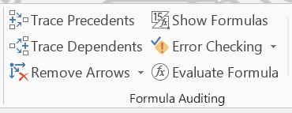
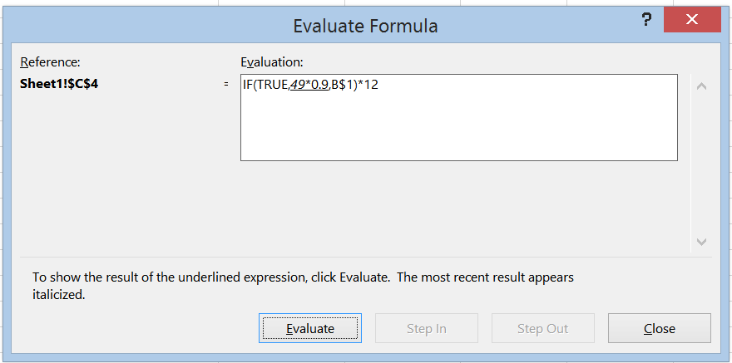
Debugging a Formula
To understand where a complex formula is incorrect, use the Evaluate Formula mechanism which evaluates the formula step-by-step and shows each intermediate result.
This is similar to a "debugger" used by programmers.

Slide 12
Lesson Summary
In this lesson you learned how to:
understand how a formula uses cells
visualize the dependencies in a worksheet
find errors in your models
use tracing to determine proper anchoring
evaluate a formula to debug it

Slide 13
Questions?

