Slide 1
More Excel Functions
CS 1100: Computer Science and Its Applications

Slide 2
The AVERAGE Function
The AVERAGE function calculates the average (arithmetic mean) of the arguments.
AVERAGE(number1, [number2], ...)
  each argument is a number, cell reference, or range you want averaged.
  the first parameter is required and the rest are is optional. There can be up to 255 parameters.

Slide 3
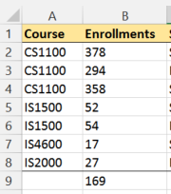
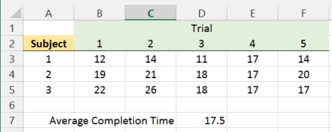
Example: AVERAGE()
=AVERAGE(B2:B8)
=AVERAGE(B3:F5)

Slide 4
Averaging Functions
AVERAGE() omits non-numeric values in the calculation
AVERAGEA() uses 0 for any cell that contains text
AVERAGEIF() only averages cells that meet a criterion

Slide 5
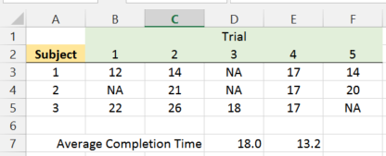
Dealing with Missing Data Values
AVERAGE() omits the value from the calculation if a cell is empty or contains text.
AVERAGEA() uses 0 in the calculation where a value is text, although an empty cell is still omitted.
=AVERAGE(B3:F5)
=AVERAGEA(B3:F5)

Slide 6
Calculating the Standard Deviation
The standard deviation is a measure of the dispersion of a data sample, i.e., how much the data values in a sample are away from the mean.
Use STDEV.S() or STDEVA() to calculate the standard deviation of a sample.
STDEV.S() omits any cells in the range that are not numeric
STDEVA() counts any cells in the range that are not numeric as 0.
There are many additional descriptive and inferential statistical functions in Excel, but those are generally covered in a Statistics course.

Slide 7
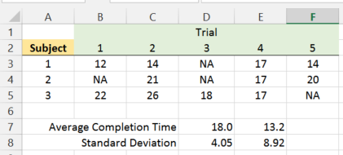
Example: STDEV.S() and STDEVA()
=STDEV.S(B3:F5)
=STDEVA(B3:F5)

Slide 8
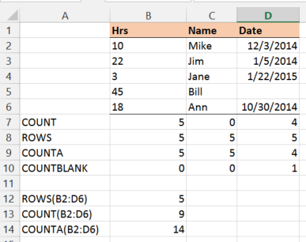
Counting Cell Ranges
COUNT() only cells with numbers (note that dates are numbers)
ROWS() rows in a cell range
COUNTA() all cells in a cell range that are not empty
COUNTBLANK() only cells that are empty

Slide 9
Date and Time Processing
Any value that is entered with / is assumed to be a Date value,
e.g., 12/22/19 is equal to December 22, 2019.
Extracting elements from a Date
  YEAR(), MONTH(), and DAY() extract the year, month, and day of a date value
  HOUR(), MINUTE(), and SECOND() extract the hours, minutes, and seconds of a time value
Making a Date
  DATE() constructs a new date value
  EDATE() constructs a new date with a monthly offset
  NOW() returns the current date and time
  TODAY() returns the current date
  TIME() constructs a new time value

Slide 10
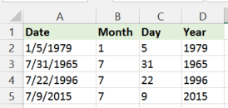
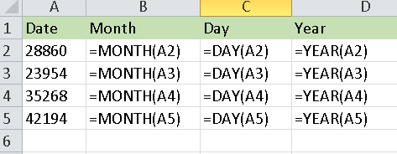
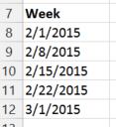
Example: Date Processing
CTRL ` View shows the formulas and actual
stored values
=DATE(YEAR(A8),MONTH(A8),DAY(A8)+7)
You can construct dates from the values of year, month, day

Slide 11
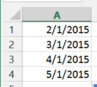
Example: EDATE()
Creates a new date that is a specified number of months ahead or behind the starting date.
=EDATE(A1,1)

Slide 12
Internal Date Representation
Dates are represented internally as numbers.
What you see is a "formatting" of that number:
    short date: 10/1/2014
    long date: Wednesday, October 1, 2014
The actual number inside the cell is: 41913
41913 is the number of days elapsed between October 1, 2014 and January 1, 1900.

Slide 13

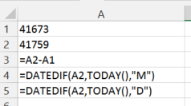
Date Calculations
Dates can be added and subtracted like numbers.
The function NETWORKDAYS() shows the number of workdays in a span of dates.
The DATEDIF() function returns the number of days, months, or years in a span of dates.
Note that DATEDIF() is a hidden function and may not be available in future releases of Excel.
Earlier date first

