Slide 1
Flexible Models
CS 1100: Computer Science and Its Applications
Modified from originals created by Martin Schedlbauer, Peter Douglass and Peter Golbus

Slide 2
Assume Data May Change!
It is best practice to write your spreadsheets in such a way that they give correct results for given data, regardless of what that data might be, and not merely the correct results for a particular data set.
If the data changes, the answer should be correct for the new data set.

Slide 3
Don’t Duplicate Data!
Since the input for a problem may change, these data should appear in one place only.
Otherwise, if data given is repeated in many places,
then any changes to that data must be applied to many places.
It’s easy to miss one of the places, which creates errors.
It’s also just a lot of unnecessary work.

Slide 4
don’t hard code values
Don’t use actual numbers or text in your formulas and functions.
Your model is more general and flexible to when data change if you only use cell references.

Slide 5

COUNT()
COUNT(arg1, [arg2], ...)
  arg1 is required and is the first item,
  cell reference, or range within which you want
  to count numbers.
Use the COUNT function to get the number of entries
in a number field that is in a range or array of numbers.
Counts the number of cells that contain numbers
or counts numbers within a list of arguments.
Note: While the arguments can contain or refer to a different types of data, but only numbers are counted.
=COUNT(A1:A5)

Slide 6
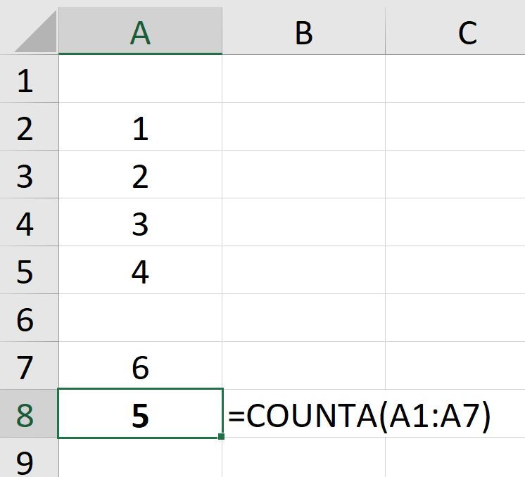
COUNTA()
COUNTA(arg1, [arg2], ...)
    arg1 is required and is the first item, cell reference, or range within which you want to count cells.
    Counts the number of cells that aren’t empty.

Slide 7
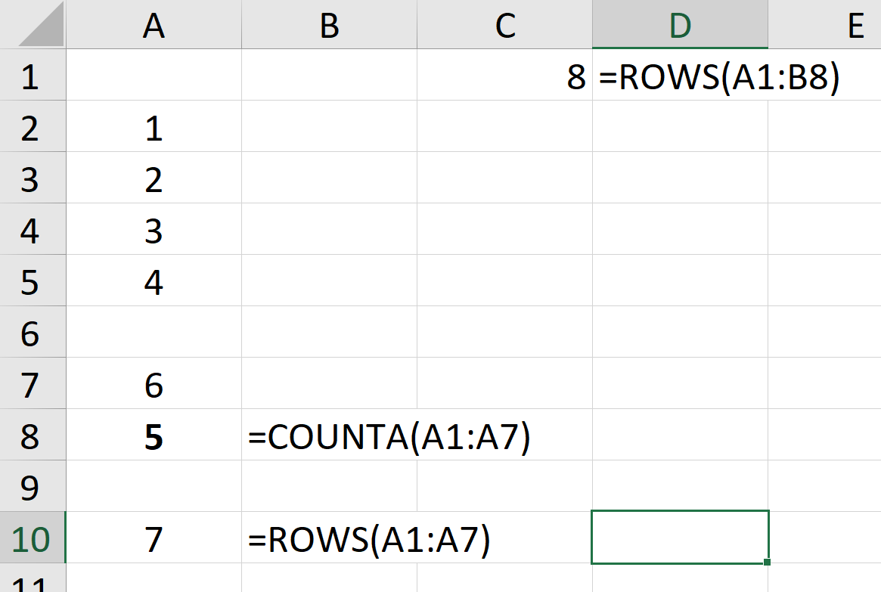
ROWS()
COUNTA(array, ...)
    Counts all rows in the array regardless of value
Note:
    ROWS(A1:A7) is 7 because there are seven rows between A1 and A7 even though A1 and A6 are empty.
    ROWS(A1:B8) is 8 for the same reason.

Slide 8
Inductively Defined Problems
An inductively defined problem has two parts:
  A set of starting conditions
  A set of rules that describe how data changes from one step to the next.

Slide 9
Inductively Defined Problems
This is the starting condition
Example:
  You deposit $1000 in a savings account
  At the end of each year, you receive 4% interest on the balance in your account.
This rule describes how data changes from one step to the next

Slide 10
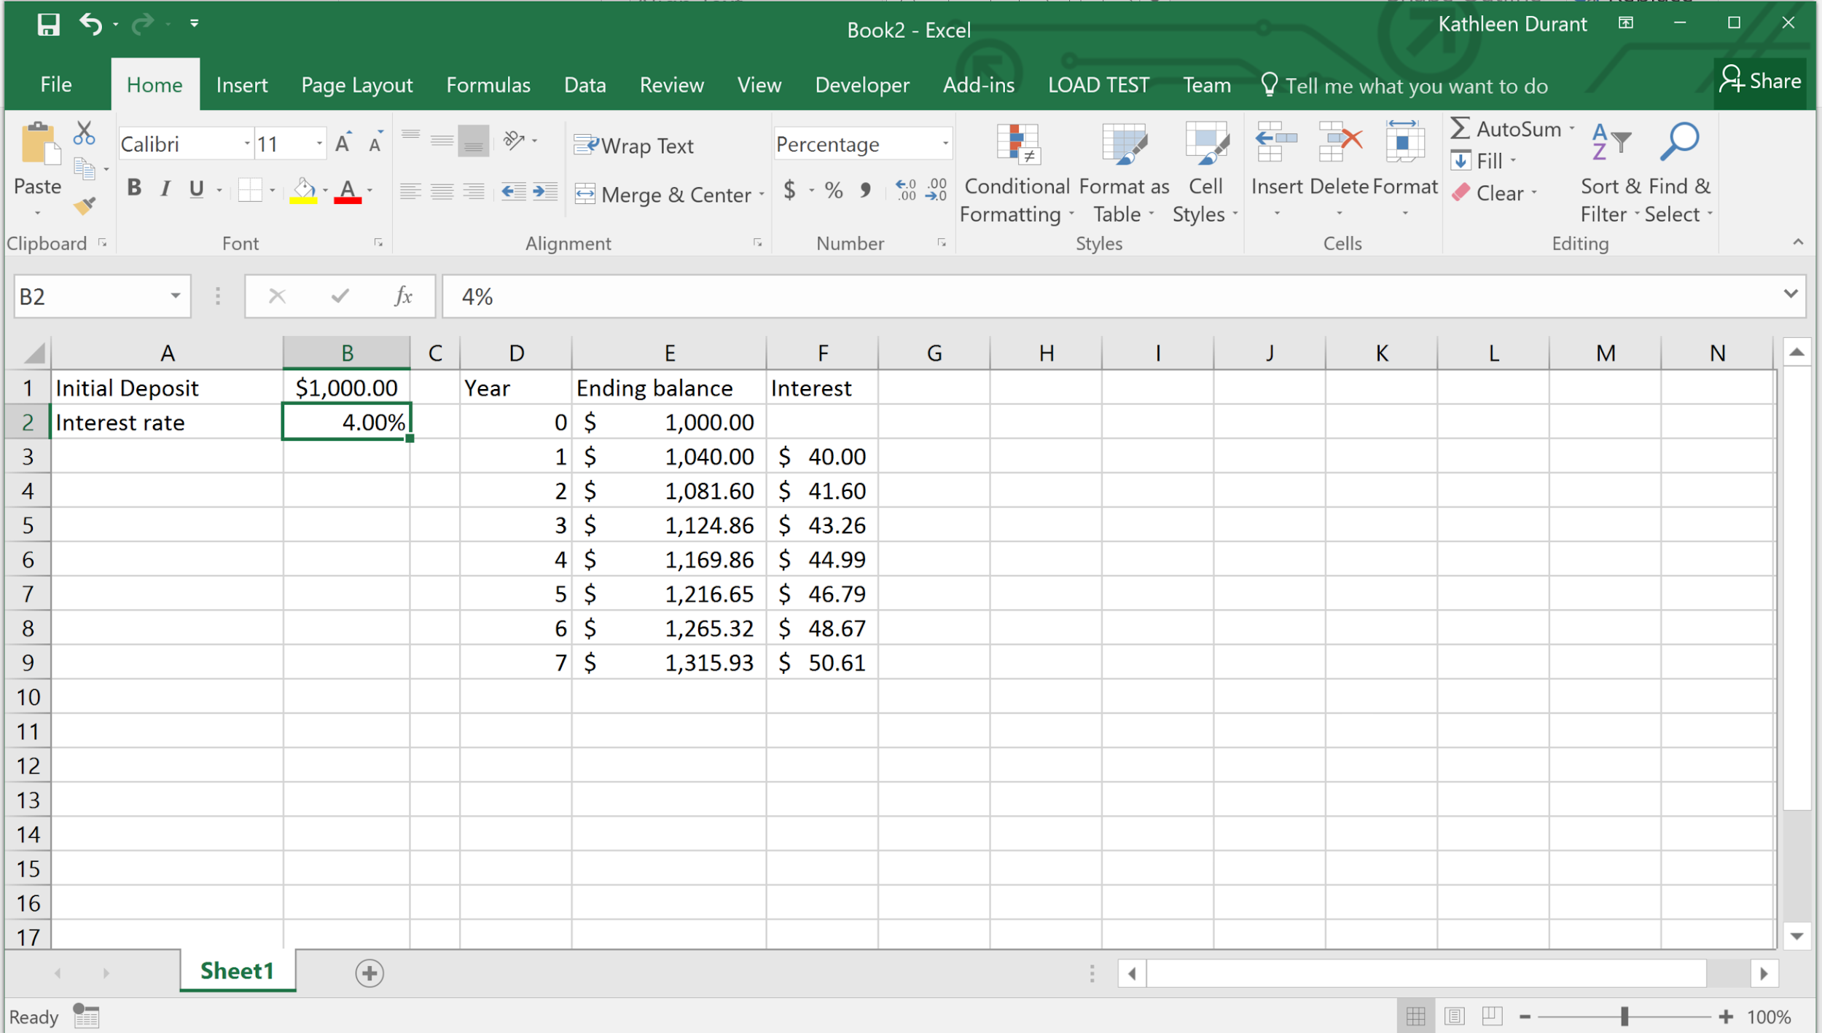
Starting condition

Slide 11
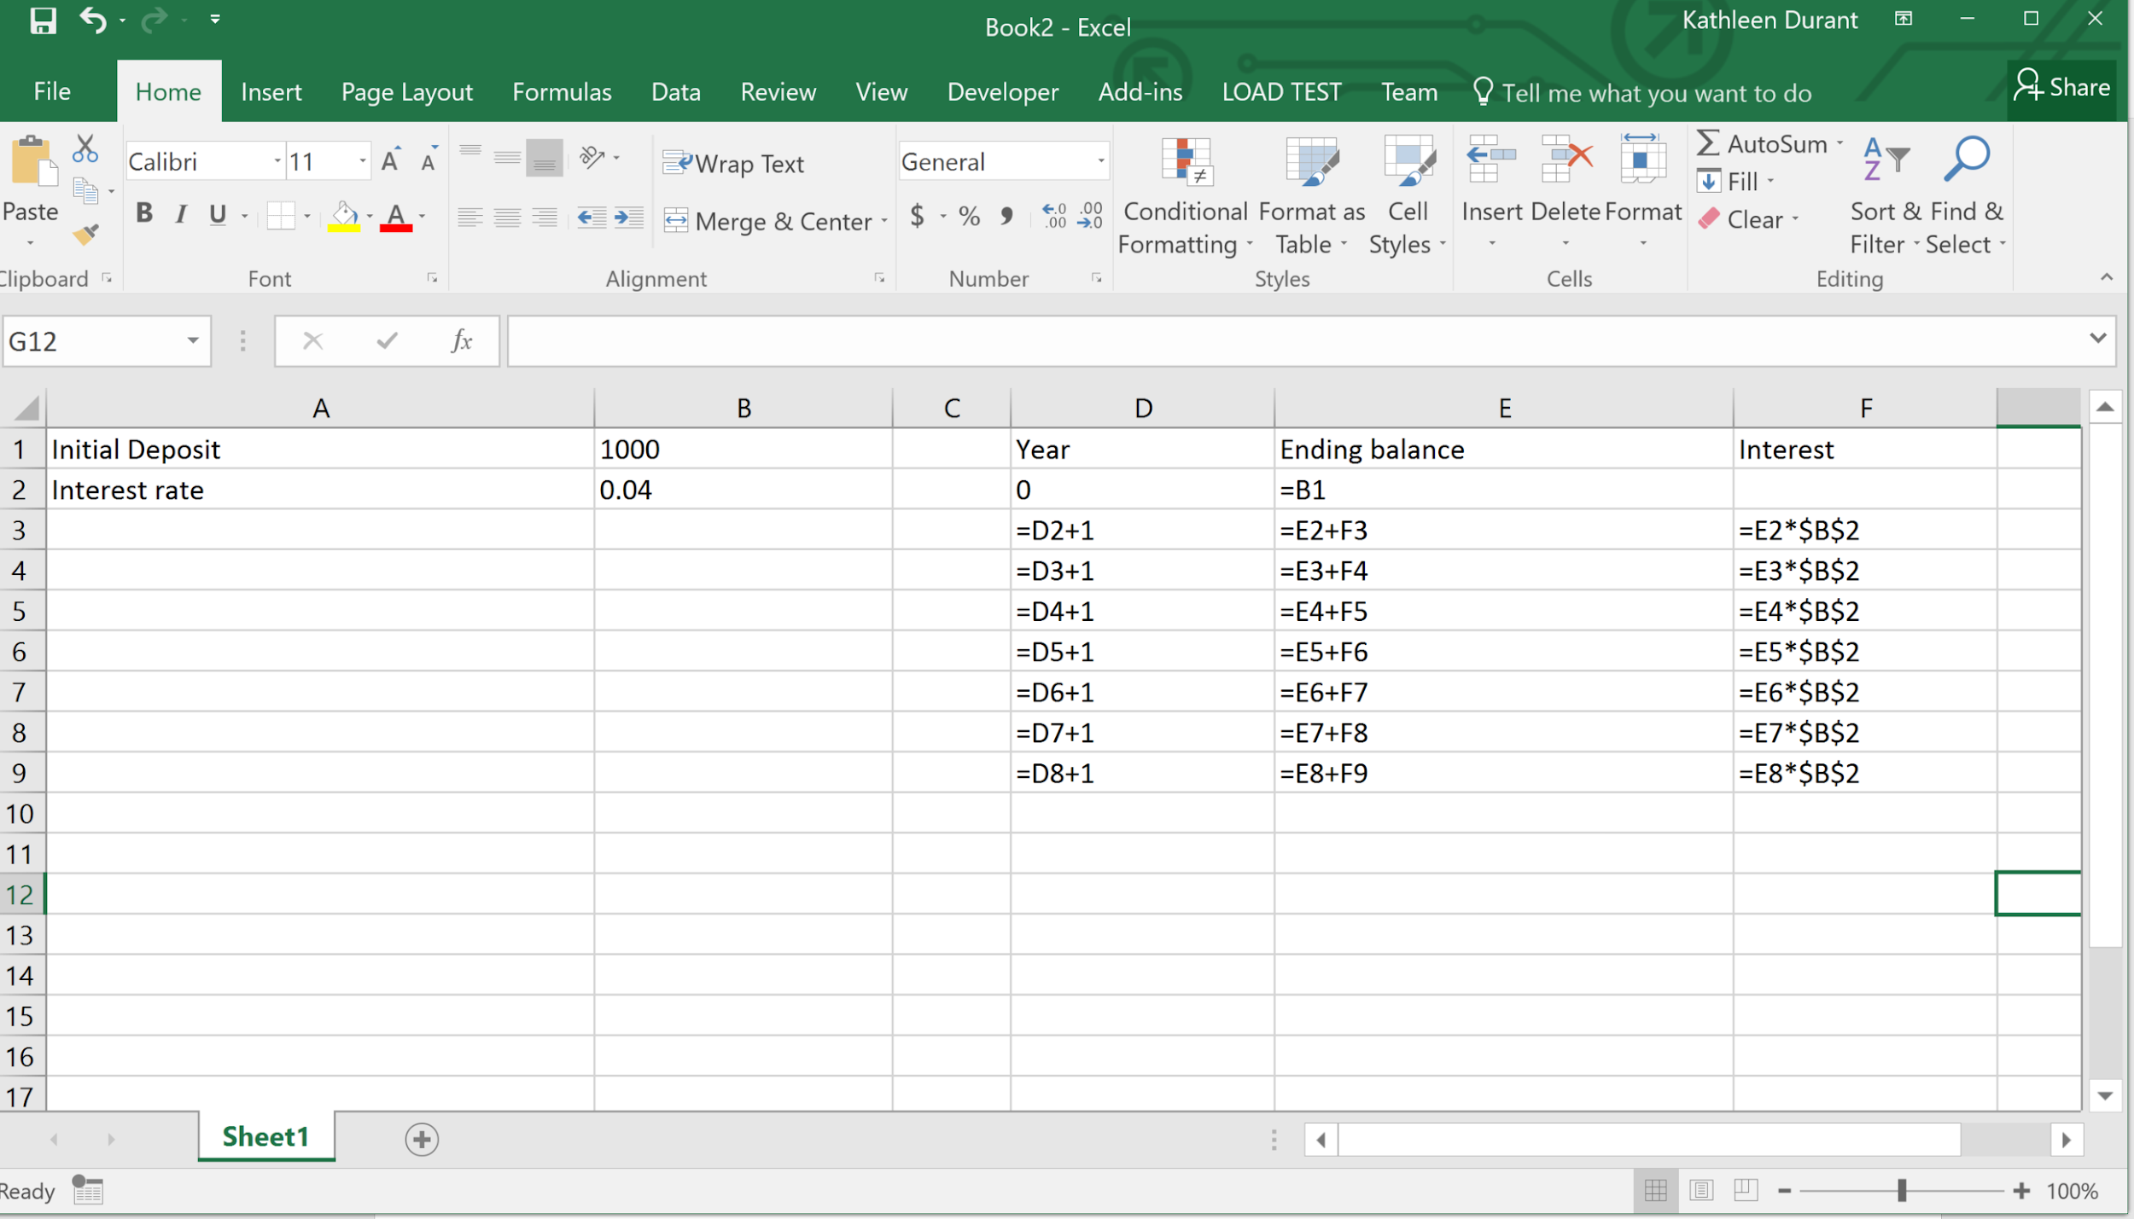
Inductive formulas

Slide 12
Inductively Defined Problems
The parameters of our problem appear separate from the calculations that model our problem (columns A and B).
There is a special year 0 in our solution that serves as a placeholder for our starting condition.
The formulas for the data for each year other than year 0 are similar, differing only in the cells that they reference.

Slide 13
Hiding Columns or Rows
To make spreadsheets easier to read,
  you can hide rows or columns that contain auxiliary (or supporting) values or temporary calculations.
Right-Click on the row or column header > select Hide

Slide 14
PMT()
PMT(rate, Nper, amount)
    rate - the interest rate per period.
    Most rates are annual rates, which means this value should be divided by the number of periods per year.
    Nper – total number of payments.
    Terms are usually in years, which means this value should be multiplied by the number of periods per year.
    amount – the amount of the loan
Calculates the monthly payment for a loan with a fixed interest rate.

