Slide 1
Action Queries
Topic 15
Lesson 1 – Action queries
Action Queries

Slide 2
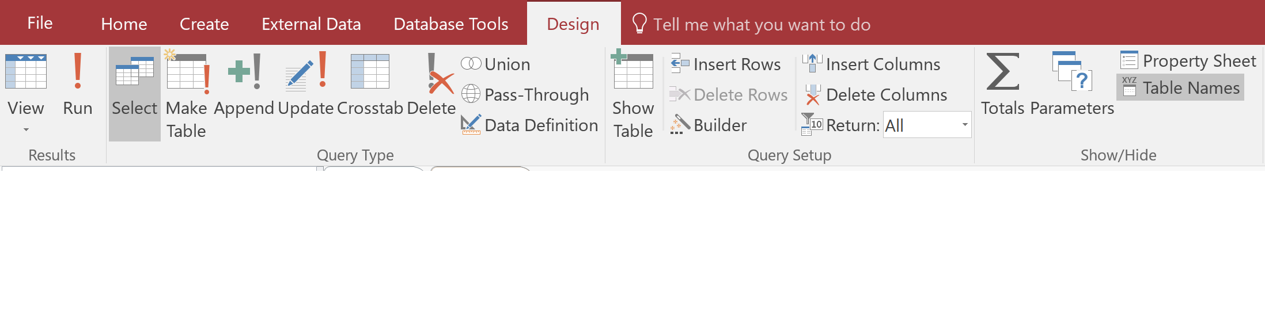
Action Queries
So far we have used queries to extract and view data.
Queries can also be used to create tables, perform data entry, modify records, etc.
The Query Type group under the Design tab contains commands for four types of action queries – Make Table, Append, Update and Delete

Slide 3
Action Queries
It is important to know that action queries are not creating a regular query in the strict sense since they modify as oppose to retrieve data.
Once it is run, the related action is executed and stays in the database even if the query is not saved – and it’s irreversible.
Good idea to backup your DB before running action queries...

Slide 4
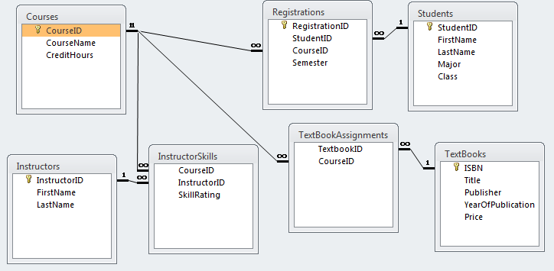
The Database Layout
These are all of the tables in the Registrar database:

Slide 5
Update Query
It’s easy to use a table or query in Datasheet view to find a single record and change one value.
But if you want to make the same change to many records, instead of going through individual rows one by one, let Access do the work with a single Update Query.

Slide 6
First Test with Select Query
Before running a query to update many records, create a query using criteria that select the records you want to update.
See how many rows need to be changed and that they are the correct rows.
Remember: Your updates are not reversible!

Slide 7
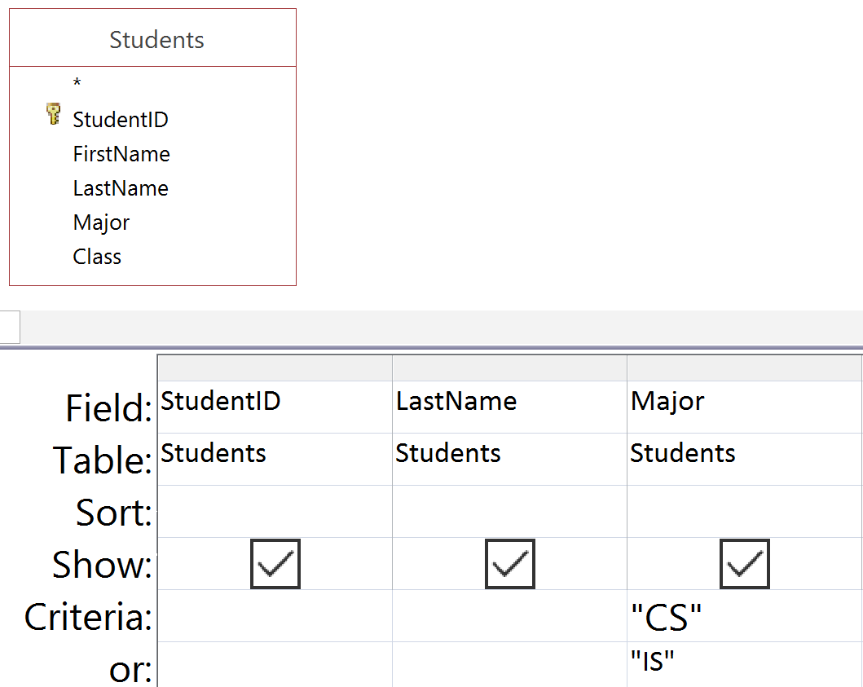
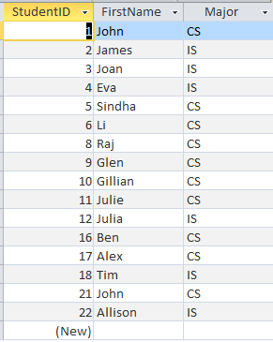
Example: Change the CS or IS major to CIS
We find 16 students that need to be changed in the database:

Slide 8
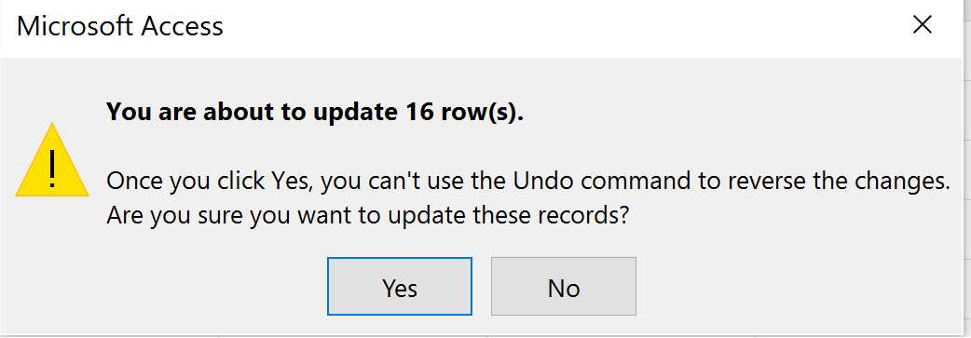

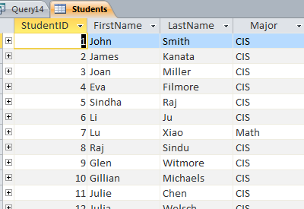
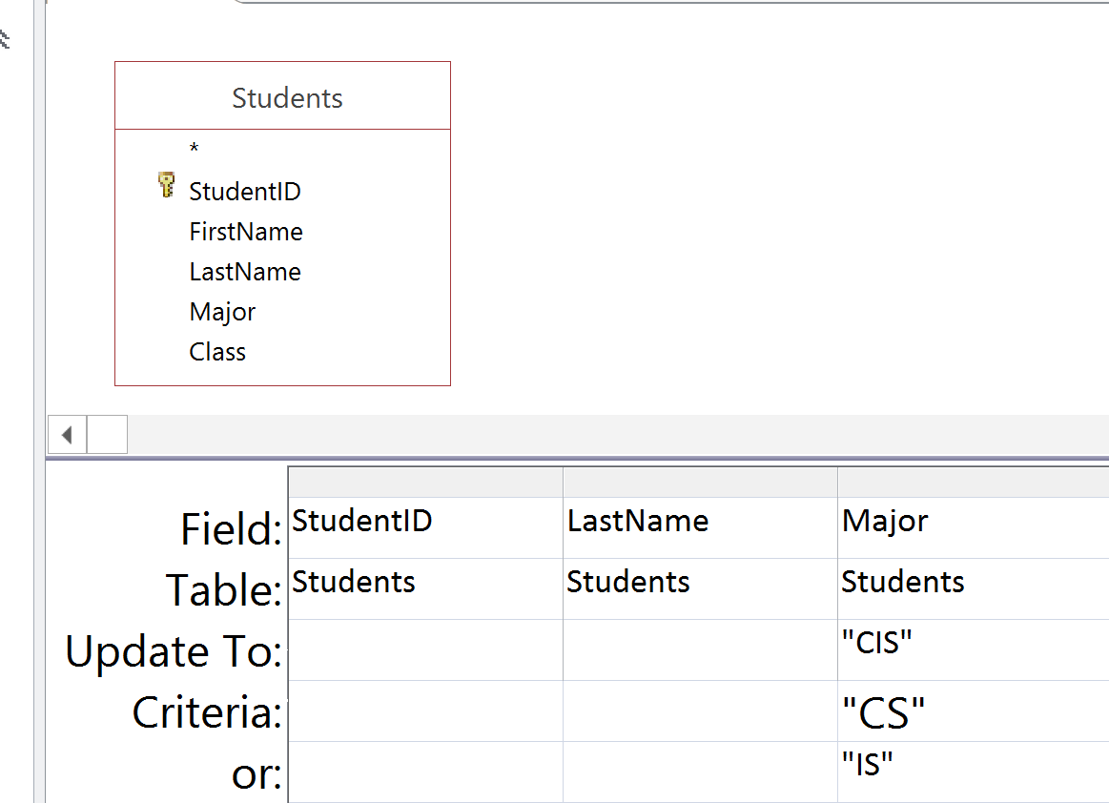
Convert to an Update Query
Now change the query so that it will update the table:

Slide 9
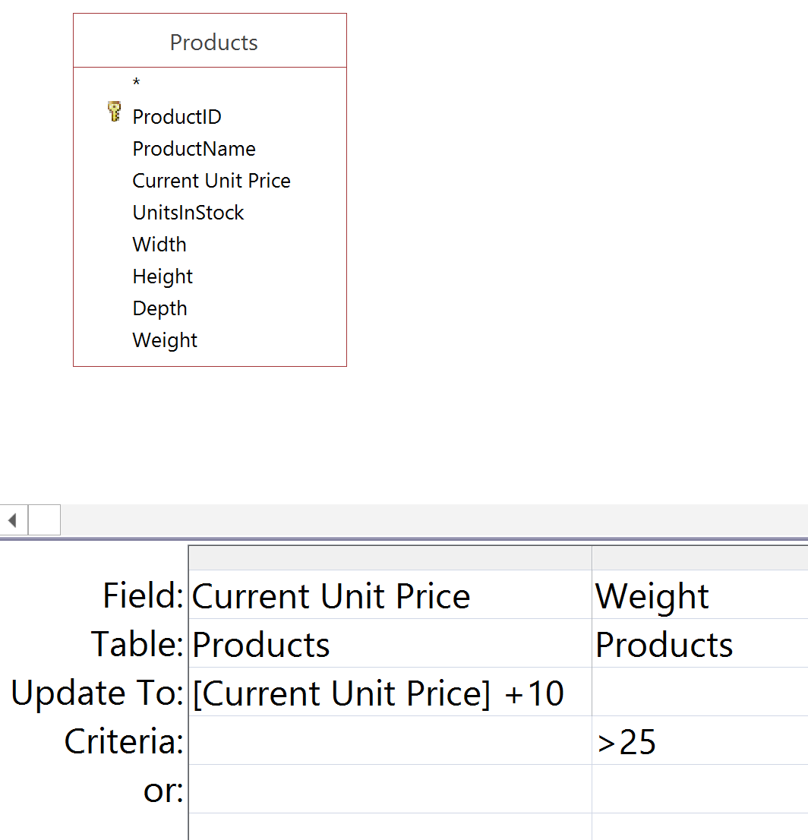
Criteria Updates
Add $10 surcharge to all heavy items.

Slide 10
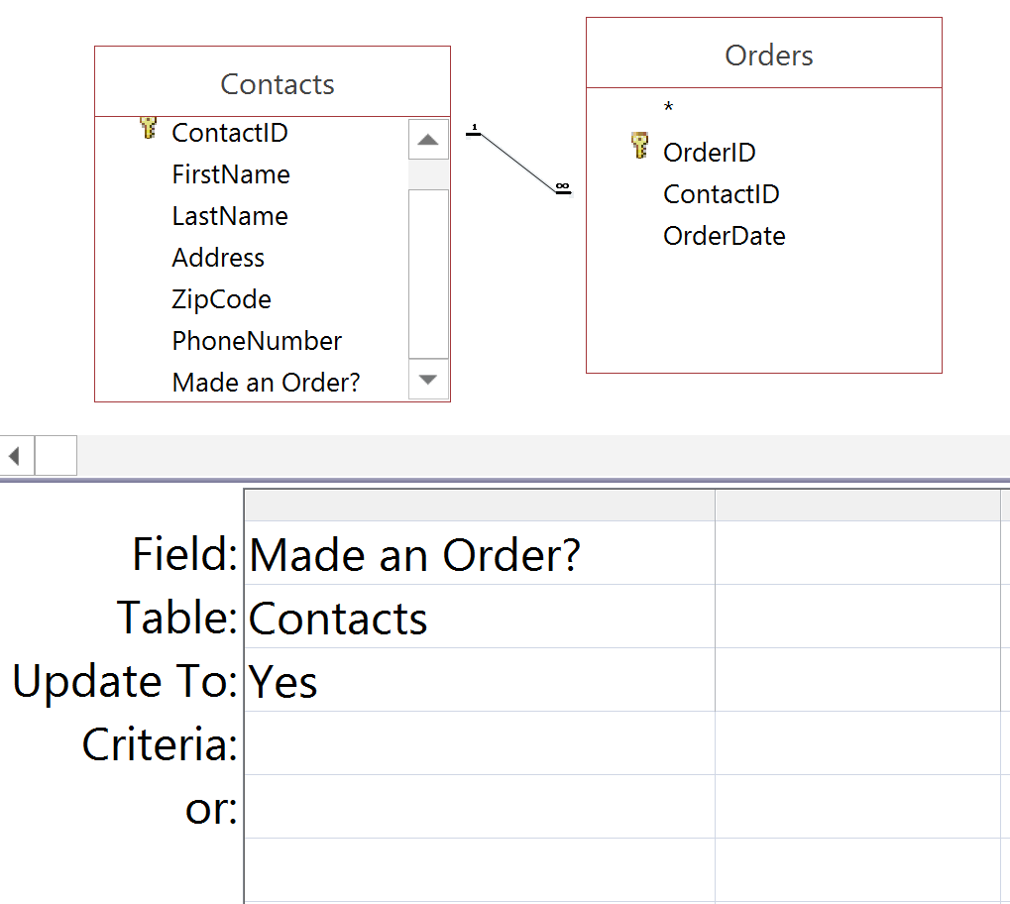
Update and Join
Change a field for everyone who placed an order.

Slide 11
Make-Table Query
If you already have values stored in a table, Access allows you to create a new table filled with values from that table.
This query is used to retrieve all or some fields of an existing table and creates a brand new table, independent of any existing table.

Slide 12
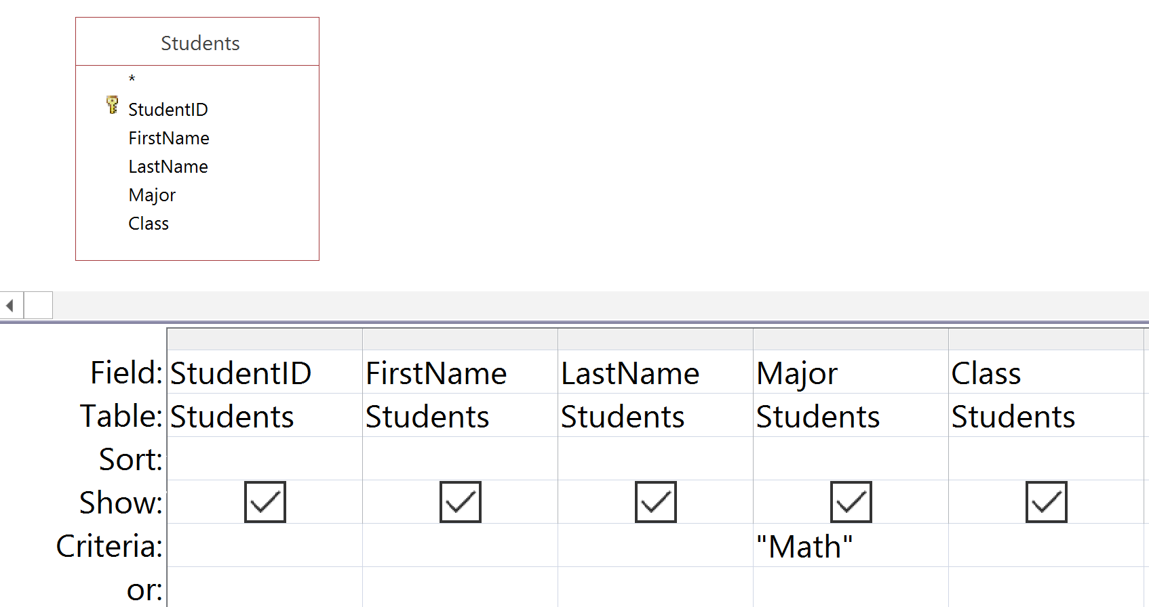
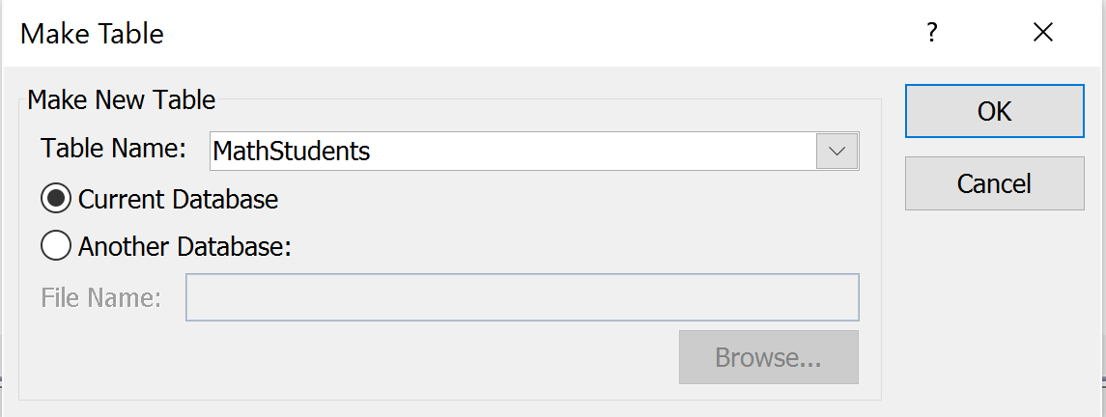
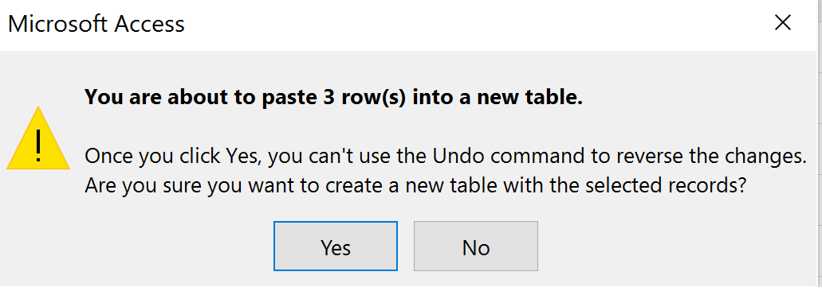
Make-Table Example: New table of Math Majors
Give the new table a name.

Slide 13
Append Query
Access allows you to create a special query that can be used to add many records to a table in one step.
An Append Query allows you to add records to an existing table, retrieved from one table and transferred to another table.

Slide 14
Appending Data
The data to be appended should have the same fields as the fields in the table.
The fields should have the same data types.
Key violations can occur if the data to be appended has the same keys as some records in the table.
Data can be appended from another table or imported from another application such as Excel.

Slide 15
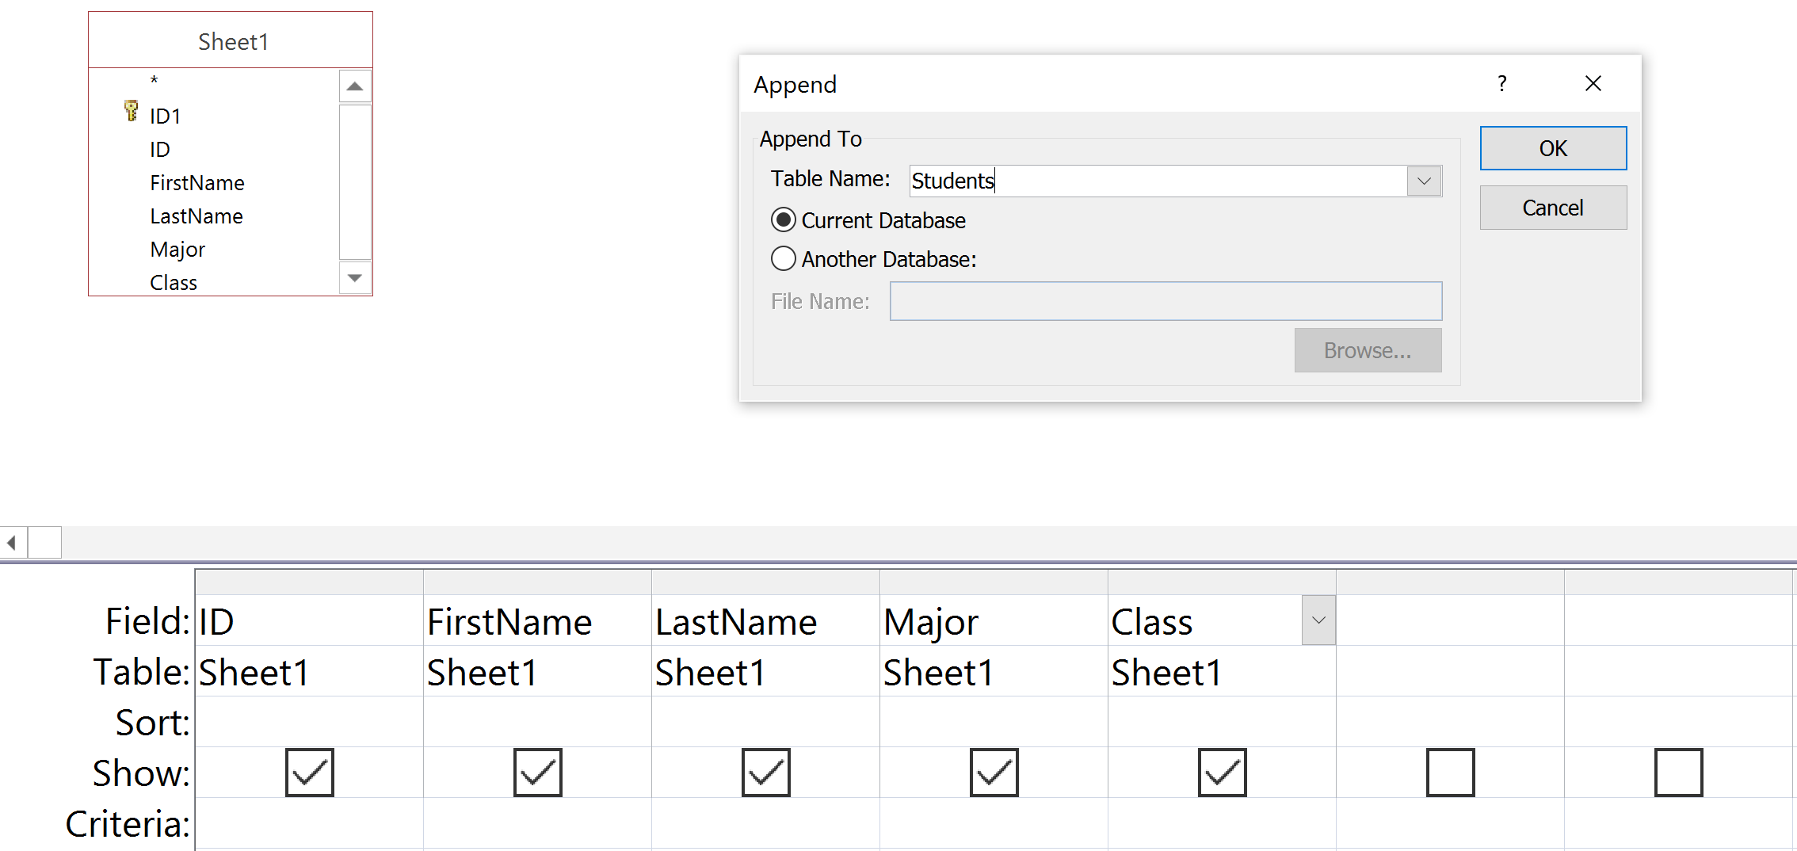
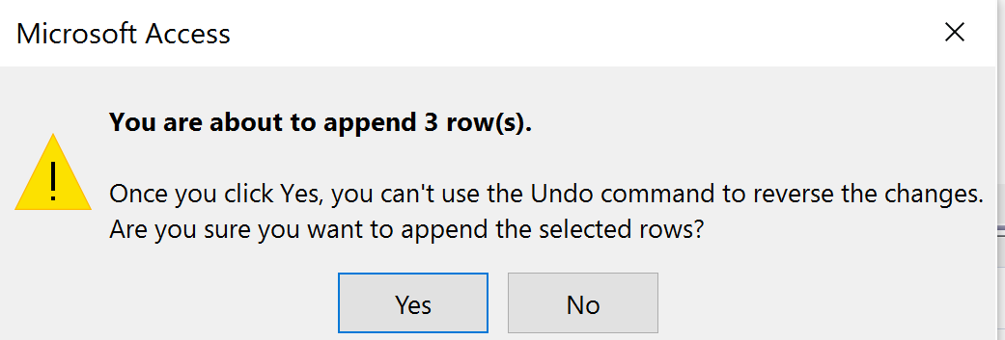
Append incoming freshmen to the students table
Choose the table to append to
Run query to receive panel stating number of affected rows.
Close modified table. Open it again and you see the modifications.

Slide 16
Delete Query
To delete a group of records in one action, you can use a Delete Query.
Allows you to select records to delete
Like other action queries, it is irreversible

Slide 17
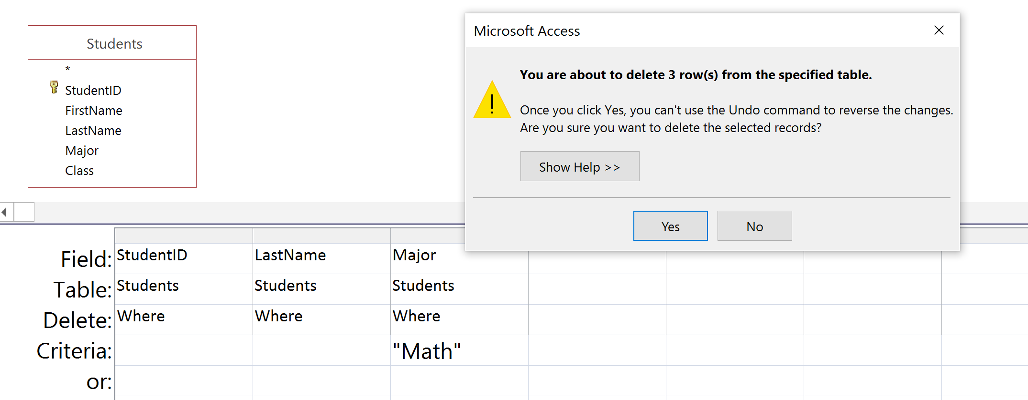
Delete Math students from the Student table
Close modified table. Open it again and you see the modifications.

Slide 18
Summary
Action queries can be used to make changes to a database.
Once an action query is run, it is executed and the updates remain in the database even if the query is not saved.
Action queries are not reversible!

