Slide 1
Creating complex queries using nesting
Topic 14
Lesson 1 – Subqueries or Nested queries

Slide 2
Nested Queries
Some complex queries must be based on the results of other queries.
The result of a query is a virtual table, i.e., something that looks and can be used like a table, but is not actually stored in the database as a table.
A query can be used (as a table is used) in the design of a query.

Slide 3
Subqueries
A subquery is a query statement that’s nested inside of another query.
Sometimes need to use the results of a query as a field in another query, or as a criterion for a query field.
Example:
How many orders have a total under $2,000?
To find the answer, first need to calculate order totals and filter out those that are $2,000 and under.
Then do a count.

Slide 4
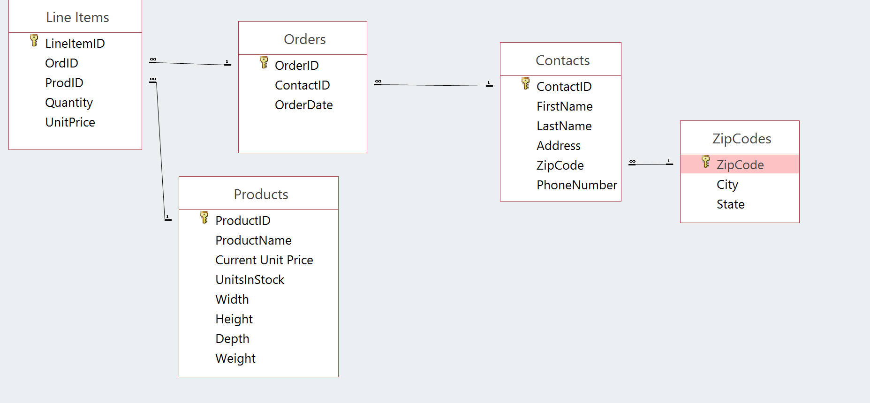
The Database Layout
These are all of the tables in the database:

Slide 5
Example Query I
How many orders were placed that had a total of less than $2000?

Slide 6
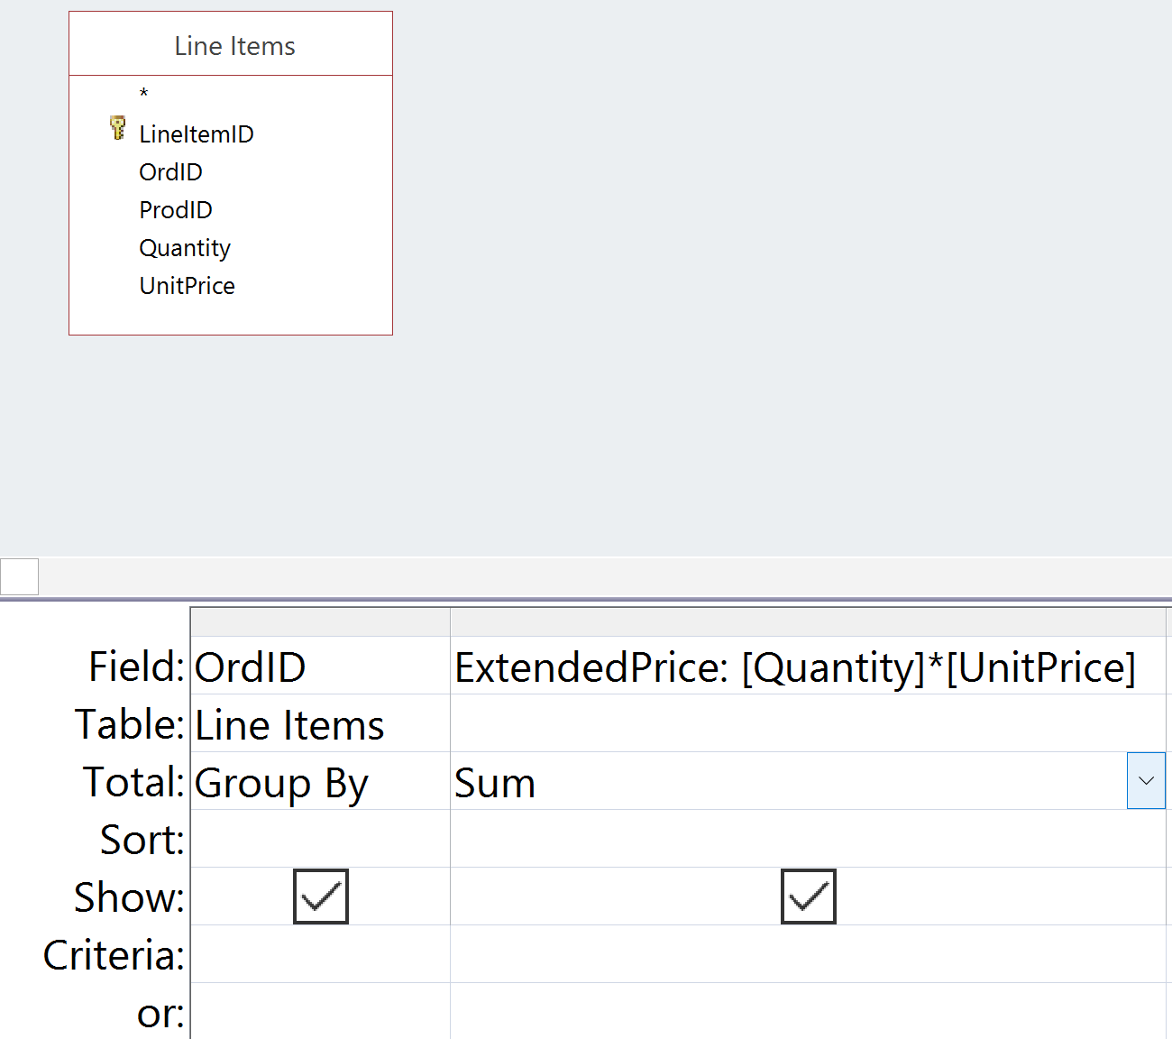
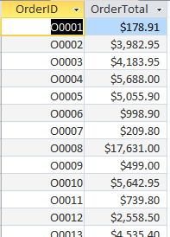
Step 1: Total for Each Order?
Design View
Datasheet View
Using the Principle of Simplest Query we break this query into two subqueries: Widening, then Aggregation.

Slide 7
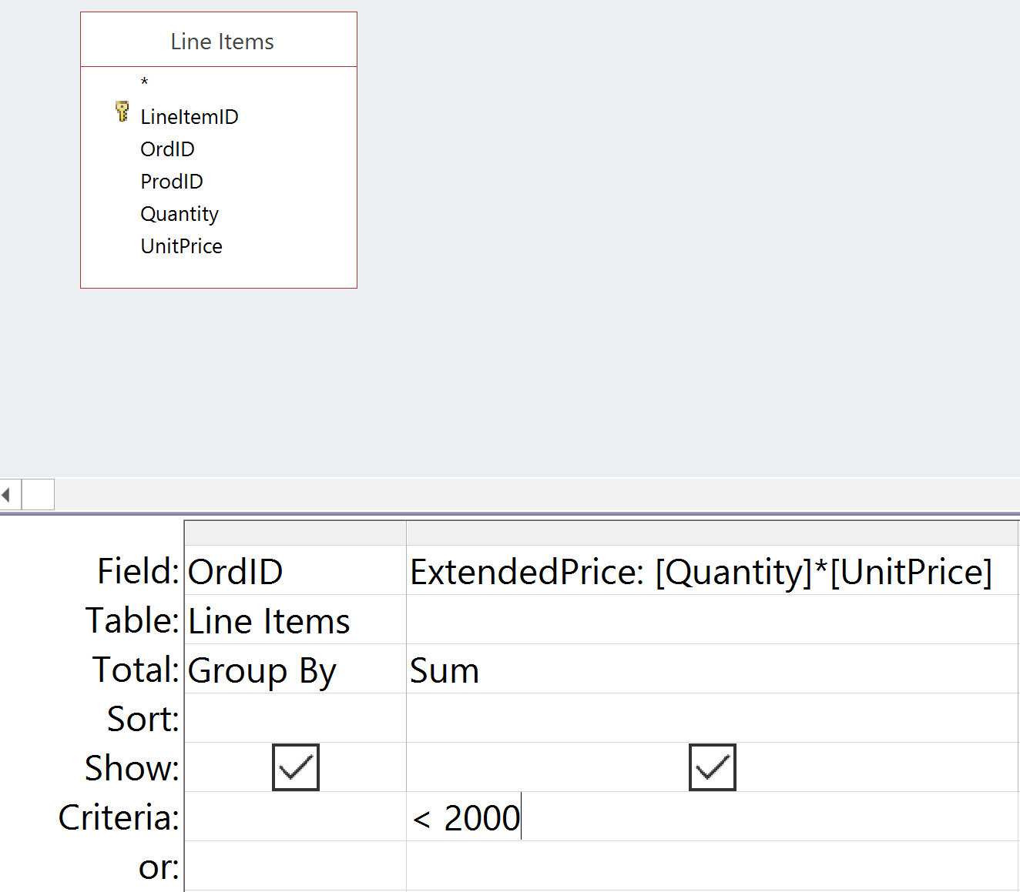
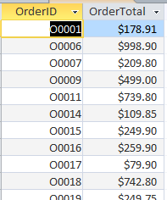
Step 2: Filter Orders Less Than $2,000?
Design View
Datasheet View
The Principle of Simplest Query would break this query into three subqueries (widening, followed by aggregation, followed by selection). A more descriptive alias for OrderTotals is FilteredOrderTotals.

Slide 8
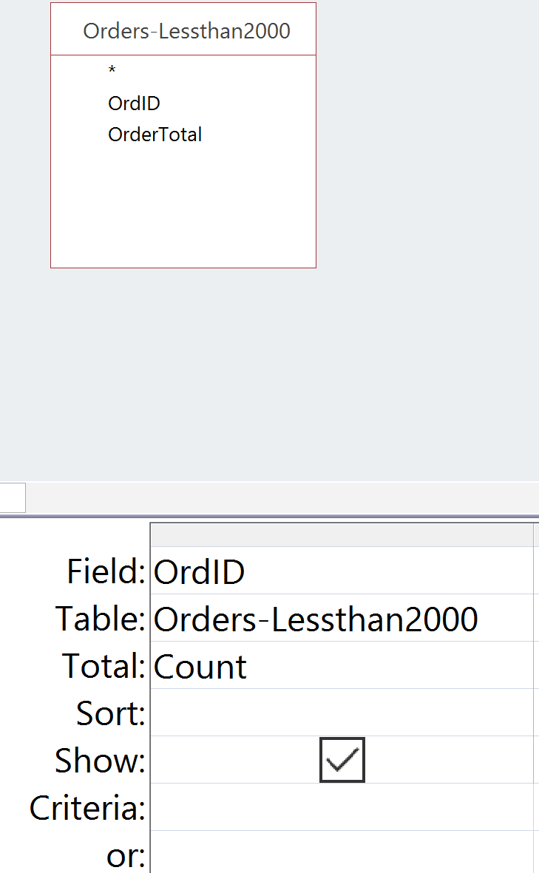
Step 3: Count the Resulting Rows
Build a new query with the previous query as a subquery
Design View
Datasheet View

Slide 9
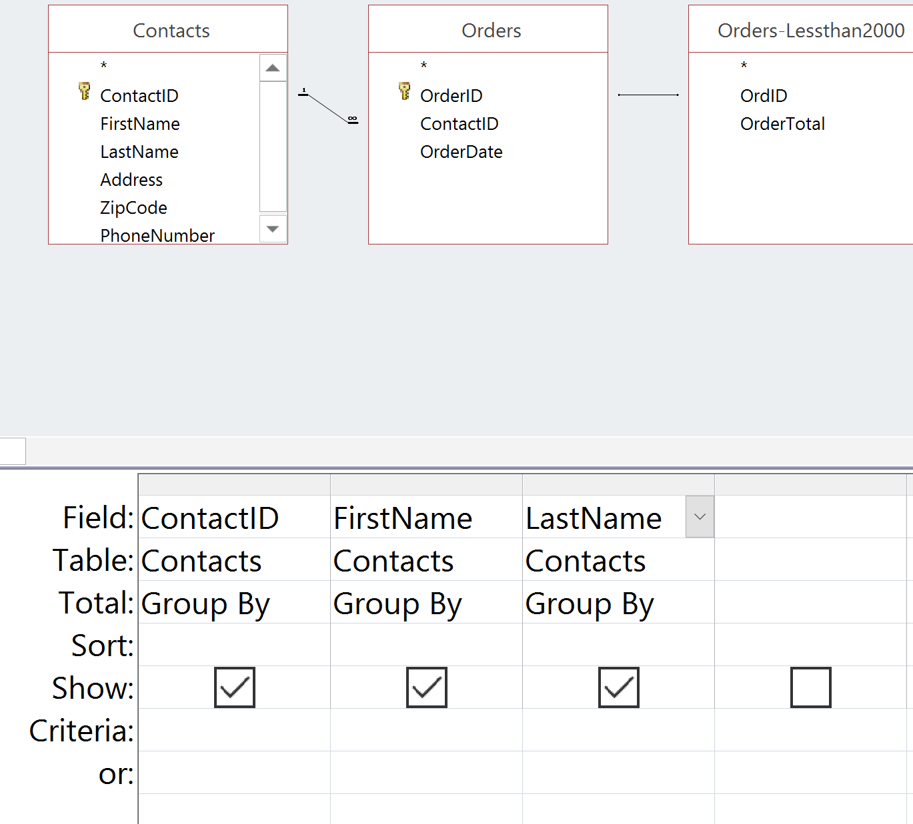
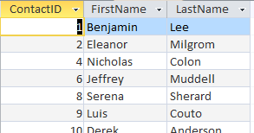
Example Query II
Who placed these orders less than $2,000?
Use OrdersTotal again as a subquery
Combine with Orders and Contacts to get customer information
Use Group By to remove duplicates
There are 15 contacts in total

Slide 10
Watch Out: Access Caches Queries
Whenever Access executes a query it saves (“caches”) the result.
When that query is used as a subquery, Access uses the cached result instead of running it again.
If you then update the subquery, Access does not automatically refresh the result for the query that uses the subquery.

Slide 11
Refreshing Queries
To refresh all queries, you need to:
Close all queries
Click the right mouse button on the query tab and select “Close”
Load the query again
double-click on the query in the navigator
This forces a refresh.

Slide 12
Use Step by Step Decomposition
How many orders are there that have a total value of less than $1000?
Create a query that finds all orders with a value less than $1000
Save the query under an appropriate name
Create another query based on the previous query that COUNTs all of the rows
CAUTION: Do not modify or rename queries that are used as subqueries.

Slide 13
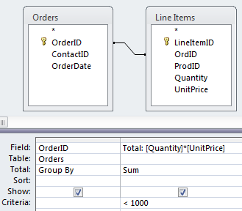
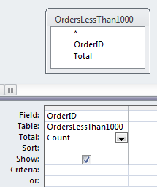
Solution with Subqueries
Subquery: OrdersLessThan1000
Note the use of the subquery and the aggregate COUNT function
OrderLessThan1000 is a convenient shortcut, but violates WASE. We combine Widening, Aggregation and Selection in one query.
So there are 21 orders with a total less than $1000

Slide 14
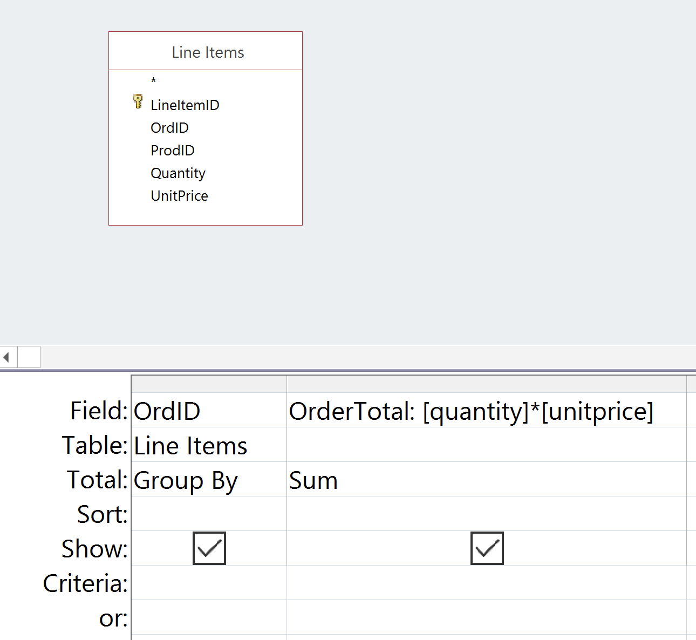
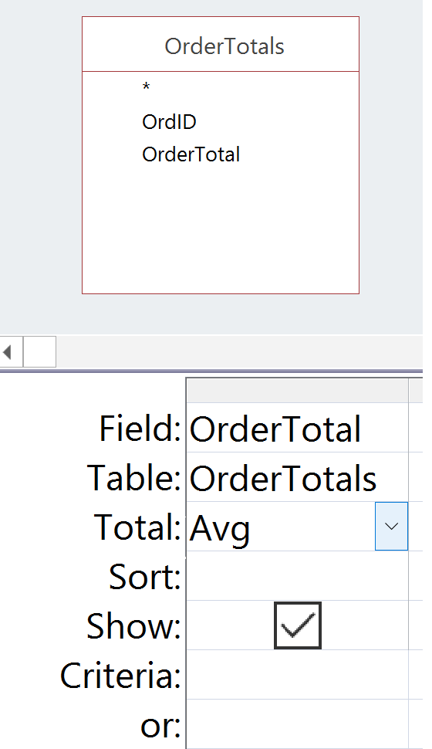
Example Query III
What is the average cost of all orders?
Note the use of the subquery and the aggregate AVG function
Subquery: OrderTotals
OrderTotals violates WASE. Exercise: rewrite using two queries: a Widening and an Aggregation subquery.

Slide 15
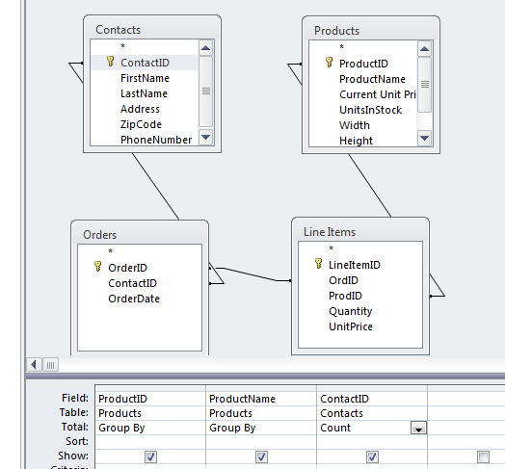
Example Query IV
How many different people bought each product?
Attempted query

Slide 16
Example: Counting Unique Occurrences
How many different people bought each product?
Attempted query
Count of Contact IDs

Slide 17
But
Grouping by Contact IDs shows 2 different contacts ordered Product #8

Slide 18
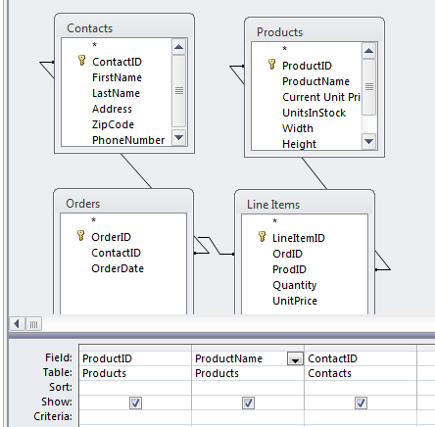
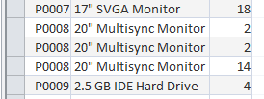
Why?
Let’s remove the Totals and Ungroup.

Slide 19
Why?
Let’s remove the Totals.
Someone ordered it twice
We have duplicates
Group by removes duplicates but doesn’t count.
Count aggregates but doesn’t remove duplicates.
So what do we do?

Slide 20
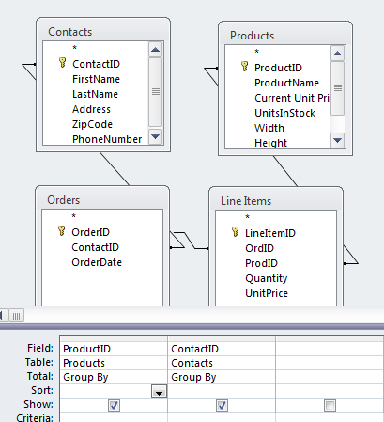
Solution
Use subquery to perform grouping
ProductContactNoDups

Slide 21
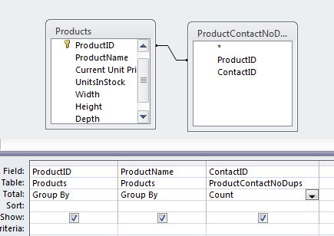
Solution
Use subquery to perform grouping, then count

Slide 22
TRY FOR YOURSELF…
Access Queries

Slide 23
Question 1
Which contacts placed three or more orders?

Slide 24
Question 2
How many contacts placed three or more orders?

Slide 25
Question 3
Which states had contacts that placed 3 or more orders?

Slide 26
Maximum and Minimum
What is the maximum amount of any order that was ever placed?
What is the minimum amount of any order that was ever placed?
Which order was the minimum order?
Who placed the minimum (smallest) order?

Slide 27
Maximum Query
What is the maximum amount of any order that was ever placed?

Slide 28
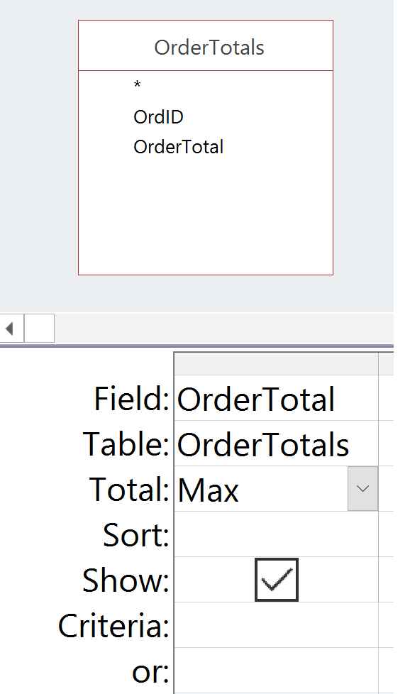
Maximum Query
What is the maximum amount of any order that was ever placed?
Use OrdersTotal again as a subquery
Apply the MAX aggregate function

Slide 29
Minimum Query
What is the minimum amount of any order that was ever placed?

Slide 30
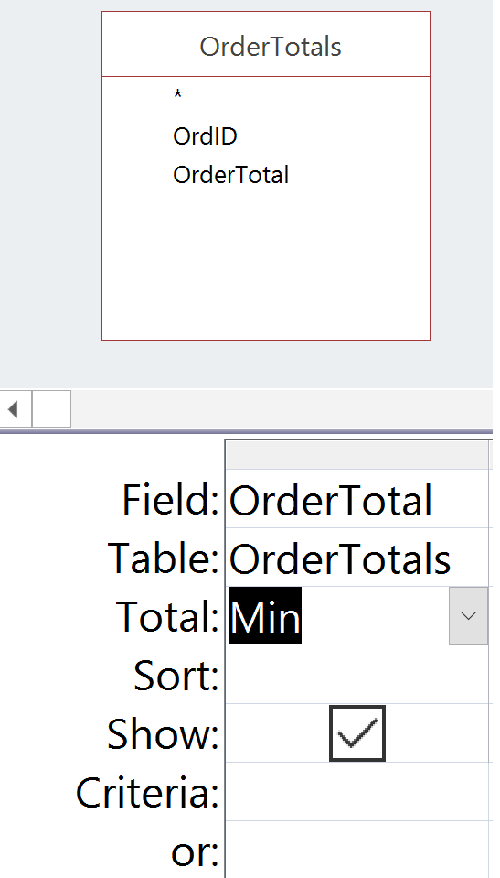
Query
What is the minimum amount of any order that was ever placed?
Use OrdersTotal again as a subquery
Apply the MIN aggregate function

Slide 31
Minimum Order Query
Which order was the minimum order?

Slide 32
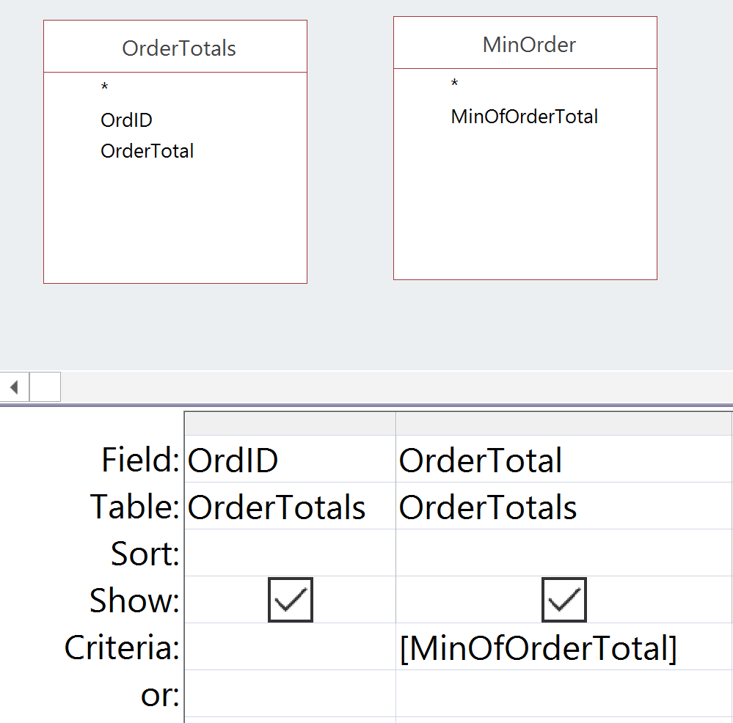
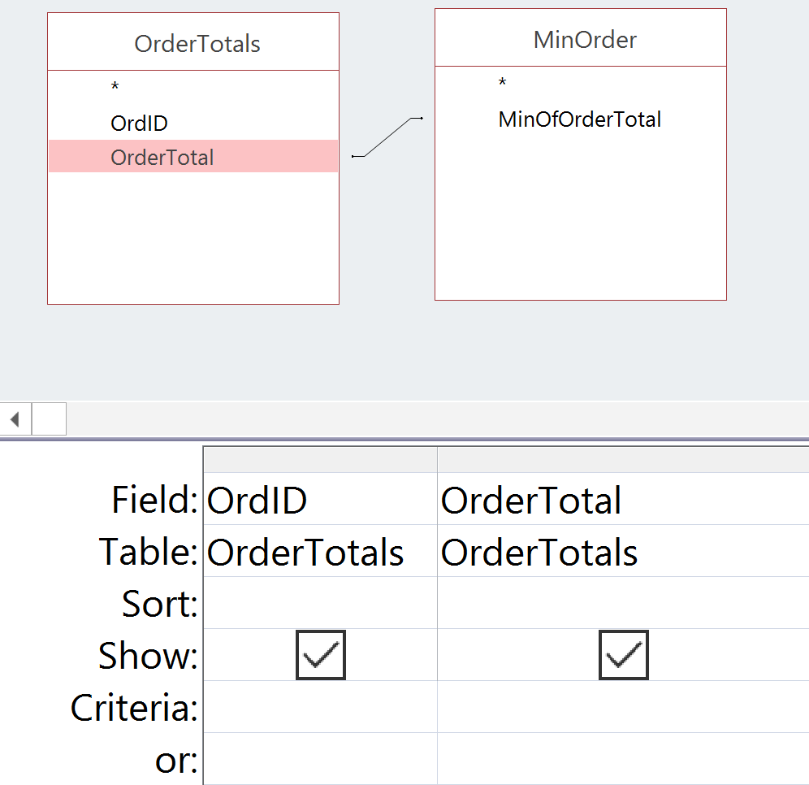
Minimum Order Query
Which order was the minimum order?
Requires the previous query and OrdersTotal as subqueries
Can use one of two approaches
Approach 1: Use Criteria
Approach 2: Create Relationship

Slide 33
Query
Who placed the smallest order?

Slide 34
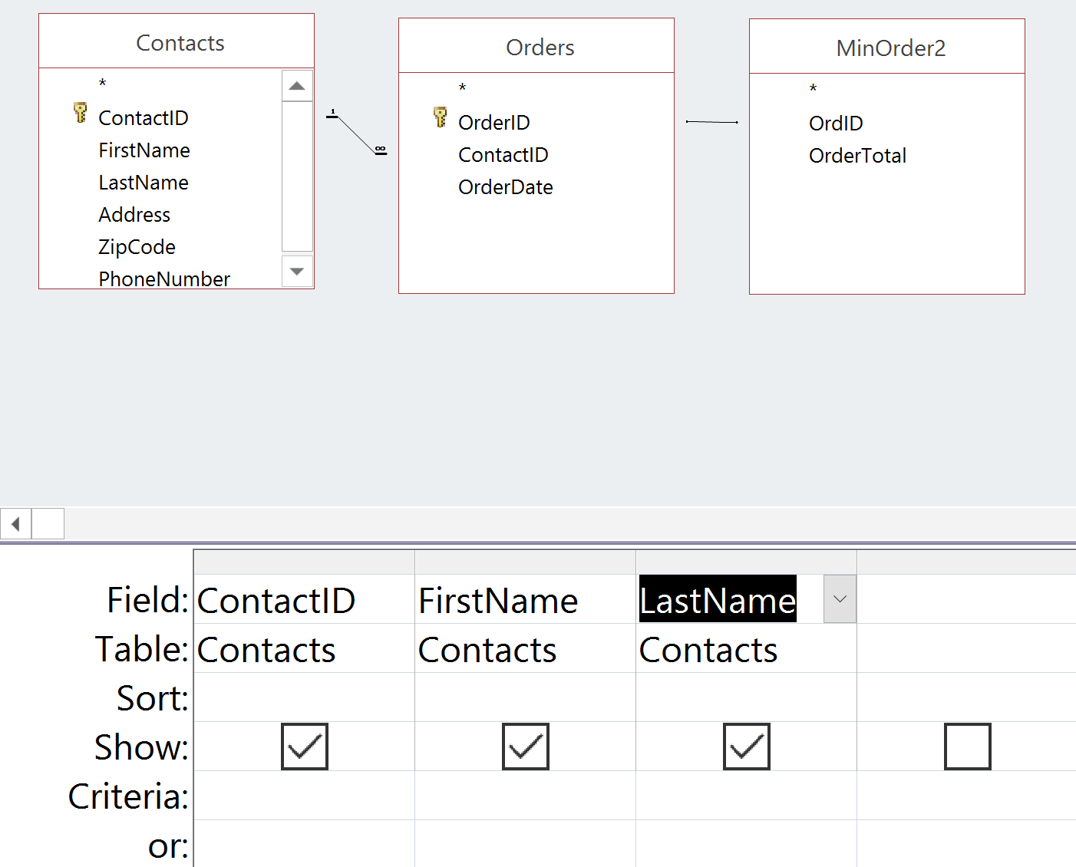
Query
Who placed the smallest order?
Use previous query as subquery
Combine with Orders and Contacts table

Slide 35
Try this:
Which orders contained a line item for the least expensive product (based on CurrentUnitPrice)?
Who ordered the least expensive product?

Slide 36
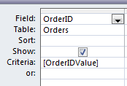
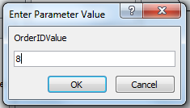
Parameterized Query
To allow user input for a query value:
specify a variable that has a name different from any of the field names
Since the value for the field is unknown, the database queries the user for its value

Slide 37
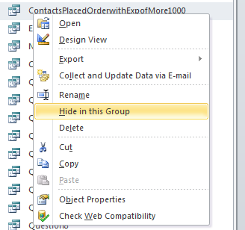
Hiding Subqueries
Queries (and tables) can be “hidden”:
Right-click on query in navigation panel
Select “Hide in this Group”

Slide 38
Unhiding Queries
Click anywhere in the Query Explorer
Select “Navigation Options…”
Check “Show Hidden Objects”
Now all hidden queries are visible and can be unhidden.

Slide 39
Summary
Group By removes duplicate rows where the Group By values are the same
Aggregate functions apply to groups or entire tables depending how they are used
Subqueries are necessary to build complex queries

