Slide 1
Building Queries using the Principle of Simplest Query (POSQ)
Topic 13
Lesson 2 – Examples using POSQ

Slide 2
Example Query 1: List Order Dates from the Orders Tables
Query: List the OrderDates where the Quantity of an item ordered is at least 2.
Easy way of implementing query with POSQ:
Selection query: select subset of OrderDates with quantity > 2.
Elimination of Duplicates.
SE : SELECT rows with criteria quantity > 2, then ELIMINATE Duplicates with “Group by”

Slide 3
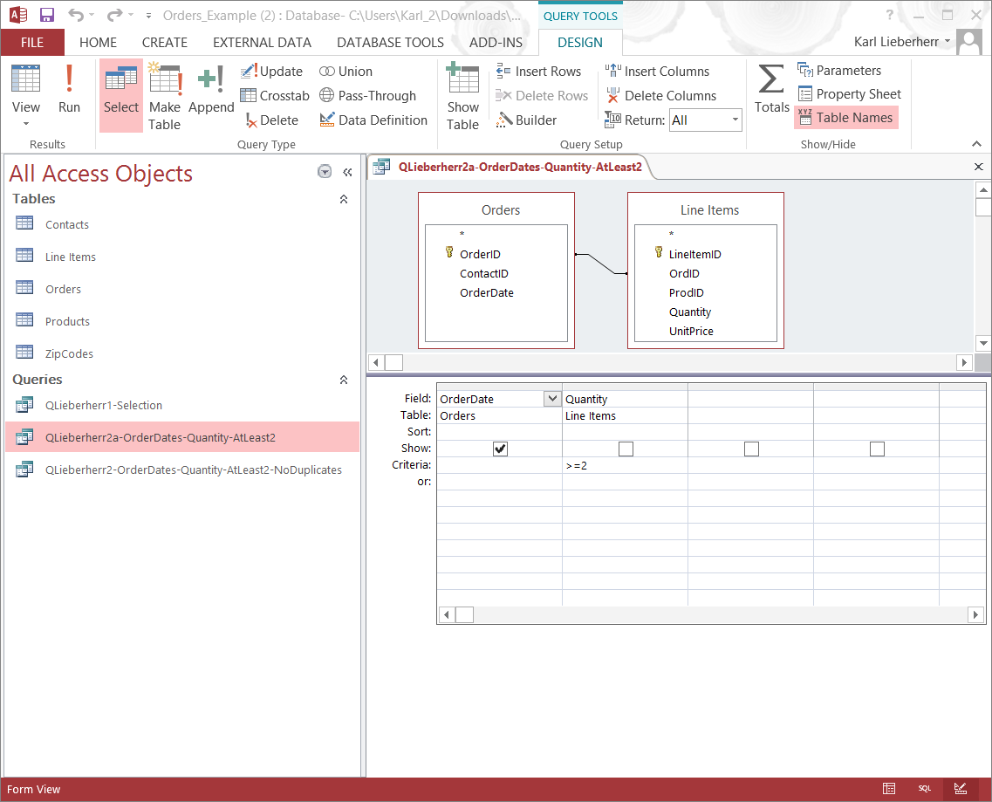
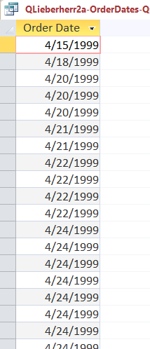
First subquery: Selection

Slide 4
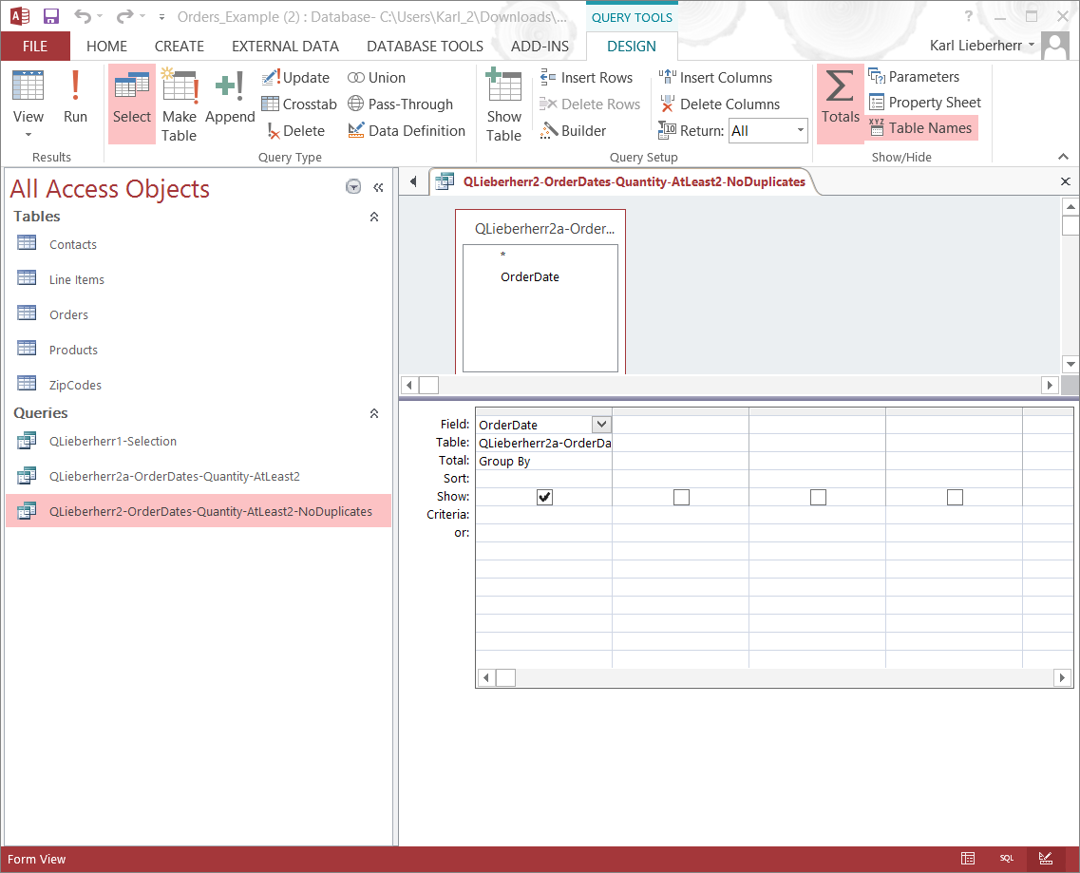
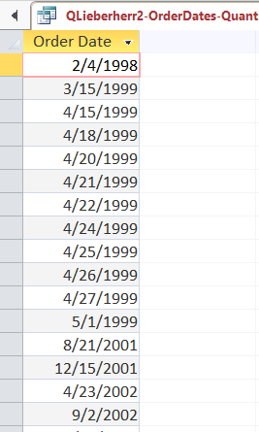
2nd Subquery: Elimination of Duplicates

Slide 5
Example Query 2: Total for each Order
Query: Calculate the total for each order. List the OrderId, OrderDate, and OrderTotal.
Easy way of implementing query with POSQ:
Widening query: calculate the extended price for each line item.
Aggregation query: calculate the total for each order.
WA : WIDEN by adding a calculated field, then aggregate the extended price column while grouping the column by OrderId.

Slide 6
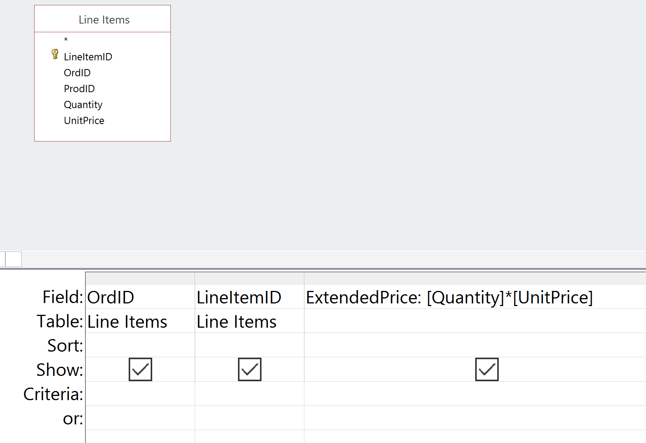
Subquery 1: Widening Example: Calculated Field with an ExtendPrice Alias
Note:
Save query as QOrder1a-ExtendedPrice

Slide 7
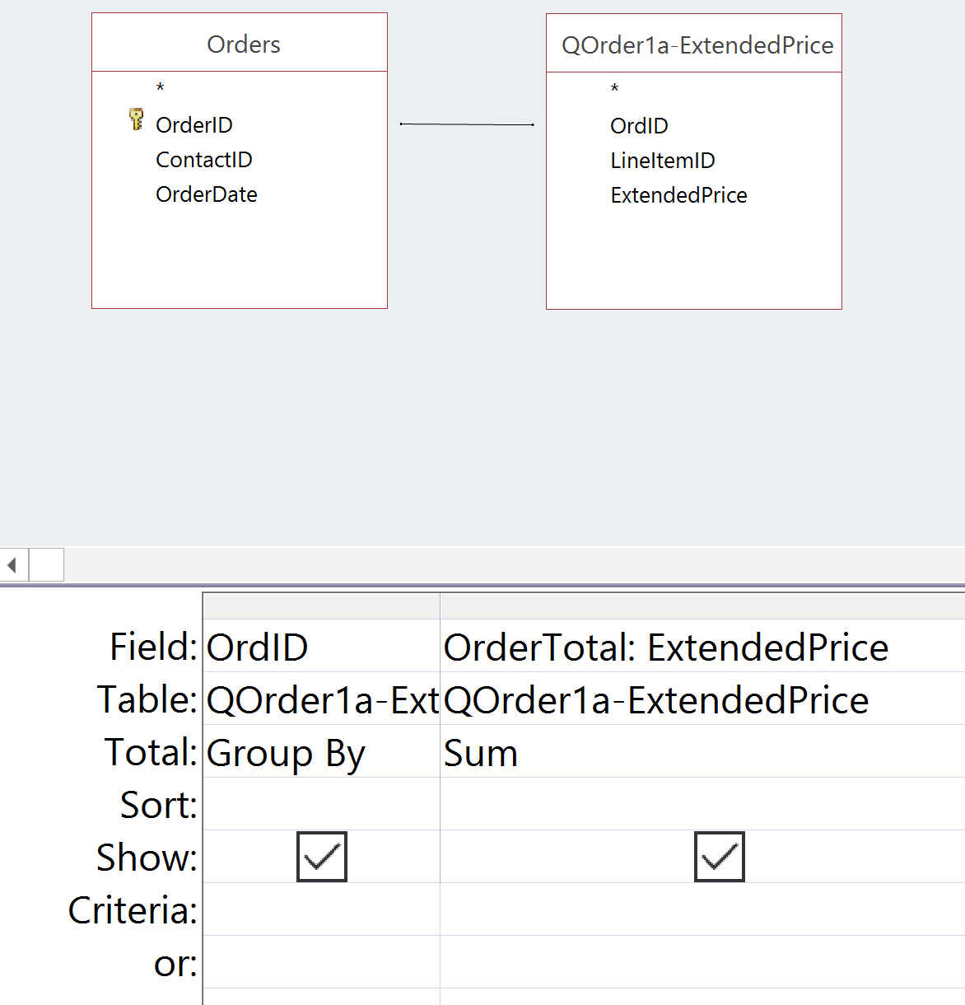
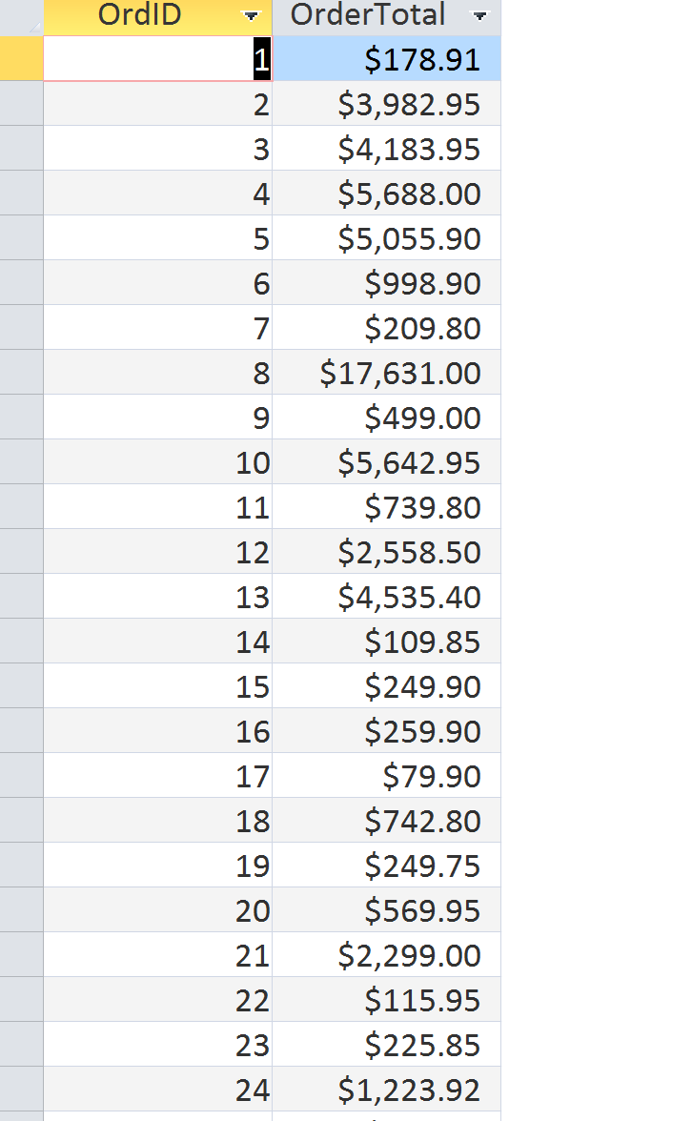
Subquery 2: Sum ExtendedPrice for each Order
Design View
Datasheet View
Note:
OrderTotal is an alias for the sum of the ExtendedPrice values in each order group.
Each order group is defined by the distinct OrdID values.
Save Query as QOrder1-Total

Slide 8
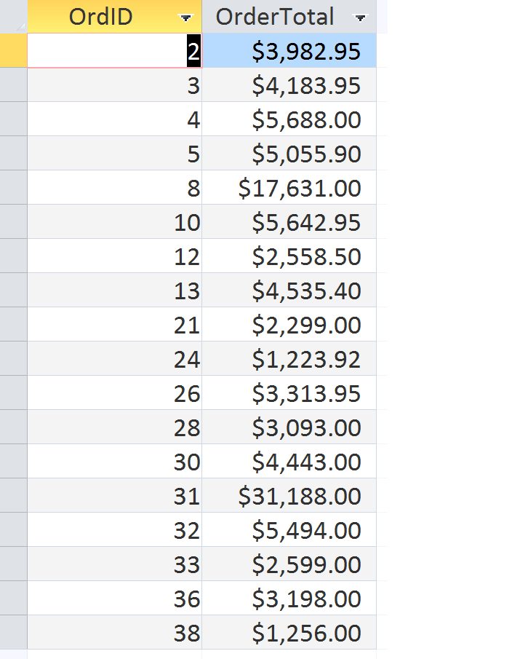
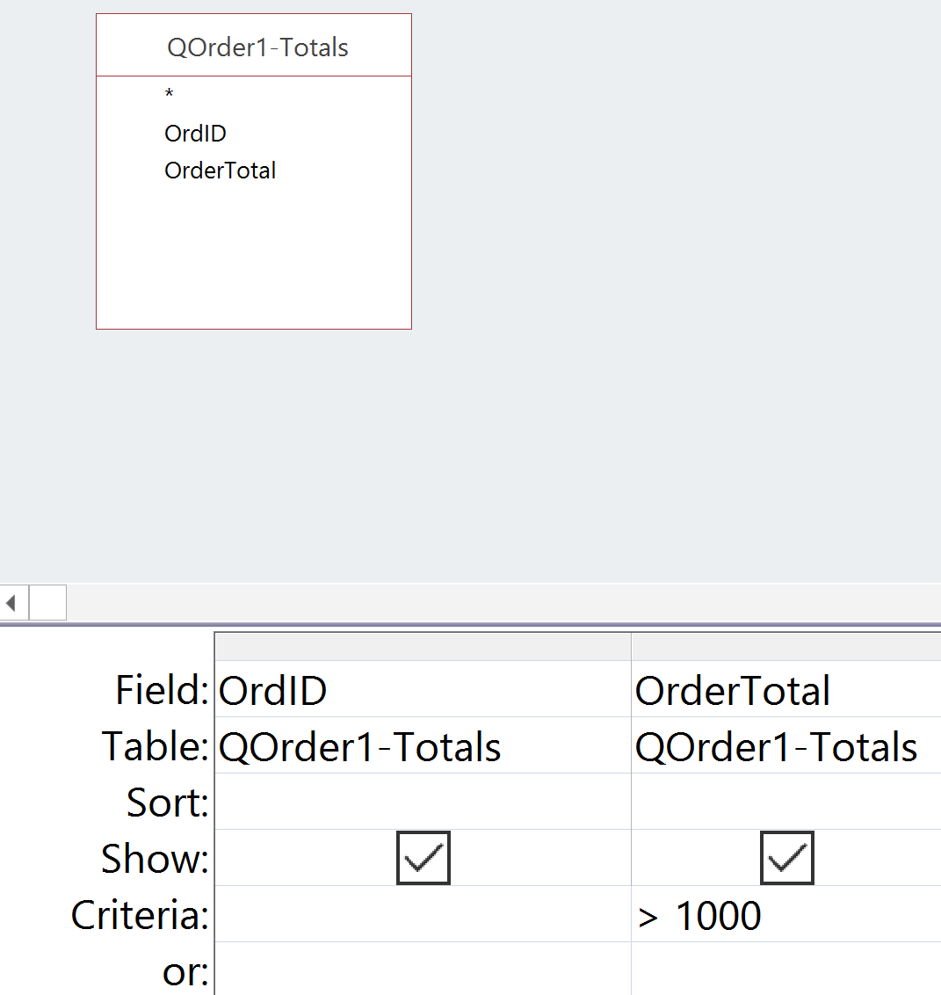
Example Query 3: List Order Ids with Order Totals Above 1000
Design View
Datasheet View
Note:
Nest queries to solve more complex queries.
This query takes advantage of the previously written QOrder1-Totals query to answer this query

Slide 9
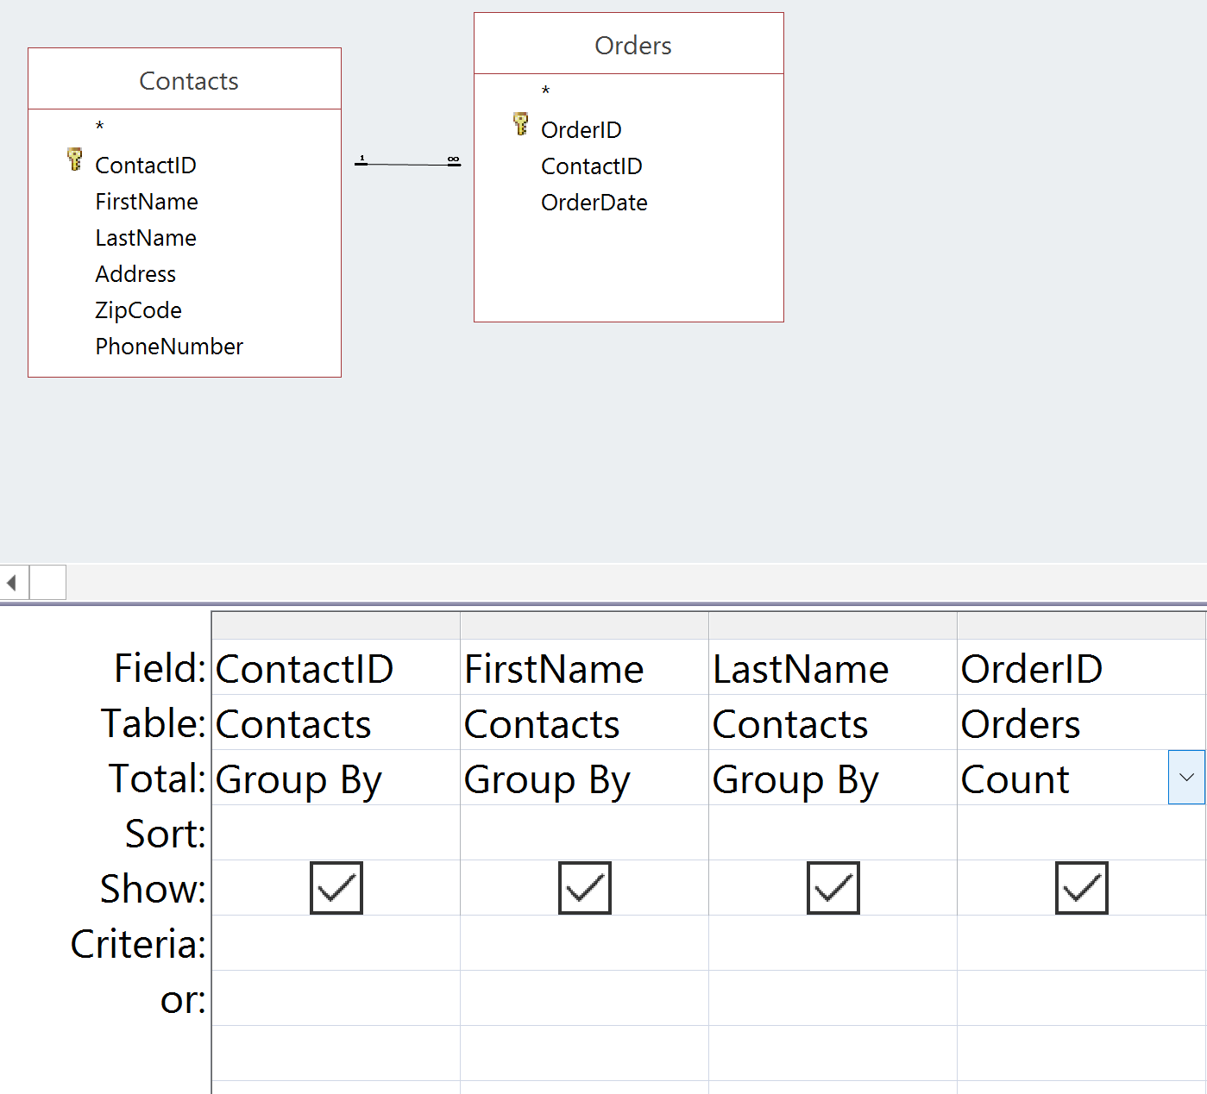
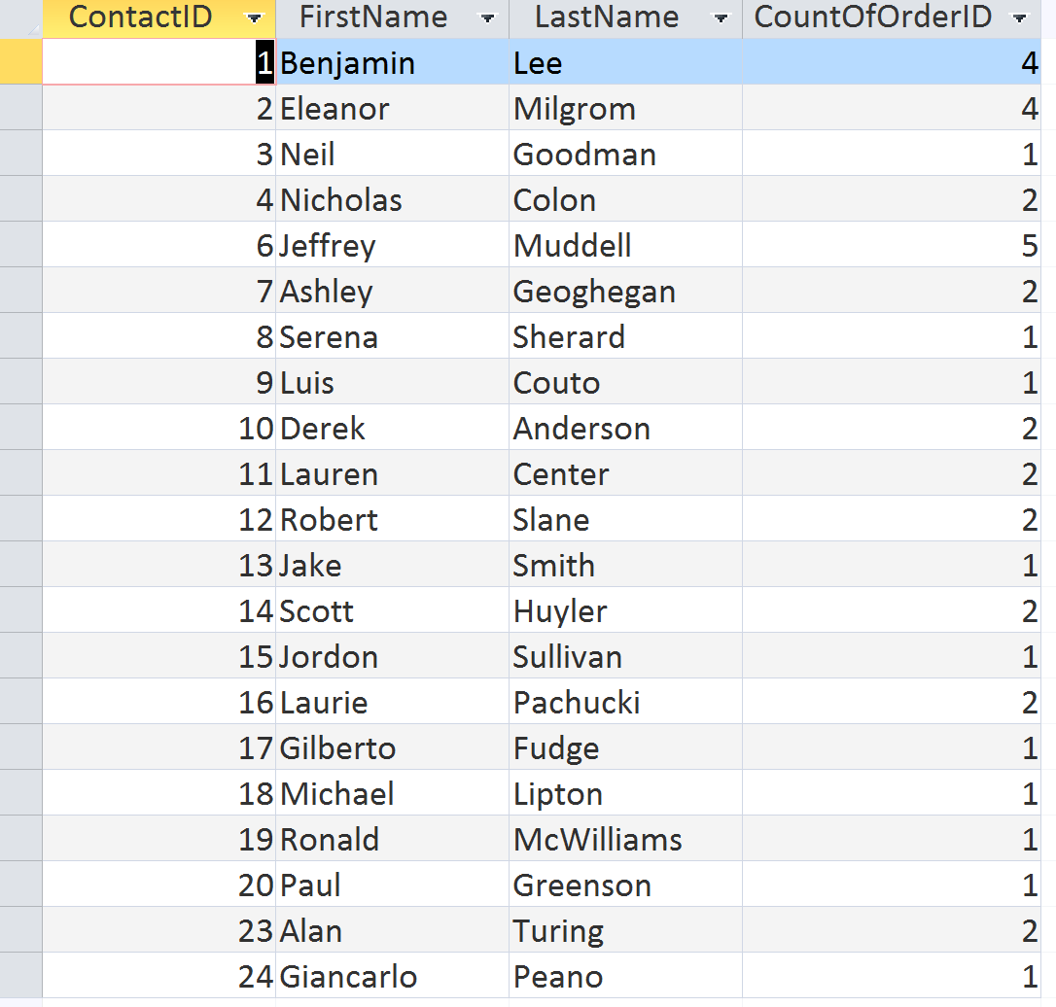
Query Example 4: Count the number of Orders each customer placed
Design View
Datasheet View
Note:
When grouping or calculating aggregations by contacts the ContactId (primary key) must be present in the query.
If it is not present, then you do not have a GROUP for each contact; this may lead to INCORRECT RESULTS!

Slide 10
Summary
Microsoft Access provides a friendly user interface for developing queries. However, the interpretation of the query by the database may not be what you intended. Apply the POSQ to each query, this will allow you to break the query into simple sub-queries that can be combined to solve the query.

