Slide 1
Joins and other advanced Queries
Topic 13
Lesson 1 – Joins, Aggregation, Group By

Slide 2
Joining Tables
A “join” is a query operation in which rows are selected that have a common value for some row.
  Two columns (each from a different table) can be related if their values represent the same thing
To find contacts that actually placed an order¹, the ContactID column value must be the same in the Contacts and the Orders table.
  This essentially finds all contacts who placed at least one order.
¹ There may be contacts in the Contacts table that are not linked to any order, i.e., they never placed an order.

Slide 3
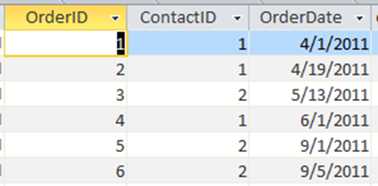
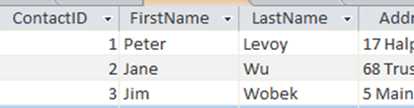
Table Joins
In this example, the ContactID in the Contact table and the ContactID in the Orders table represent the same thing so the records with the same corresponding value are related.
Contacts Table
Orders Table

Slide 4
Steps for Joining Tables
For every possible combination, take a row from the first table and a row from the second table
Remove all the rows that do not have equal values in the related columns
Merge the related columns into one column

Slide 5
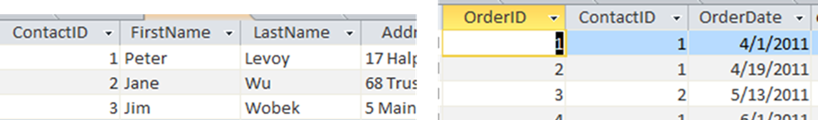
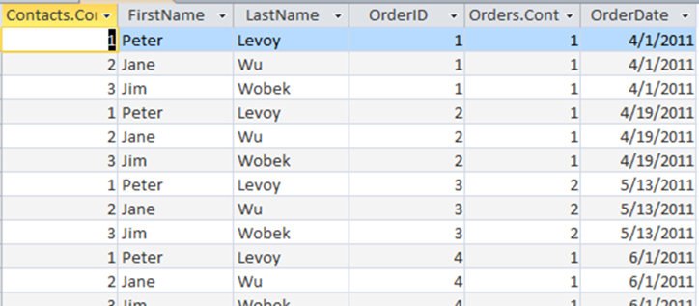
Step 1 – all combinations
Input Tables: Contacts and Order Tables
Output result – Contact values from the order and contacts table not necessarily the same

Slide 6
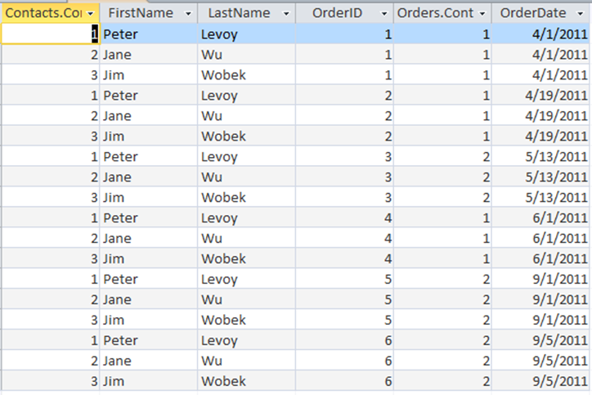
Step 2 – remove rows with unequal values in related columns

Slide 7
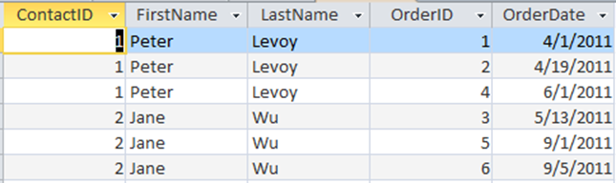
Step 3 – merge related columns

Slide 8
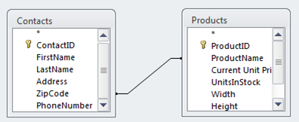
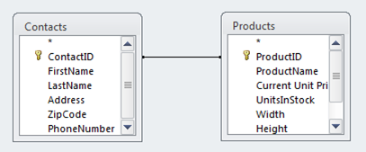
Bad Joins
No Output: Attributes are never equal.
Meaningless Output: Attributes are equal but there is no real relationship between the fields.

Slide 9
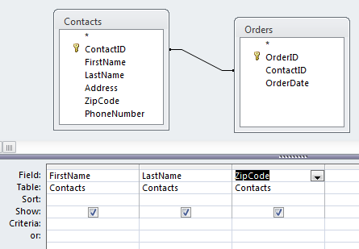
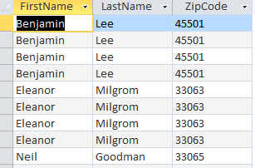
Example: Group By and Join
Find the first name, last name, and zip code of all contacts that placed an order.
Here’s the result without a Group By:
Note the duplicate rows

Slide 10
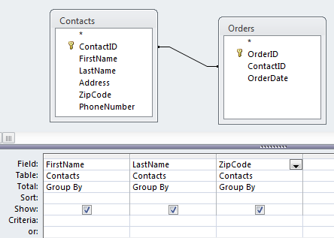
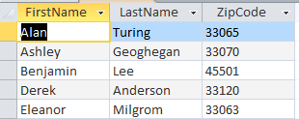
Example: Group By and Join
Find the first name, last name, and zip code of all contacts that placed an order.
Here’s the result with a Group By:
All rows with the same first name, last name, and zip code have been collapsed into a single “group”

Slide 11
Unrelated Tables
It is possible to join tables without relating columns in those tables.
Such a join is called a “Cartesian product.”
The Cartesian product contains all possible combinations of rows.
For new database users, the Cartesian product is almost always the wrong thing.

Slide 12
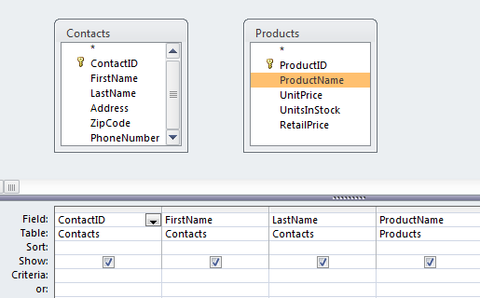
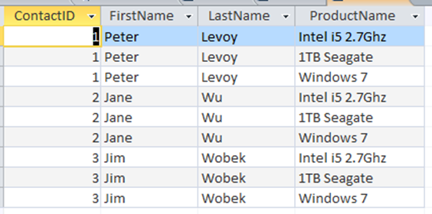
Who ordered which products?
No relationship lines so the tables are unrelated – wrong, misleading result set
Every contact is paired with every product.

Slide 13
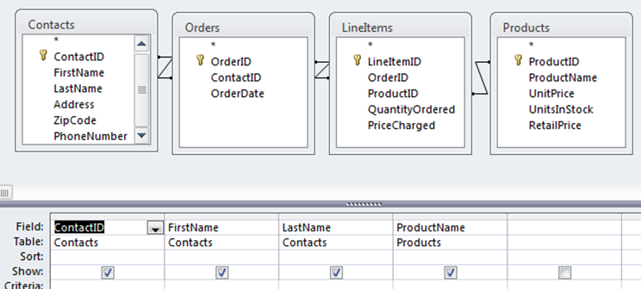
Who ordered which products?
Correct:
Need relationship lines between tables

Slide 14
Example
List the OrderDates where the Quantity of an item ordered was at least 2. Each date should only appear once in the result.

Slide 15
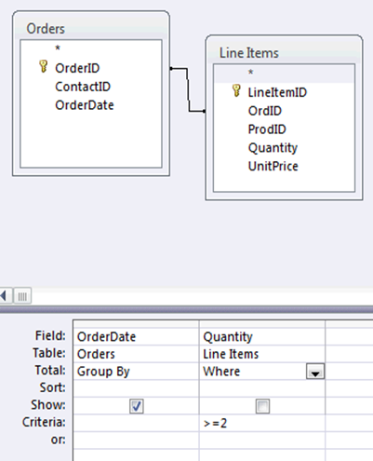
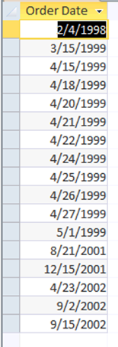
Correct: Use a WHERE Clause
Exercise: rewrite without WHERE using POSQ.
Can’t be shown, may be more than one quantity >=2 per date

Slide 16
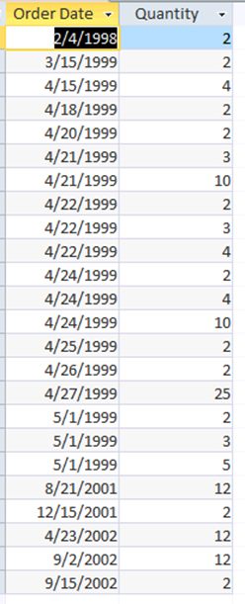
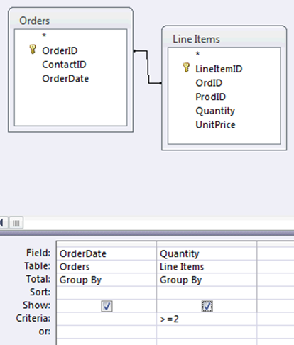
Incorrect: To use a GROUP BY instead of WHERE
Exercise: rewrite without WHERE POSQ.
Can be shown, some dates appear more than once with several quantities >=2

Slide 17
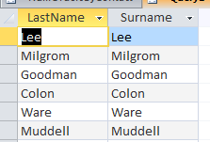
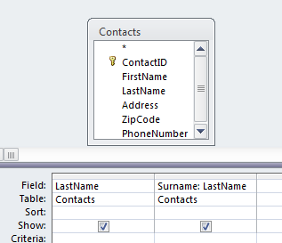
Renaming Attributes
In query design view, attributes can be renamed with a colon :
  newname: oldname

Slide 18
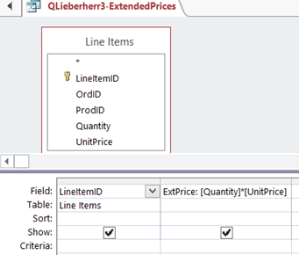

Calculated Fields
A query can also use calculated expressions.
Example:
  List the extended prices for each line item.
Note the user defined field name (ExtPrice) and the use of brackets for the field names, e.g., [Quantity].

Slide 19
Aggregate Functions
Aggregate functions work on multiple rows.
If used within a Group By, they work on the rows within each group.
If used on an entire table or query, they work on all of the rows in the table or query.

Slide 20
Aggregate Functions
Aggregate Function | Description
COUNT | Counts the rows in a table or a group if used in a Group By
SUM | Adds the values of the summed field in a table or a group if used in a Group By
AVG | Averages the values of the field in a table or a group if used in a Group By
MIN | Finds the minimum value of the field in a table or a group if used in a Group By
MAX | Finds the maximum value of the field in a table or a group if used in a Group By
STDEV | Finds the standard deviation of the field in a table or a group if used in a Group By

Slide 21
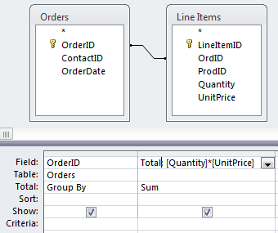
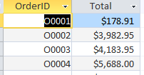
Example: SUM
Exercise: rewrite without mixing widening and aggregation using POSQ.
Find the total of each order, i.e., the sum of the extended prices for each line item within an order.
Note the user defined field name (Total) and the use of brackets for the field names, e.g., [Quantity]. The SUM applies to the values of the [Quantity]*[UnitPrice] within each group.

Slide 22
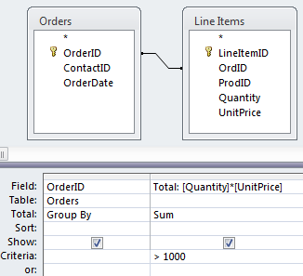
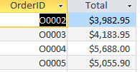
Example: SUM and Filter
Exercise: rewrite without mixing widening, aggregation and selection operations using POSQ.
Find all orders which have a total value of more than $1000.

Slide 23
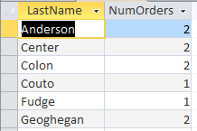
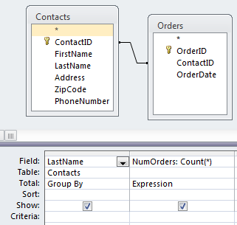
Counting Items in a Group
Exercise: Rewrite using the POSQ.
To count the rows that were collapsed into a group, use the COUNT(*) function.
The Group By collects identical rows into a group. Only the group is displayed, but COUNT counts the number of rows that are in each group. So the above query tells us how many orders each contact placed.

Slide 24
Expressions
Note the use of the “Expression” in the Total row for COUNT(*).
Expression is often required when an aggregate function is used.
Aggregate functions work on the items within a group of the Group By clause:
  COUNT – counts items in a group
  SUM – adds the items in a group (numbers only)
Beware when Access rewrites your query with an expression, this typically means there is an error in the query

Slide 25
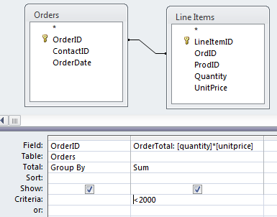
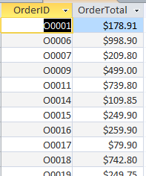
Query Example 1
Which orders have totals less than $2,000?

Slide 26
Solution for Query Example 1
Exercise: rewrite query without mixing widening, aggregation and selection in one query.
Which orders are for less than $2,000?

Slide 27
TRY FOR YOURSELF…

Slide 28
Question 1
How many orders were placed from each state?

Slide 29
Question 2
How often was each product ordered?

Slide 30
Question 3
Which contacts placed three or more orders?

Slide 31
Question 4
Which products have a total sales volume of more than $10,000, i.e., for which products did the total amount sold across all orders exceed $10,000?

