Slide 1
Queries
Topic 12
Lesson 2 – Retrieving Data with Queries

Slide 2
Queries
Data is retrieved through queries.
Queries are formulated in a specialized language called SQL (pronounced SEQUEL).
Microsoft Access makes it easy to create SQL queries through a simple drag-and-drop interface called the Query Builder.
Queries are eventually integrated into reports, forms, programs, or executed by themselves.

Slide 3
Queries on Tables
Queries retrieve data from one or more tables.
You can specify which
rows to include in the result through filters
columns to include in the results
The result of a query is a table that can be used in other queries (as subqueries).

Slide 4
Creating Queries in Access
To create a query:
Select the Create tab
Pick Query Design
Select the tables to include in the query or simply close the dialog and drag the needed tables into the query designer

Slide 5
Running a Query
To run a query, click on the Run icon:
To return to the query design, click on ‘View’ and Select “Design View” from the Menu:

Slide 6
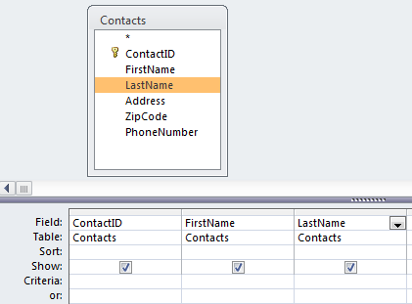
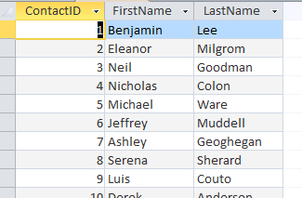
Example: Simple Query
Find the contact id, first name, and last name for each contact.
Query in Design View
Query in Datasheet View

Slide 7
Removing Duplicates
Query results often contain duplicate rows.
These are removed by “grouping rows” with the same value as a single row.
To do a Group By, follow these steps:
Select the function button in the ribbon
Select “Group By” for each field

Slide 8
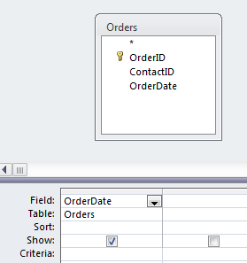
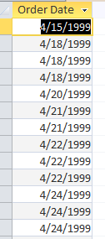
Example: Group By
Find the dates on which orders were placed.
Here’s the result without a Group By:
Note the duplicate rows - one row per order

Slide 9
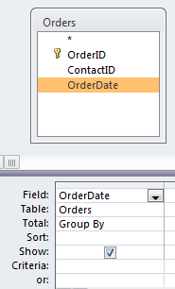
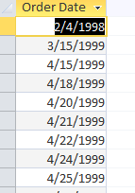
Example: Group By
Here’s the same query with a Group By:
Note that the duplicate rows have been “collapsed” into groups and only the group is displayed
One result set record per day as oppose to order

Slide 10
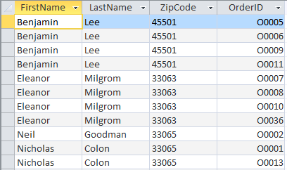
Removing Duplicates with “Group By”
Group By collapses all rows that contain the same data across all columns.
OrderIDs are not the same in this example so names will show up more than once even if using Group By.

Slide 11
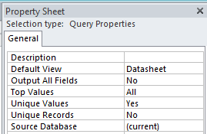
Removing Duplicates with “Unique Values”
Duplicates can be eliminated by specifying that the query should only return unique values.

Slide 12
Joining Tables
A “JOIN” is a query operation that allows you to select data from multiple tables
Rows are selected from the tables where the rows have a common value in the relationship fields.
To find contacts that actually placed an order¹, the ContactID column value must be the same in the Contacts and the Orders table.
This essentially finds all contacts who placed at least one order.
¹ There may be contacts in the Contacts table that are not linked to any order, i.e., they never placed an order.

Slide 13
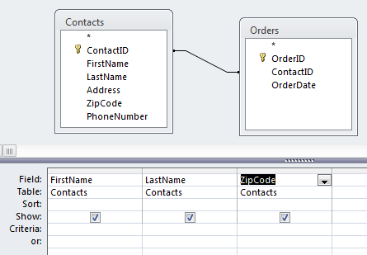
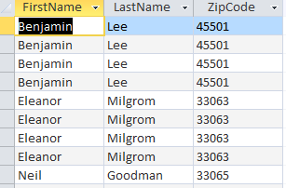
Example: Join
Find the first name, last name, and zip code of all contacts that placed an order.
JOIN occurs across ContactID (relationship line)
Here’s the result without a Group By:
Note the duplicate rows – one row for each order as oppose to contact

Slide 14
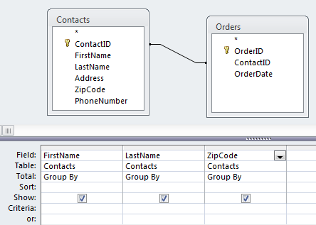
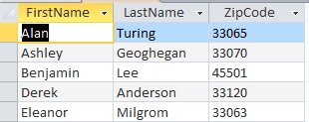
Example: Group By and Join
Find the first name, last name, and zip code of all contacts that placed an order.
Here’s the result with a Group By:
All rows with the same first name, last name, and zip code have been collapsed into a single “group”, one row per contact.

Slide 15
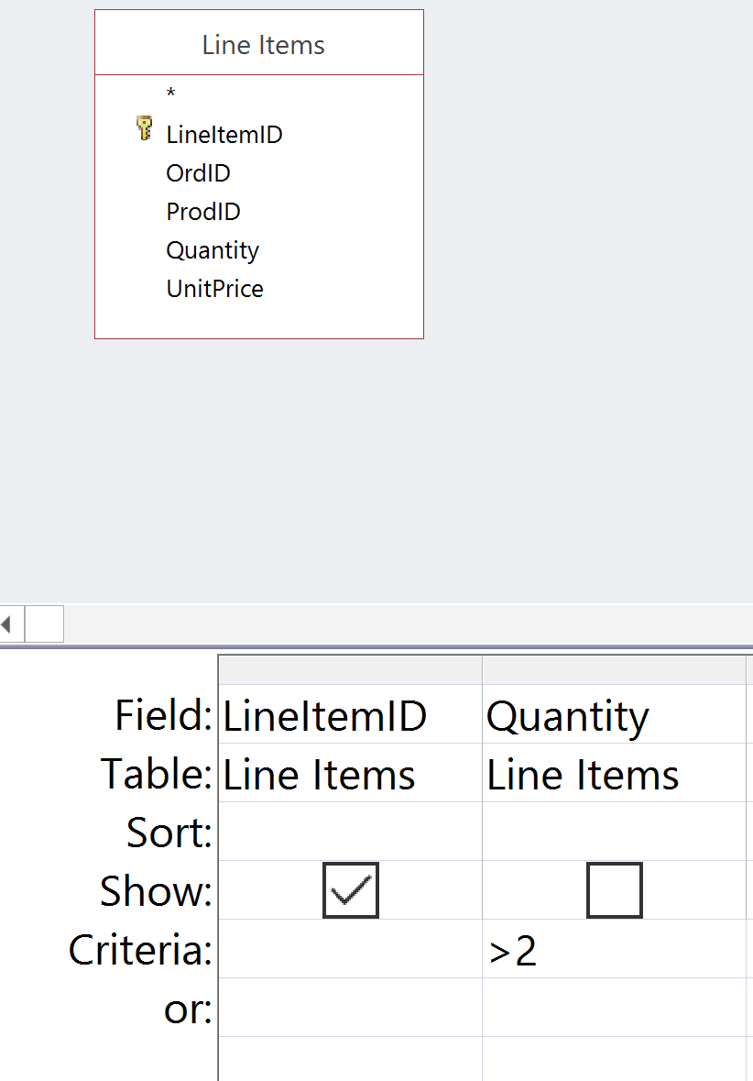
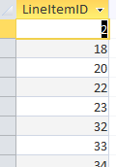
Filtering
Selecting rows that meet a certain criteria.
Lists all of the line items (ID only) that have a Quantity > 2.

Slide 16
Selection Criteria
Selection criteria are specified as an algebraic relationship, but queries are generally stated as a narrative, so we need to “translate”.
Narrative | Algebraic Term
At least X | >= X
No more than X | < X
More than X | > X
No less than X | >= X
Less than X | < X
Up to X | < X
At most X | <= X

Slide 17
Registrar Example Database
Relationships
Data
Queries
Student names, address, city, state, zip
Courses with 4 or more credits
Students in CS2500
Students in CS1100

Slide 18
Questions?

