Slide 1
Data and Databases
Topic 12
Lesson 1 – Data and databases

Slide 2
Data and Databases
Storing, accessing, searching, and viewing data are important in any business.
While spreadsheets work well for small amounts of data, databases are used for larger data collections.
Learning how to access data is an important skill when working with databases.
We will learn how to formulate queries in the Microsoft Access database system.

Slide 3
Reasons to Move to a Database
Too much data in an individual file
  Difficult to manage data
Have multiple uses for the data
  Need multiple “views” of the data
Need to share the data
  Numerous people are entering, deleting, viewing data
Need to control the data
  Control data values and consistency

Slide 4
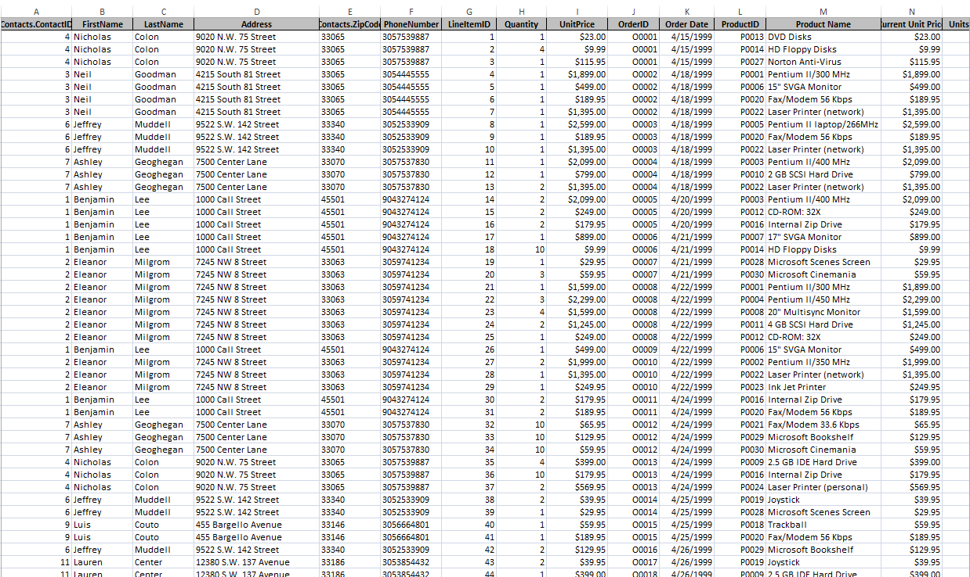
This data belongs in a database…

Slide 5
Value of Knowledge
What we learn here is applicable to many other database that are used by businesses:
  Oracle
  Sybase
  Microsoft SQL Server
  JavaDB
  MySQL
  …
We will also learn how to logically decompose data problems.

Slide 6
About Microsoft Access
Not available with MacOS – you should be running Windows in a Virtual Box
You can use RemoteApps (remotely login to a virtual Northeastern session). (Use myneu to have access to RemoteApps )
DOWNLOAD AND SAVE!
  You must download and save Access files BEFORE starting to work on them or you will lose your work
.laccdb files: file locking is controlled by a locking file with the file name extension .laccdb.
  Do not submit this file! Close your file first and the .laccdb file goes away.

Slide 7
Relational Databases
Microsoft Access is a relational database which means that it stores data in tables
  Each table stores information about a single subject
Each table contains rows; one row for each record, i.e., a contact, order, product, etc.
Each column (or field) contains different kinds of information about the subject
Each row in a table has a unique identifier (or primary key), e.g., OrderID, ProductID, ContactID, etc.

Slide 8
Relational Databases
Each table in the database contains information related to a single subject and only that subject.
You can manipulate data about two classes of information (such as customers and orders) based on related data values
Example: it would be redundant to store all customer information with every order.
In a relational DB, the table for orders contains one field that stores data such as a customer ID
  This duplicated field connects (or relates) each order with the appropriate customer information.
  The duplicated field is known as a foreign key
  It allows a user to determine which customer placed each order

Slide 9
Relational Databases
Microsoft Access is a relational database which means that it stores data in tables (a 2 dimensional structure, row by column).
Tables contains records; one row for each record, e.g., a contact, an order placed, a product, etc.
Tables have attributes; one column for each attribute, each record has a place to store a value for each attribute, e.g., a product’s name, the price of a product, a product’s dimensions…
Each row in a table has a unique identifier attribute called a primary key, e.g., OrderID, ProductID, ContactID, etc.

Slide 10
LAYOUT OF THE ORDERS DATABASE
Microsoft Access Tutorial: Data, Databases, and Queries

Slide 11
The Orders Database
We will be using a database that contains data for orders placed by customers for our examples.
This database stores the following information:
  For each order, we know what was ordered, how many of that item was ordered, and at what price.
  For each order, we know who placed that order.
  For each customer (called a contact), we store where he/she lives.
  For each product, we track its description and price.

Slide 12
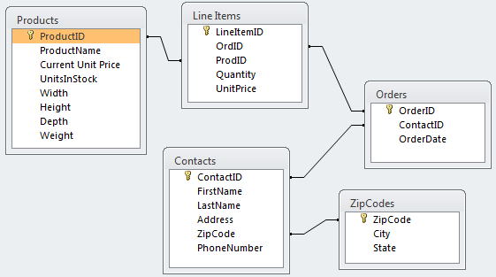
The Database Layout
These are all of the tables in the database:

Slide 13
The Database Layout
For each order item we know what was ordered, how many of that item were ordered, and at what price.
For each product, we know its description and price.
For each order, we know who placed that order and when the order was placed
For each customer (called a contact), we know where he/she lives.

Slide 14
A Sample Order
Order | O0001
Customer Contact
Contact ID: | C0004
Name: | Colon, Nicholas
Address: | 9020 N.W. 75 Street
 | Coral Springs, FL 33065
Order Date: | 4/15/1999
Product ID | Product Name | Quantity | UnitPrice | ExtendedPrice
P0013 | DVD Disks | 1 | $ 23.00 | $ 23.00
P0014 | HD Floppy Disks | 4 | $ 9.99 | $ 39.96
P0027 | Norton Anti-Virus | 1 | $ 115.95 | $ 115.95
 |  | Order Total: |  | $ 178.91

Slide 15
Where Does The Data Come From?
Order | O0001
Customer Contact
Contact ID: | C0004
Name: | Colon, Nicholas
Address: | 9020 N.W. 75 Street
 | Coral Springs, FL 33065
Order Date: | 4/15/1999
Product ID | Product Name | Quantity | UnitPrice | ExtendedPrice
P0013 | DVD Disks | 1 | $ 23.00 | $ 23.00
P0014 | HD Floppy Disks | 4 | $ 9.99 | $ 39.96
P0027 | Norton Anti-Virus | 1 | $ 115.95 | $ 115.95
 |  | Order Total: |  | $ 178.91
Orders.OrderID
Contacts
ZipCodes
ExtendedPrice =
Quantity * UnitPrice
Orders.OrderDate
LineItems
Total Order Amount

Slide 16
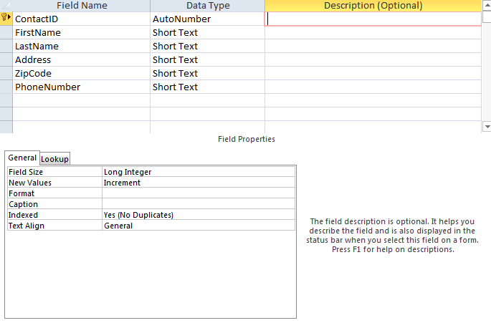
A closer look at the Contacts table
The Design view
  Design your table in this view:

Slide 17
Field Data Types
Short Text – alphanumeric data up to 255 characters
Long Text– alphanumeric data up to 1 gigabyte
Number – numeric data
Date/Time – dates and times
Currency – monetary data
AutoNumber – unique value generated by Access for each new record (not editable)

Slide 18
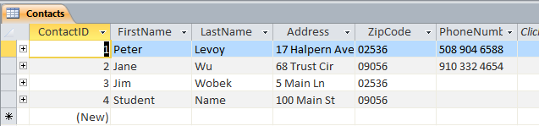
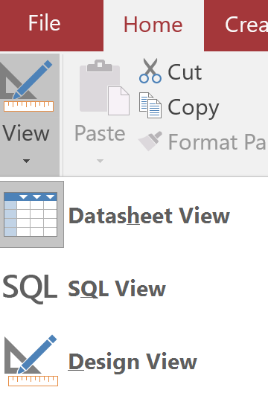
A closer look at the Contacts table
The Datasheet view
  Enter new data in this view by typing data into the cells
Can be accessed from the View icon

Slide 19
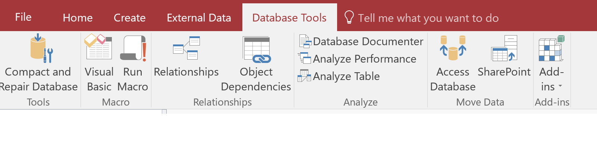
Relationships: Fundamental to a Relational database
A relational database separates the data into a collection of related tables
    The relationships pull the data together in a meaningful and useful way
A user manages (creates, review, updates, deletes) the relationships between the Tables by using the ‘Relationships’ icon found on the ‘Database Tools’ tab.

Slide 20

Relationships in Access
Each line represents a relationship between two tables
Typically, the fields in the two tables have the same name, but this is not a requirement (see ProductID and ProdID)
We can have a 1 to 1 relationship, a many to many relationship or the more common 1 to many relationship Example: 1 ContactID in the Contact table is related (has placed) many Orders in the Orders table.

