Slide 1
Automation
Lesson 1 - Automating Tasks

Slide 2
What is a Macro?
Automate a repetitive task with a single click
⇒ Use macro recorder
Programming language used to build macros is called VBA
VBA = Visual Basic Application
Macros can be recorded with a click of a button
Macro recorder writes the code for the steps followed in Excel

Slide 3
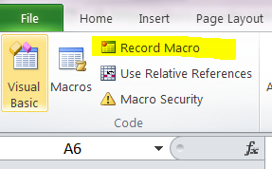
Developer Tab
You must show the Developer tab in the ribbon
Click on File tab→ options→ customize ribbons→ check box for Developer tab
The record macro button is in the “Code” group in the “Developer” tab
Click on “record macro” button in the Developer ribbon to start recording
Make sure you turn off the macro recorder when you are done

Slide 4
Absolute vs. Relative Reference
Absolute macros: record absolute movement of the selected cell (uses range function)
Relative macros: record relative movement of the selected cell (uses offset function)
When the “Use Relative References” button is highlighted, the macro is recording relative cell references in the macro, otherwise it records absolute references

Slide 5
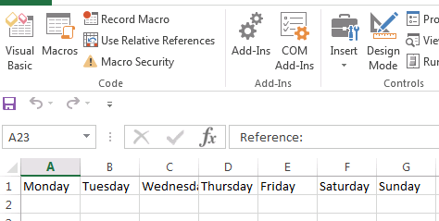
Work with Macros - Example 1
Click Record Macro
Name your macro: FillDaysAbsolute
Type Monday in cell A1 → copy to cell G1 → Fill series
Stop recording
Now clear your cells
Click on “Macros” icon
Select the name of the macro
you just created
Click run

Slide 6
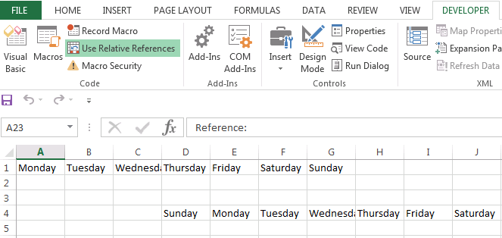
Work with Macros - Example 2
Click on Use Relative References, then Record Macro
Name your macro: FillDaysRelative
Type Monday in cell A1 → copy to cell G1 → Fill series
Stop recording
Now clear your cells
Click on “Macros”
Select the name of the
macro you just created
click run
What is the difference
between the two macros
we just created?

Slide 7
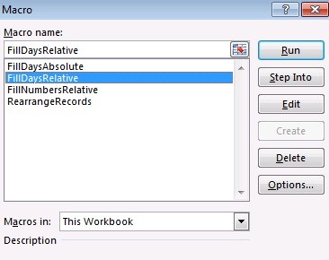
Edit a Macro
Click on Macros in the Developer tab
Select FillDaysRelative that we just created
Click edit
What you will see is the code generated by Excel for the existing macros

Slide 8
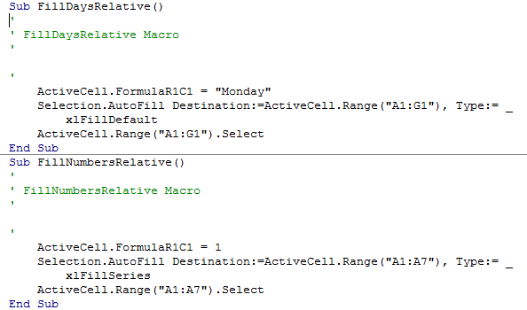
Edit a macro cont’
This is the VBA code for the macro FillDaysRelative we just created
Copy it, paste it, then make small modifications to have another macro called FillNumberRelative that inserts number series

Slide 9
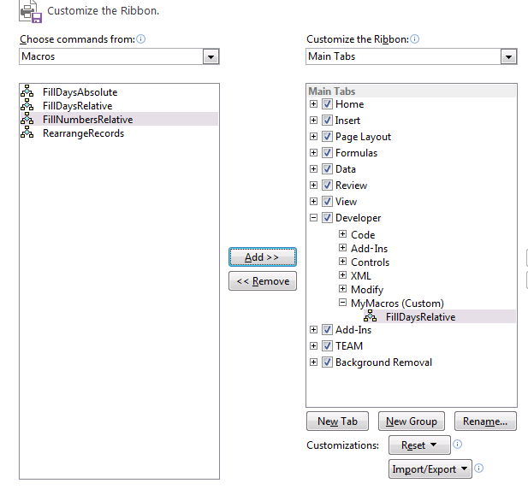
Assign a Button
Under File/Option/Customize Ribbon
Click on New Group
Enter a name (ex: MyMacros)
Click on the drop down “choose command from”
Click on Macros
Choose one of the macros listed
Then click add
Click Ok

Slide 10
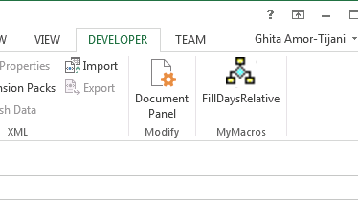
Assign a Button cont’
Check the Developer tab
There it is… you just added an icon for a macro you created!!

Slide 11
More Examples: Transpose Columns
Consider a data set where records are listed vertically
→ Need to list them horizontally
→ Need to transpose columns
→ What if we had a lot of records

Slide 12
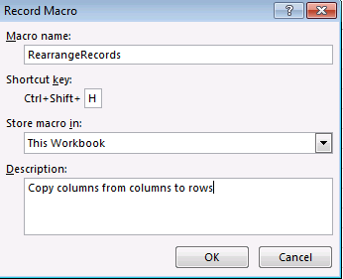
Transpose Columns: Steps
Click on the first cell in the first record
Click on “use relative references”
Click record button
Name the macro: “rearrangeRecords”
Assign a shortcut key to the macro, click ok.

Slide 13
Transpose Columns: Steps cont’
Click on the cell with the first value: A3
CTRL-Shift-Down to select the field values of the first record
CTRL-C to copy the cells
Move up by one row: A2
Right click → Paste Special... → Transpose
Data is copied horizontally now!!
Delete that range of data delete up
Go to beginning of next record
Stop recording
Use the shortcut key to transpose the rest of the records

Slide 14
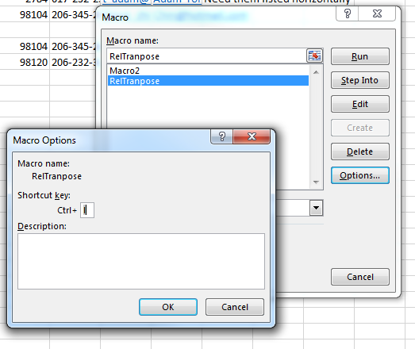
Delete a Macro Shortcut Key
Select the Macro Icon from the Developer tab
Select the Name of Macro you want to change
Select the Options Button
Remove the key value stored in Shortcut key

Slide 15
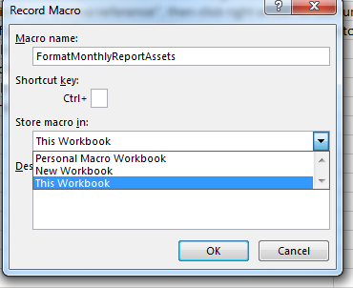
Storing a Macro
When you create a Macro you choose where it is stored
Default is to store the macro in the current workbook
Personal Macro Workbook allows all workbooks to have access to the macro

Slide 16
Access to your Macros
Macros are defined within a particular workbook
However, if the defined workbook is opened you can run a macro from any of your other opened workbooks
So macro definitions are not limited to the workbook they are defined in

Slide 17
Questions?

